Slide 1
Audit of Completeness and Appropriateness of Radiology Request and Adequacy of Clinical Information on Radiology Request
Dr. Hussain Abdulla Ali Prianna Menezes
Alekya Devi Anala Zarish Hussain
Maryam Farhan Juma Dr. Bedoor Al Omran

Slide 2
PURPOSE
Radiology request forms are one of the essential communication tools used in referring patients for radiological investigations.
The objectives of this audit were to:
Assess the level of completion and legibility of information captured in electronic-based medical imaging forms and to determine whether the clinical history provided aided in the final impression/diagnosis.
Evaluate whether the correct radiological examination/procedure is prescribed.
Appraise the justification of the radiological examinations.

Slide 3
Methods
A retrospective cohort study of the radiological requests was conducted at the Royal Medical Services-Bahrain Defence Force Hospital between 12-March-2023 and 25-March-2023.
The electronic radiological request for the general X-rays and CT scans were manually assessed for the following criteria:
Essential clinical information
Relevant clinical information
The collected data were analyzed using SPSS and Microsoft Office. A check mark was placed for data that was missing among the requested forms.

Slide 4
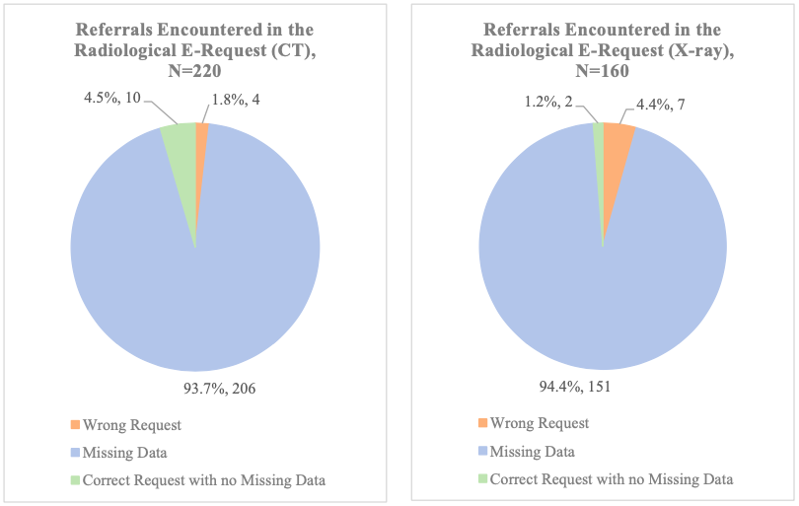
Results
Three hundred eighty (380) referrals to the radiology department through e-request were analyzed.

Slide 5
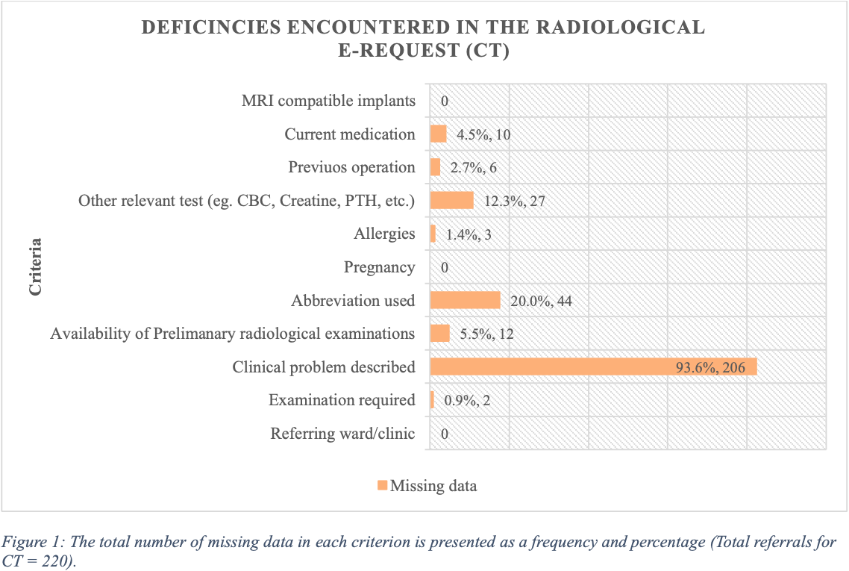
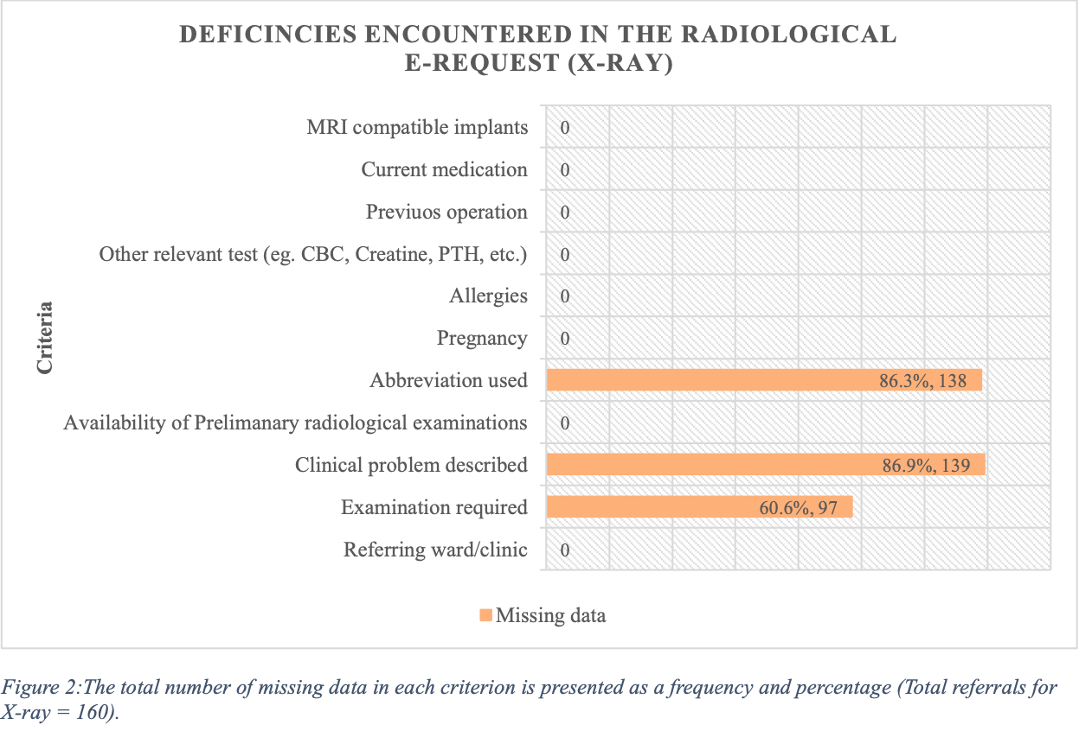
Results

Slide 6
Discussion
According to Bahrain Defence Force Hospital standards, the referrer must provide enough medical information regarding the desired medical exposure so that the radiation practitioner can determine whether the exposure is appropriate.
The highest missing data criteria in both the CT and X-ray requests was the "clinical problem described" which is essential in assisting the patients with writing more accurate reports and guiding them for further investigations for the diagnosis and treatment.
Missing clinical information leads to a cumulative effect of various problems, such as increasing the stochastic effect of radiation in patients by repeating the imaging when the request is incorrect, decreasing the imaging machine life, extra costs for patients and the hospital, delay in diagnosing/treating the patient, miscommunication between the referring physician, technologist, and radiologist. These issues can be easily avoidable if the referring physician fills out the radiology request form adequately.

Slide 7
Conclusion
It is essential to properly fill radiologist requests form as it is important for radiologist to make the correct radiological diagnosis.
In our study, there is a significant amount of missing data for both the X-ray and CT scan radiology request forms.
Incomplete radiological requests increase costs, workload, and radiation exposure to patients and staff.
Therefore, cutting down on radiological requests will not only spare patients from needless exposure, but it can also significantly reduce operating expenses and workload for the department.

