Slide 1

Toward Patient-Centric Medical Imaging Systems
By: Nawaf Alharbi
13.10.2023

Slide 2


Outlines
Medical Imaging, Then
  Objective
  Challenges
Medical Imaging, Today
  Objective
  Challenges
Medical Imaging, Moving Forward
  Direction
  Opportunities & Challenges
Conclusion
Reference
Discussion & Questions

Slide 3
Medical Imaging System, Then…

Slide 4
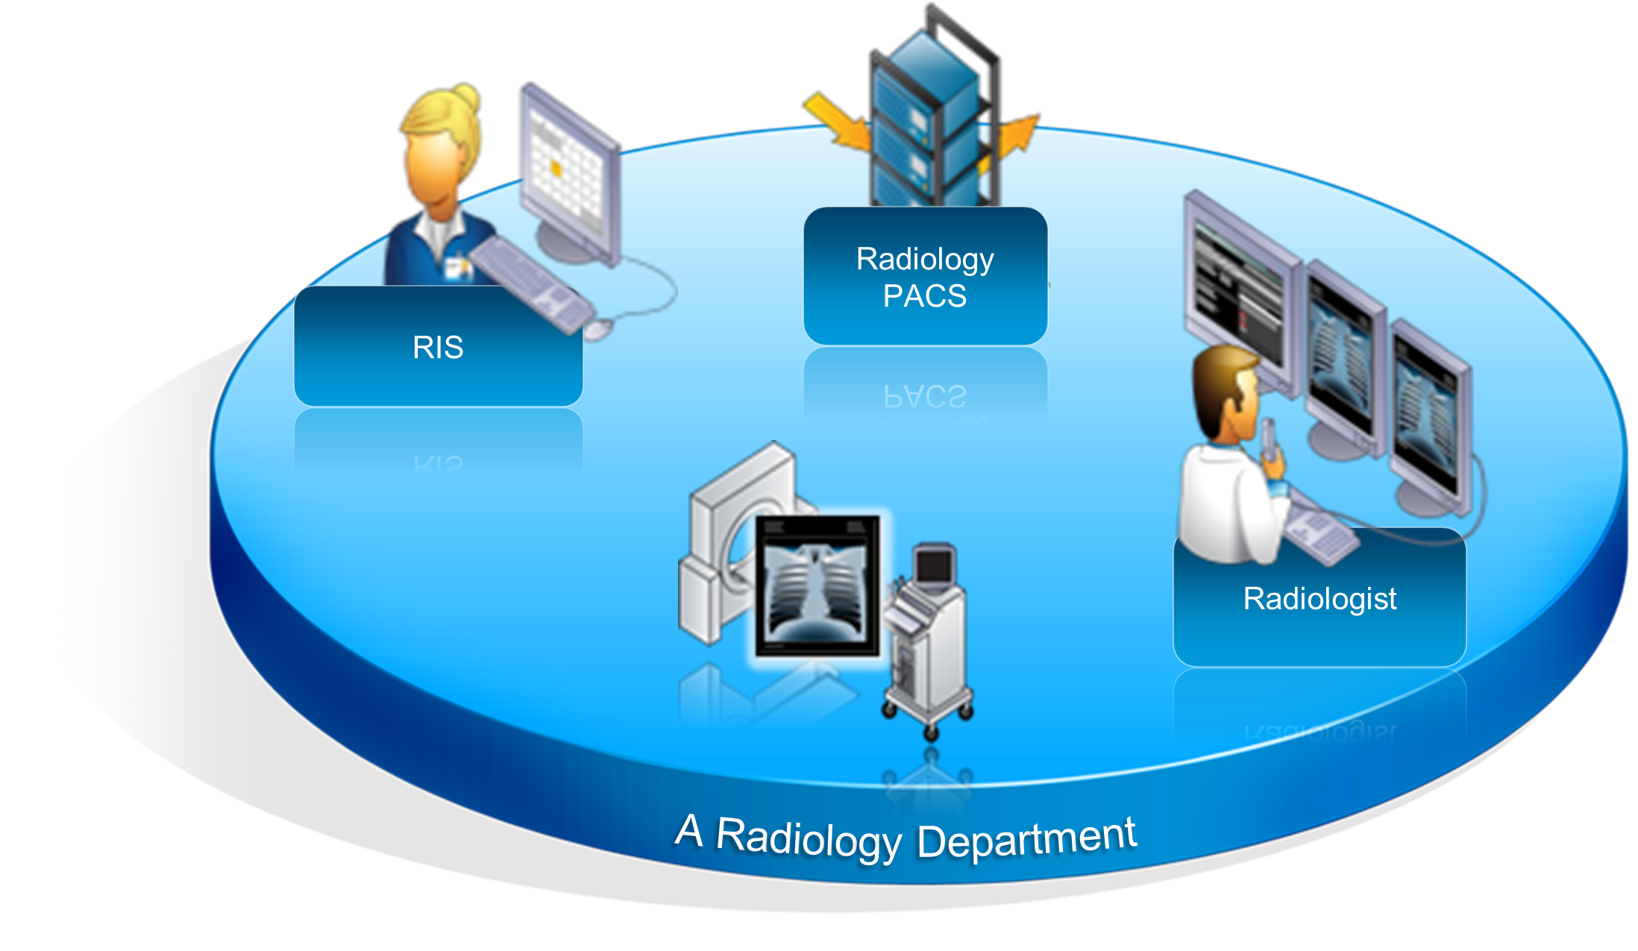
Medical Imaging System, Then…
Main Objective
  Conversion from paper to digital image, thus:
    Archive and display of Images
    Diagnoses of Images
    Communication
      Health Information System (HIS)
      Radiology Information System (RIS)
    Enhancing radiological workflow
    Facilitating image processing

Slide 5
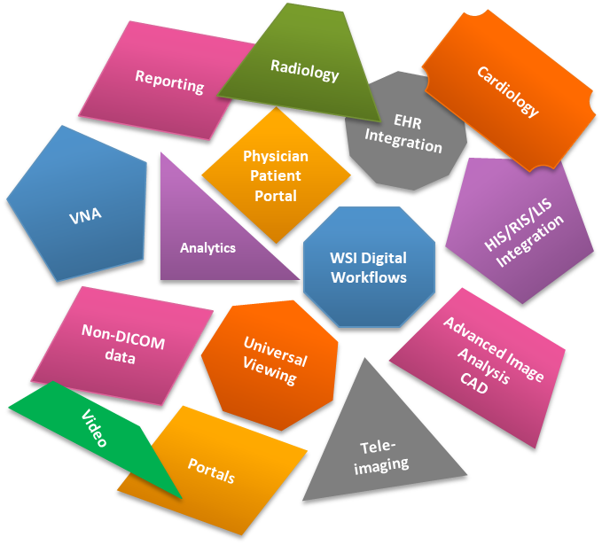
Then, Challenges…
Challenges
  Silos of Medial Imaging System
  Limited Communication:
    Between systems
    Across departments
  Technological Challenges:
    Management
      Storge, Updates, Securities
    Limited Access
    Backup and Recovery
Notes:
Greyling, A. G., & Pitcher, R. D. (2018a). Who pacs a punch? the role of the picture archiving and Communication System/Radiology Information System (PACS/RIS) in quantifying experiential learning in radiology residency. Journal of Digital Imaging, 31(6), 792–798. https://doi.org/10.1007/s10278-018-0106-7

Slide 6
Medical Imaging System, Now…

Slide 7
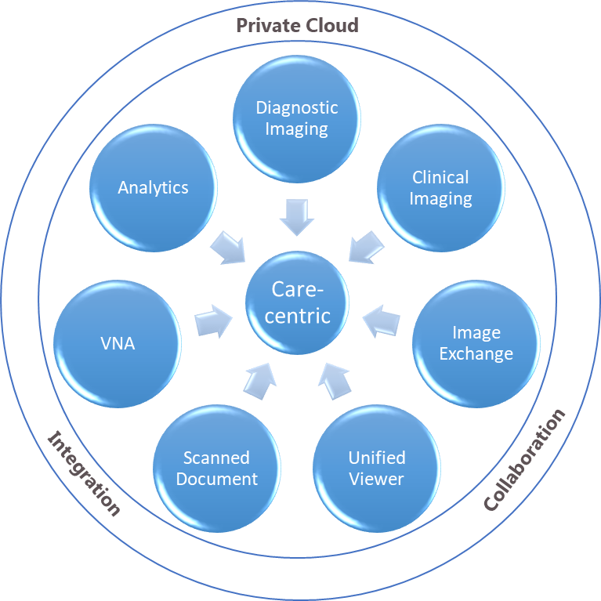
Medical Imaging System, Now…
Main Objective
  Spanning across
    Multi-department’s
    Multi-facilities
  Best of Breed Vendor
Outcome
  Workflow optimization
  Increased efficiency
  Increased productivity
  Time-saving
  Cross-facility collaboration
  AI Detection, Prediction & Prioritization

Slide 8
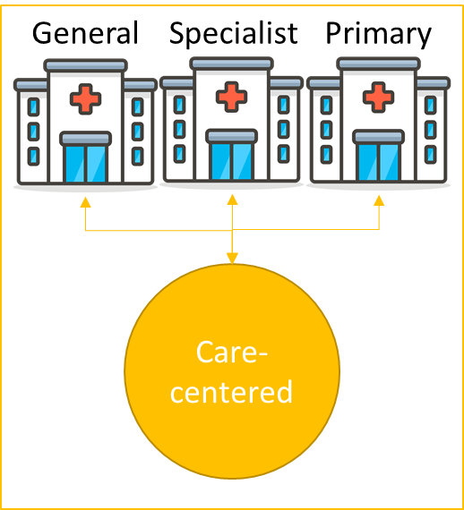
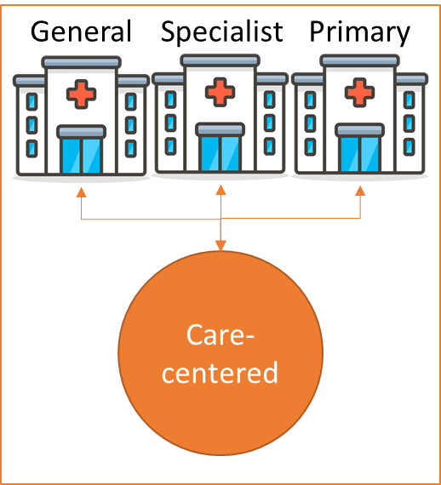
Now, Challenges…
Technological
  Compute & Storage resources
  System compatibility & communication
Clinical
  Accessibility
    Local vs. remote
    Cross-Facilities (out-of-group)
  Functionalities
    Reporting
    Use case-based AI
Management
  Analytics & Productivity
Economic
  Budgeting & Financing
External
  Regulatory
  Patient Expectation
Silos of Health Groups
Public Health Group
Private Health Group

Slide 9
Medical Imaging System, Moving Forward…

Slide 10
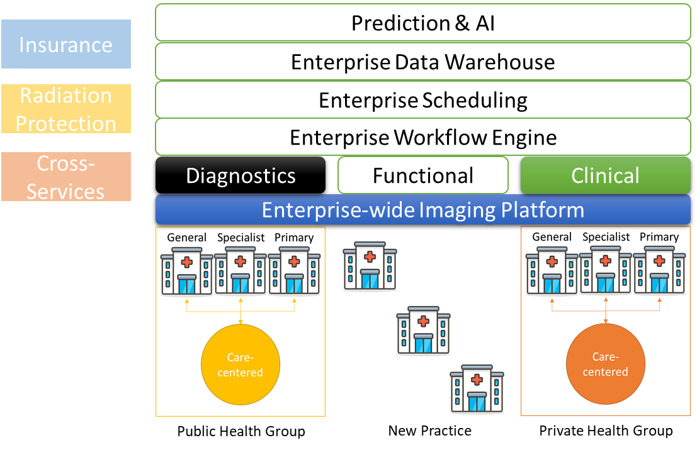

Medical Imaging System, Moving Forward…
Prediction & AI
Objective
  National
    Medical Imaging Archive
    Unified Patient Access
    Artificial Intelligence
    Analytics
    Radiation Protection & Control
  Clinical
    Shared Services
    Shared Reading
    Shared Workflow
    Workflow Orchestration
  Technological
    Consolidation
Patient-centric Medical Imaging System
Insurance
Enterprise Data Warehouse
Radiation Protection
Enterprise Scheduling
Enterprise Workflow Engine
Cross-Services
Diagnostics
Functional
Clinical
Enterprise-wide Imaging Platform
Public Health Group
New Practice
Private Health Group

Slide 11
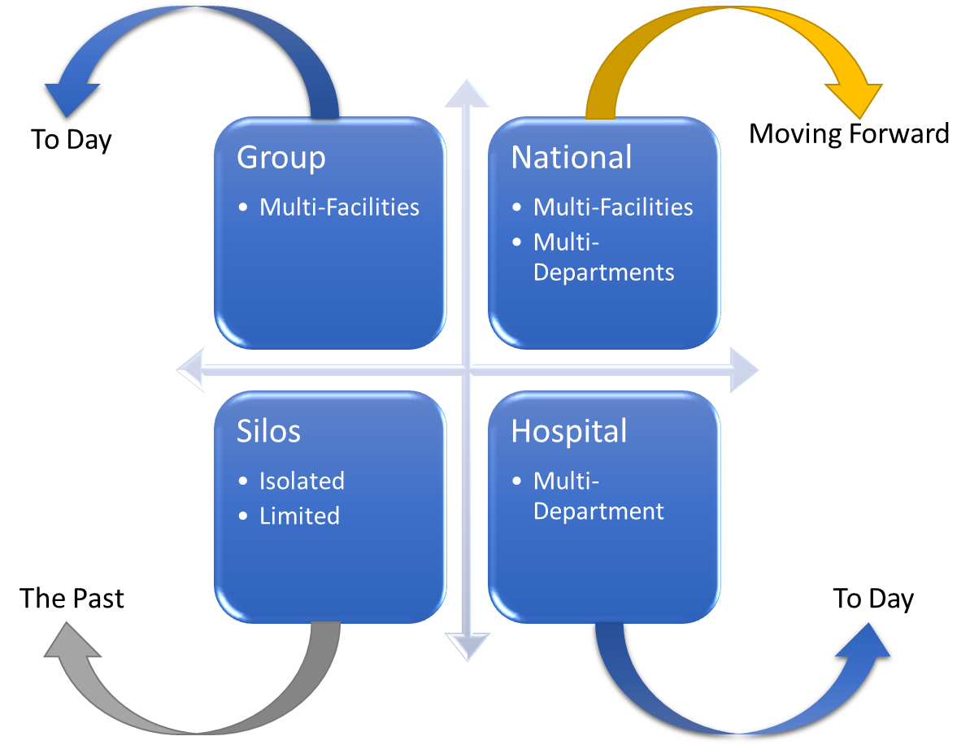
Moving Forward, Direction…

Slide 12



Moving Forward Directions, Rebuild…
Technological
  Infrastructure
  Platform
  Connectivity
Clinical
  Workflow
  Reporting
  Application
Functional
  Master Patient ID
  Repository and Registry

Slide 13
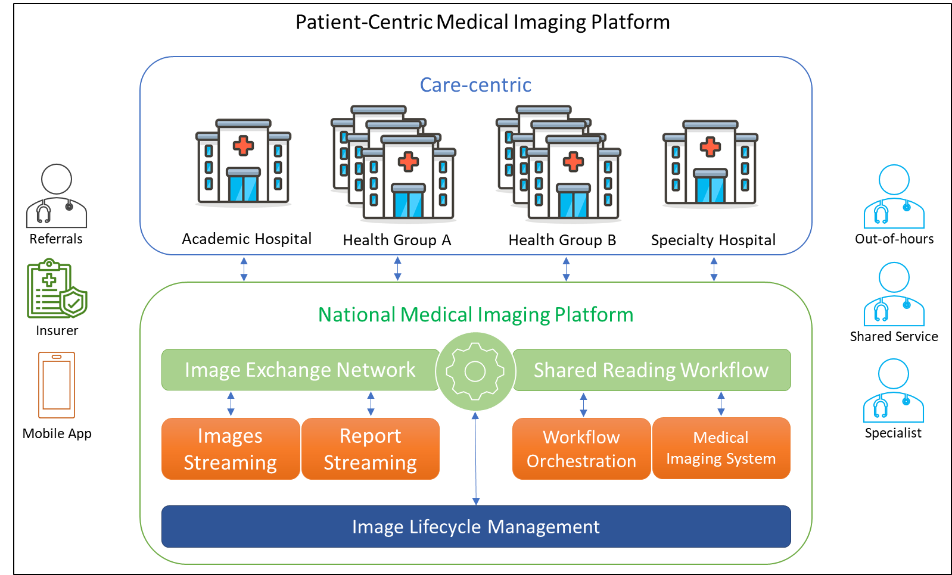
Moving Forward Directions, Capitalize…
Technological
  Exchange Network
  Platform
  Connectivity
Clinical
  Shared Services
  Workflow Orchestration
  Image Lifecycle Management
Regulatory
  Master Patient ID
  Pre-Fixing
Consumer
  Insurance
  Patient

Slide 14
Opportunity & Challenges…

Slide 15
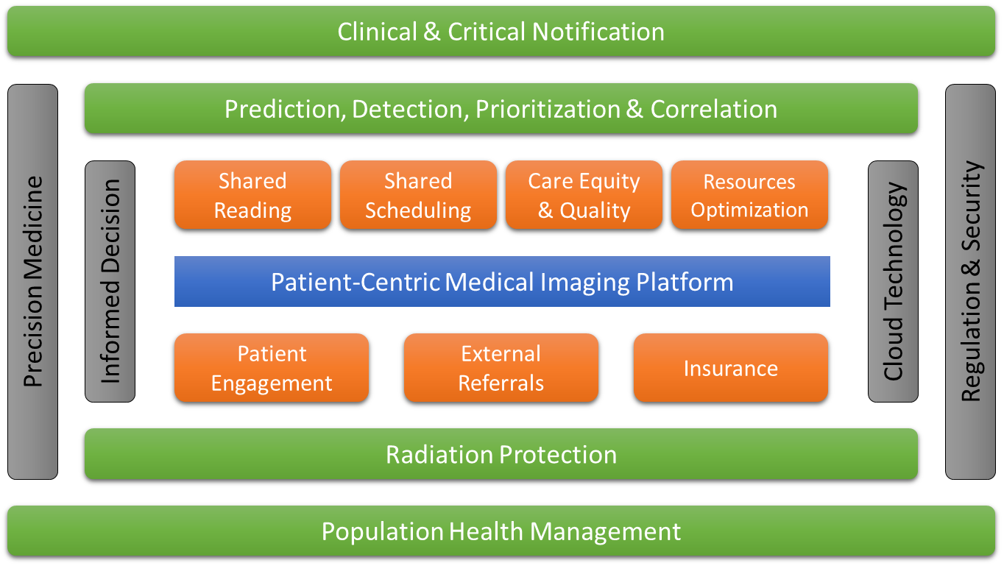
Moving Forward, Opportunity…

Slide 16
Moving Forward, Challenges…
Direction
Interoperability
Cybersecurity
Infrastructure Reediness
Expenditure
Emerging Technologies
Image retention
Ownership

Slide 17
Conclusion…

Slide 18
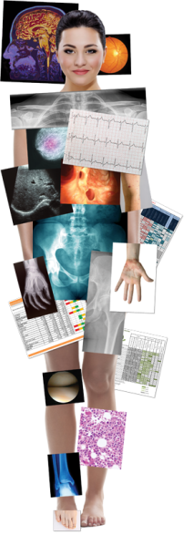
Maximize
Minimize
Nation image access
Turnaround time
Nation data exchange
Standardization
Resources utilization
Hospitality
Exams retake
Education
Integration complexity
Duplication
AI Applications
Radiation Exposure

Slide 19
References…

Slide 21
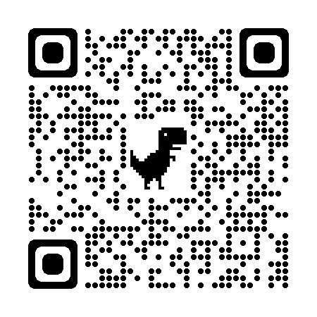
Discussion & Questions…
Nawaf Alharbi, MBA | Agfa HealthCare
Regional Imaging Informatics | Strategy Oriented | Digital Transformation Influencer | Authentic Leadership | Deep Learning and Artificial Intelligence | Business Development | Sustainability

Slide 22


