Slide 2
Pediatric Neuroradiology
& Head and Neck Imaging
Quiz
Korgün Koral, MD, MBA

Slide 3
1

Slide 4
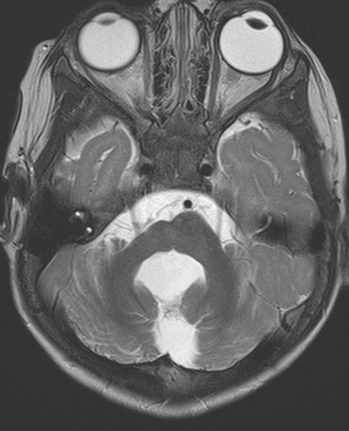
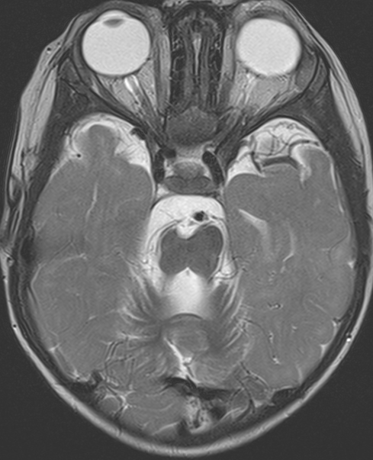
15 m, M
Notes:
5142190; 15 m, M

Slide 5
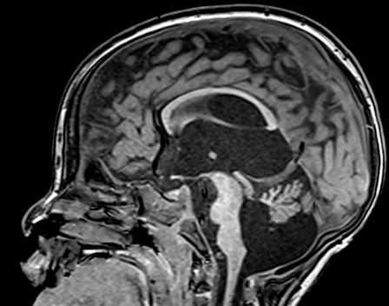
15 m, M

Slide 6
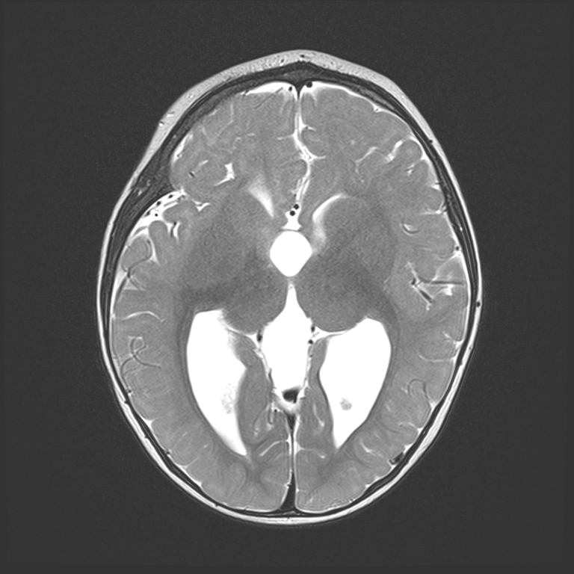
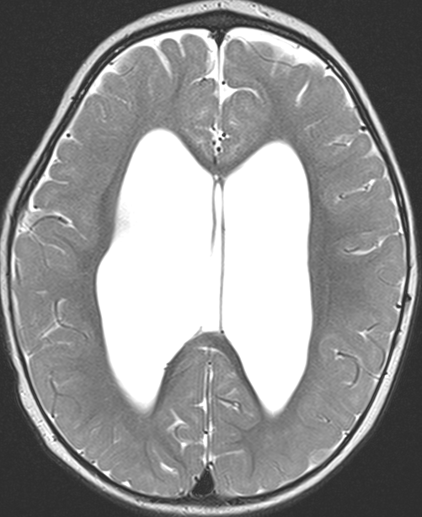
15 m, M

Slide 7
Tubulinopathy

Slide 8
2

Slide 9
Septo-optic Displasia
3 m, F
Notes:
1528071, 3 month old female, septo-optic dysplasia

Slide 10
3

Slide 11
Bacterial
Meningitis
4 w

Slide 12
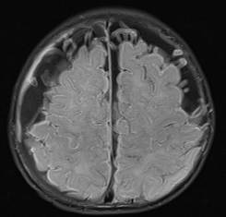
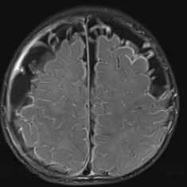
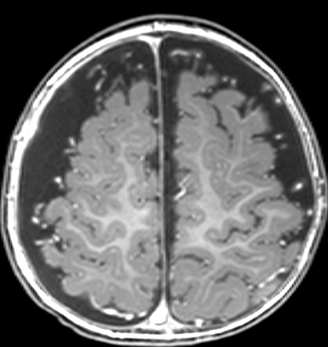
FLAIR
FLAIR+
T1+
6 m, M
S. Pneumoniae meningitis
Notes:
5218574, 6 m, M; Meningitis due to Streptococcus pneumoniae

Slide 13
FLAIR+
DWI
6 m, M
S. Pneumoniae meningitis
Notes:
5218574, 6 m, M; Meningitis due to Streptococcus pneumoniae

Slide 14
4

Slide 15
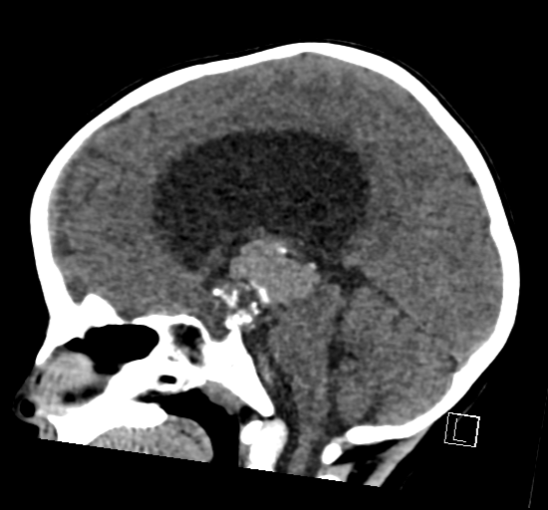
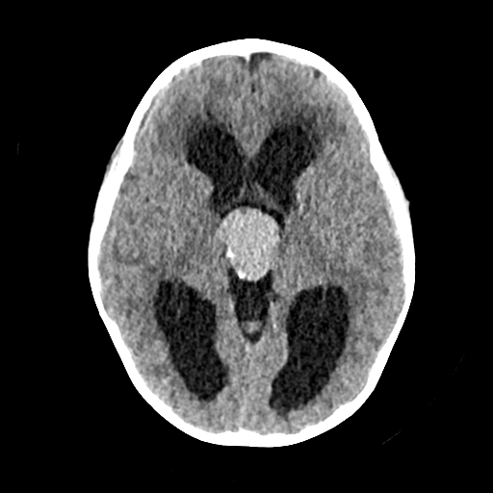
3 y, F
Notes:
4537854, 3 y, F

Slide 16
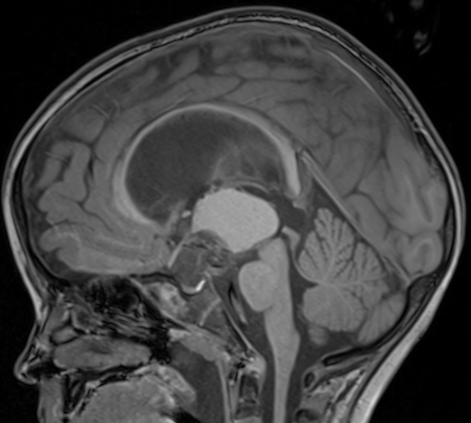
3 y, F

Slide 17
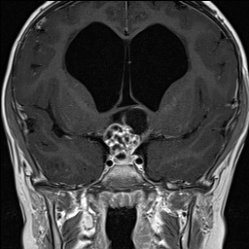
3 y, F
Craniopharyngioma

Slide 18
5

Slide 19
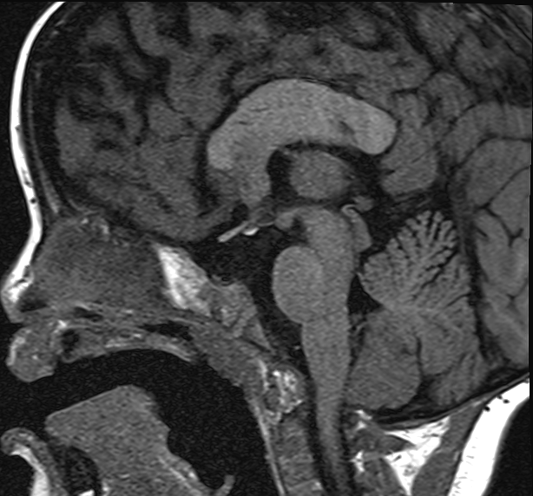
2 y, F
Ectopic Neurohypophysis
Notes:
4732306, 2 y, F

Slide 20
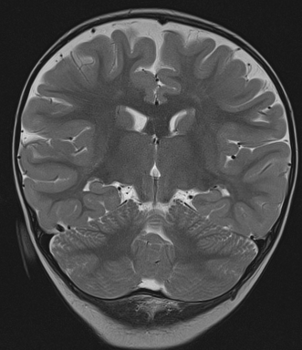
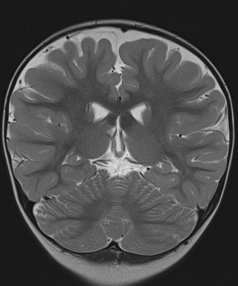
Ectopic Neurohypophysis & Thickened Forniceal Crura
Notes:
4732306, 2 y, F

Slide 21
6

Slide 22
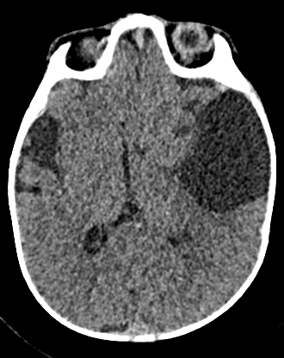
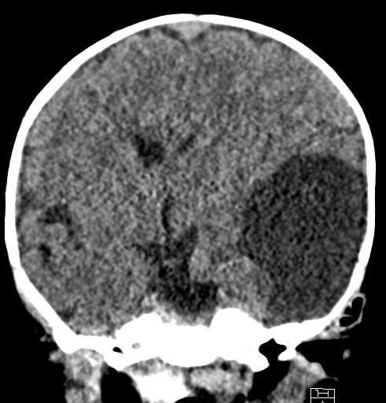
4 m, M
Notes:
4235209, DIG, 4 m, M

Slide 23
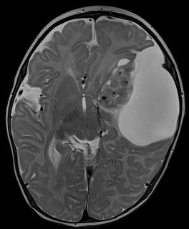
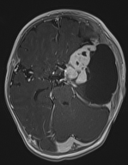
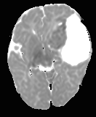
DIG (Desmoplastic Infantile Ganglioglioma)
4 m, M

Slide 24
7

Slide 25
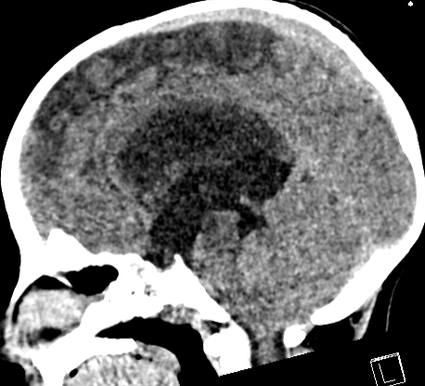
4 y, M
Notes:
3674292, 4 y, M

Slide 26
4 y, M

Slide 27
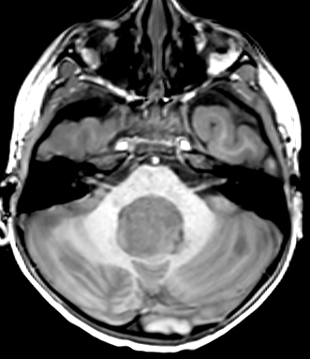
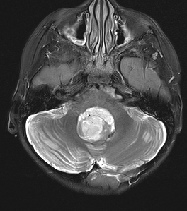
4 y, M
Medulloblastoma (non-Wnt, non-SHH)

Slide 28
8

Slide 29
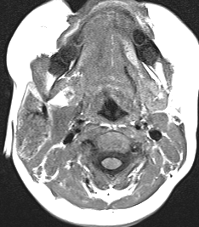
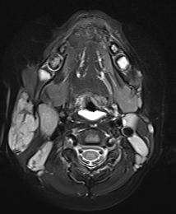
14 m, M
Notes:
5311529, 14 M, F

Slide 30
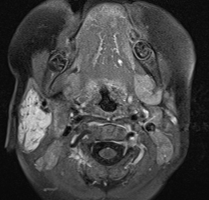
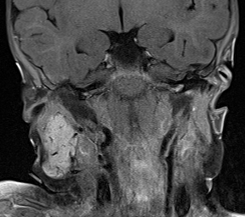
Infantile Hemangioma

Slide 31
9

Slide 32
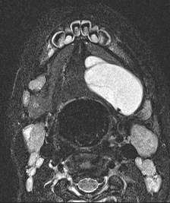
2 y, M
Notes:
4676092, 2 y, M

Slide 33
2 y, M
Ranula (Plunging)
Notes:
4676092, 2 y, M

Slide 34
10

Slide 35
16 m, M
Notes:
5196794, 11 m, F

Slide 36
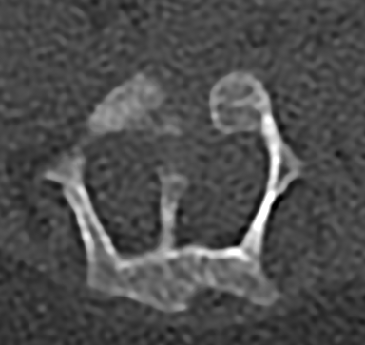
Diastematomyelia

