Slide 1



Slide 2


Pediatric Neuroradiology and
Head-Neck Imaging
Korgün Koral, MD, MBA

Slide 3
Congenital Brain Malformations
Macrocephaly & Hydrocephalus
Sellar & Suprasellar Region
Supratentorial Tumors
Infratentorial Tumors
Head & Neck
Congenital Spinal Malformations

Slide 4
Congenital Brain Malformations
Macrocephaly & Hydrocephalus
Sellar & Suprasellar Region
Supratentorial Tumors
Infratentorial Tumors
Head & Neck
Congenital Spinal Malformations

Slide 5
1

Slide 6
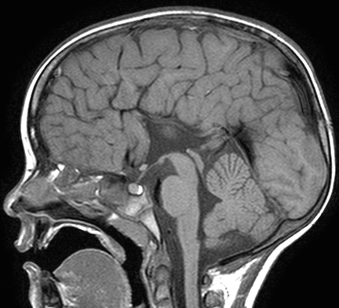
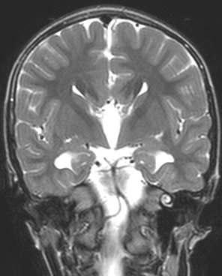
6 y, M
Agenesis of Corpus Callosum
Notes:
107241

Slide 7
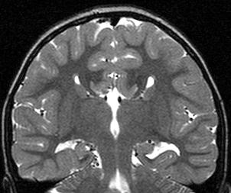
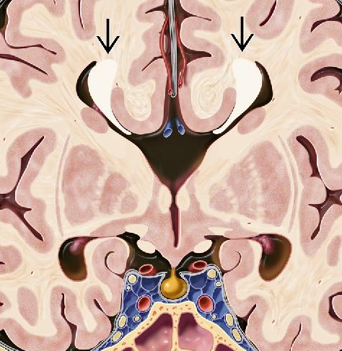
Probst Bundles
Agenesis of Corpus Callosum
Notes:
1585342

Slide 8
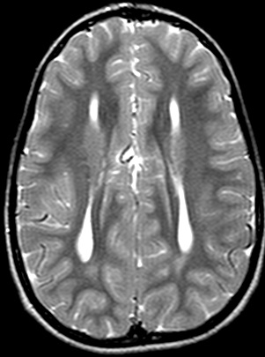
Agenesis of Corpus Callosum
Colpocephaly
Notes:
1585342

Slide 9
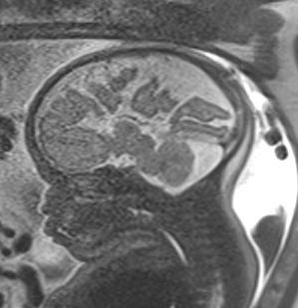
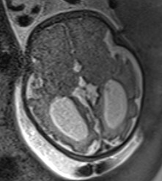
Agenesis of Corpus Callosum

Slide 10
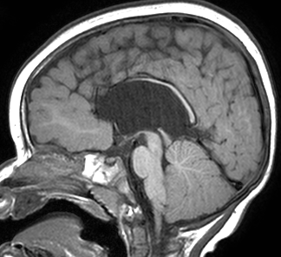
1 y, E
Notes:
3411977, 1-year-old, male

Slide 11
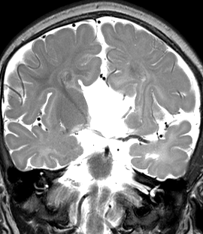
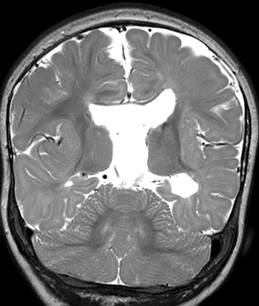

Slide 12
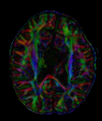
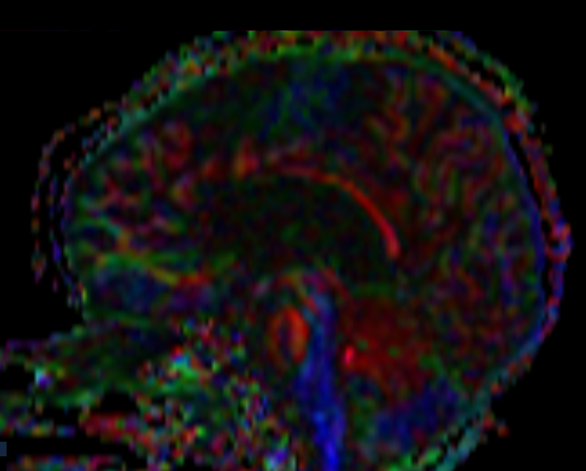

Slide 13
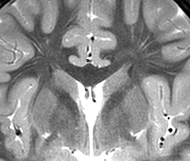
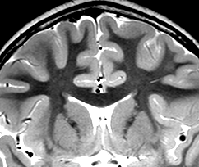
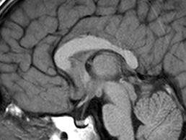
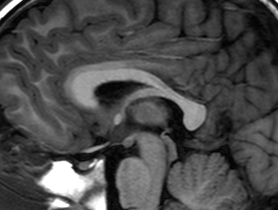
Abnormal Supracallosal Fibers
Notes:
3569739, 6 y/o, male, abnormal supracallosal fibers

Slide 14
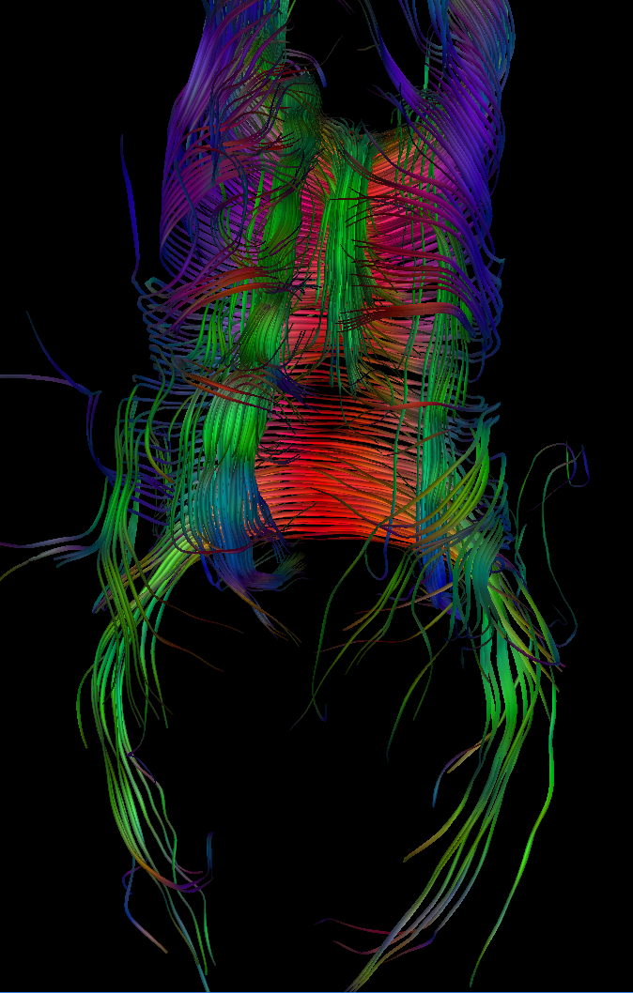

Abnormal Supracallosal Fibers
Notes:
3569739, 6 y/o, male, abnormal supracallosal fibers

Slide 15
2

Slide 16
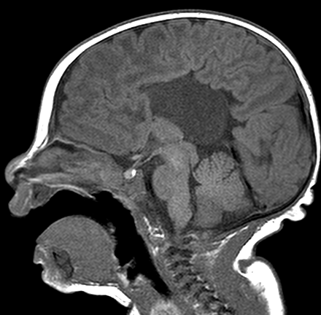
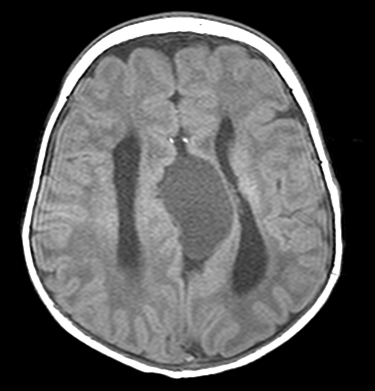
c
1 month
Notes:
1518428

Slide 17
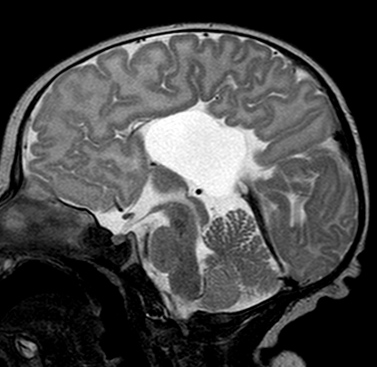
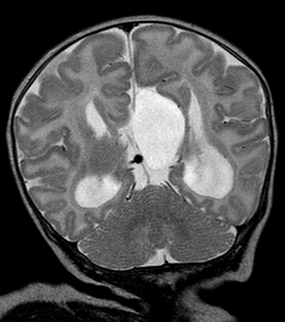
1 month

Slide 18
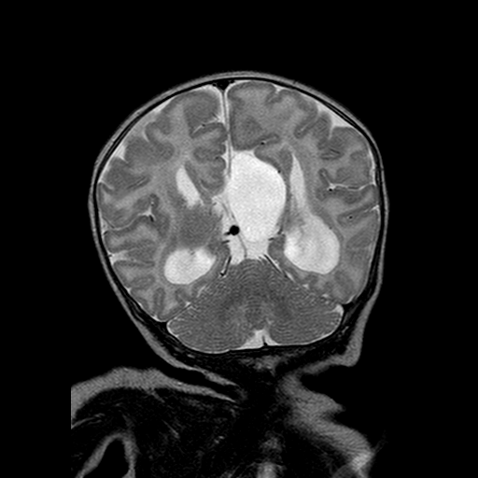
Callosal Agenesis and
Interhemispheric Cyst
Type I: Contiguous with the ventricles
Type II: Not contiguous

Slide 19
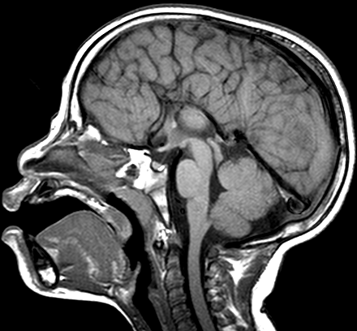
13 months
Notes:
1507601

Slide 20
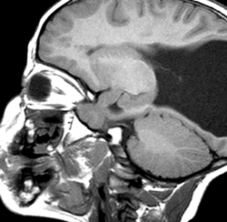
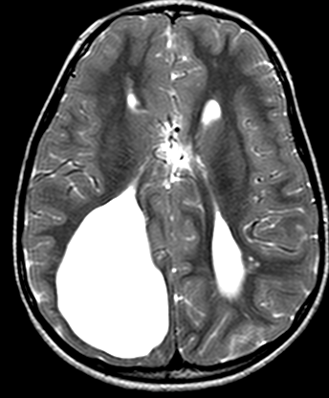
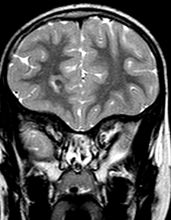
13 months

Slide 21
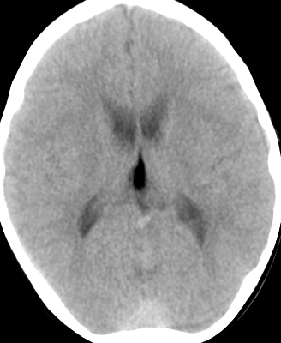
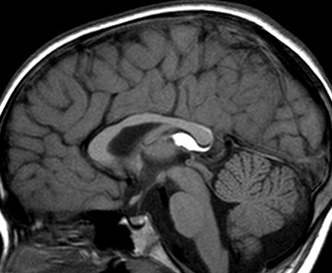
Lipoma
4 y
Notes:
1235747

Slide 22
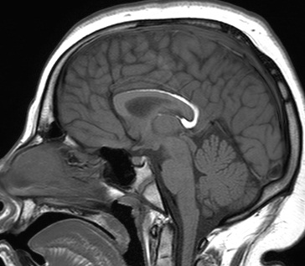
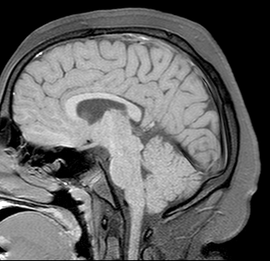
11 y
Lipoma
Notes:
1503301

Slide 23
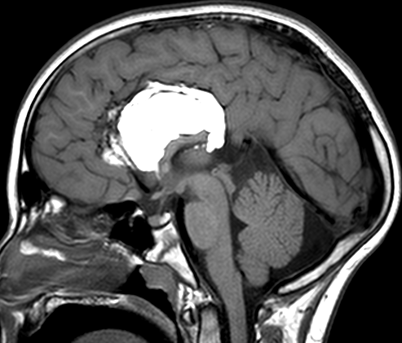
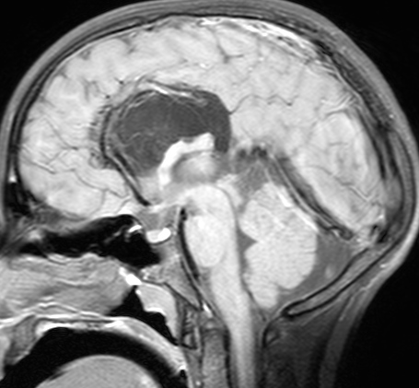
Lipoma
10 y

Slide 24
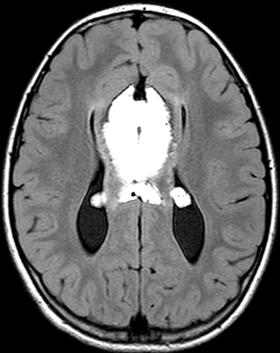
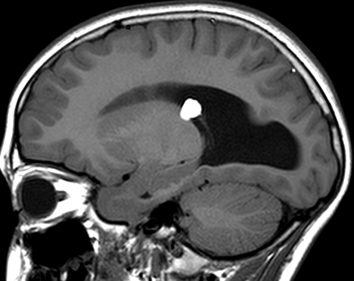
10 y
Lipoma

Slide 25
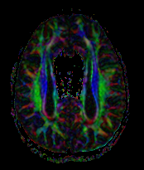
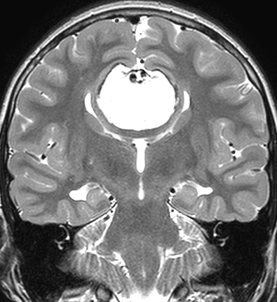
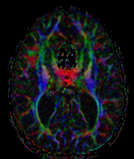
10 y
Lipoma

Slide 26
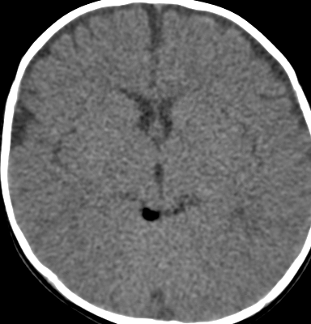
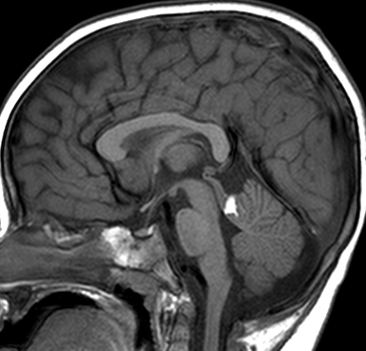
6 m, F
Lipoma
Notes:
1504085

Slide 27
3

Slide 28
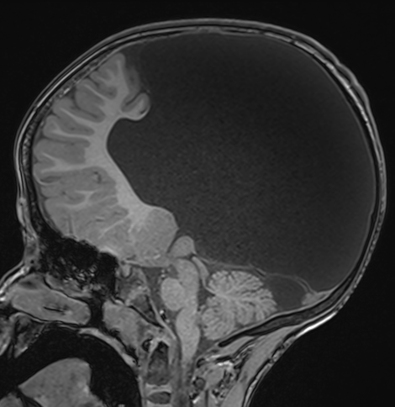
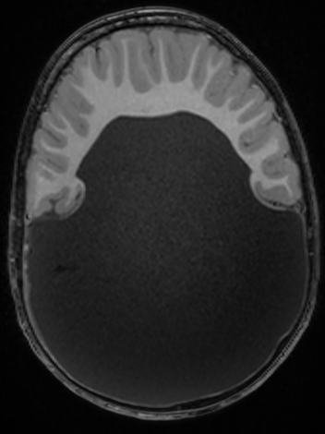
6 y, F
Alobar Holoprosencephaly
Notes:
5232268; alobar holoprosencephaly; 6 y, F

Slide 29
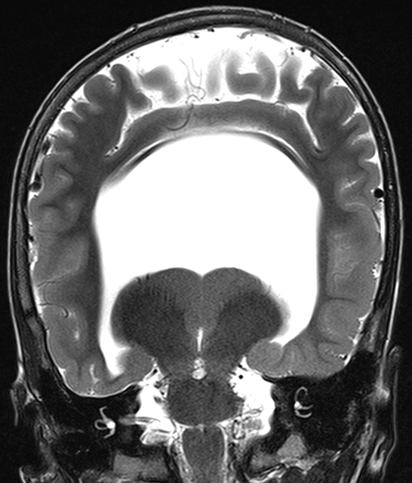
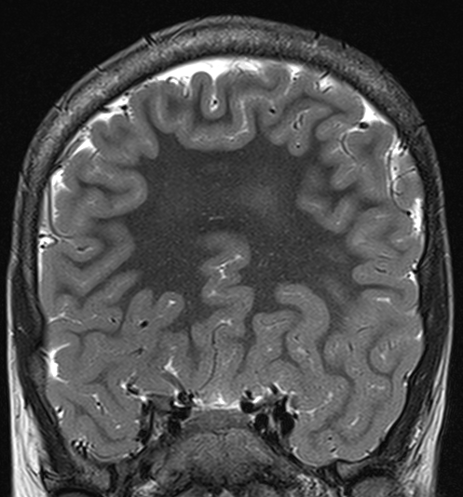
Monoventricle
6 y, F
Alobar Holoprosencephaly

Slide 30
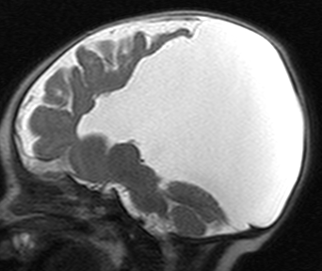
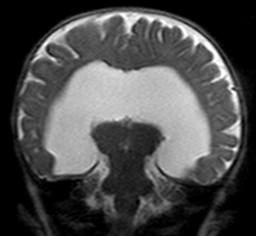
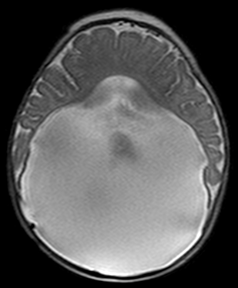
Monoventricle
4 m, F
Alobar Holoprosencephaly
Notes:
4742668; 4 m F

Slide 31
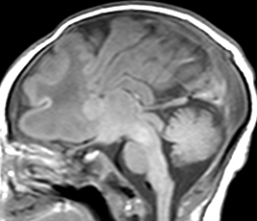
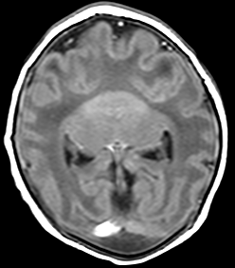
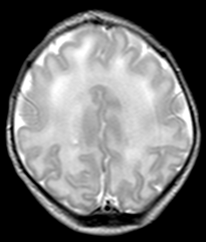
4 d, M
Semilobar Holoprosencephaly
Notes:
1303113, semilobar holoprosencephaly

Slide 32
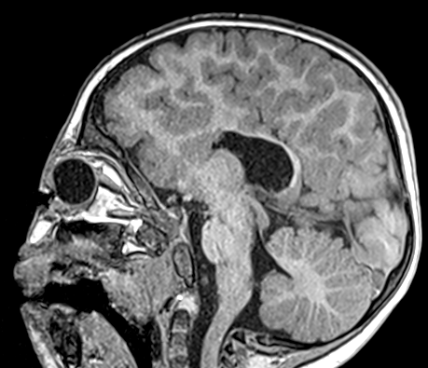


17 m, F
Semilobar Holoprosencephaly
Notes:
4716039, 17 months, female, semilobar

Slide 33
Corpus Callosum
?
Posterior genu
Anterior body
Anterior genu/ posterior body
Splenium
Rostrum

Slide 34






Slide 35


Slide 36




Slide 37


Absent Septum Pellucidum
Ectopic Neurohypophysis
9 m, M
Septo-optic Dysplasia
Notes:
4716451, 9 m M

Slide 38


9 m, M
Septo-optic Dysplasia

Slide 39
4

Slide 40

Cortical formation abnormalities
Proliferation

Slide 41
Abdel Rezak et al. AJNR 2009

Slide 42

2 d, F
Notes:
3083226

Slide 43


Proliferation
2 d, F
(Microlissencephaly with Simplified Gyral Pattern)
Notes:
3083226

Slide 44
Abdel Rezak et al. AJNR 2009

Slide 45



Proliferation
Hemimegalencephaly
6 m, F
Notes:
1227266, 6m, female

Slide 46
Abdel Rezak et al. AJNR 2009

Slide 47


13 y, F
Focal Cortical Dysplasia
Notes:
3378398, 13 y, female

Slide 48
5

Slide 49

Cortical formation abnormalities
Migration

Slide 50
Abdel Rezak et al. AJNR 2009

Slide 51


Migration
Classic Lissencephaly
(Agyria-Pachygyria)
10 d
Notes:
1526394

Slide 52

15 mm
Classic Lissencephaly
(Agyria-Pachygyria)
2 y
Notes:
3004452

Slide 53


Classic Lissencephaly
(Agyria-Pachygyria)
Notes:
3004452

Slide 54

Band Heterotopia
(Mildest form of Classic Lissencephaly)

Slide 55

Band Heterotopia
(Mildest form of Classic Lissencephaly)

Slide 56

Band Heterotopia
(Mildest form of Classic Lissencephaly)

Slide 57

Band Heterotopia
(Mildest form of Classic Lissencephaly)

Slide 58


Slide 59


Slide 60


Slide 61


Slide 62


Slide 63


Slide 64


Slide 65


Slide 66

DCX

Slide 67


Slide 68


Slide 69


Slide 70


Slide 71


Slide 72


Slide 73


Slide 74

Band heterotopia

Slide 75


Slide 76


Slide 77


Slide 78


Slide 79
Abdel Rezak et al. AJNR 2009

Slide 80

Migration
Walker-Warburg Syndrome
11 m, M
Notes:
1585553, WWS

Slide 81


Walker-Warburg Sendromu
Notes:
1585553

Slide 82
Abdel Rezak et al. AJNR 2009

Slide 83


Ectopic Migration
Gray Matter Heterotopia
3 y, F
Notes:
1415403

Slide 84
6

Slide 85
Cortical formation
Abnormalities
Organization

Slide 86
Abdel Rezak et al. AJNR 2009

Slide 87


Normal
Perisylvian Polymicrogyria
5 y, M
Notes:
3111710

Slide 88

Perisylvian Polymicrogyria
Notes:
3111710

Slide 89


2 y, M
Polymicrogyria
Notes:
1471739

Slide 90
Abdel Rezak et al. AJNR 2009

Slide 91


Schizencephaly (closed)

Slide 92

1 y, F
Schizencephaly (open)
Notes:
1382792

Slide 93


11 m, M
Schizencephaly (open)
Notes:
1559041, open lip schizencephaly

Slide 94
Ectopic Neurohypophysis
9 m, M
Septo-optic Dysplasia
Notes:
4716451, 9 m M

Slide 95
9 m, M
Septo-optic Dysplasia

Slide 96


1 y, F
Schizencephaly (open)
Septo-optic Dysplasia
Notes:
3708607, 1 y, female

Slide 97


Schizencephaly (open)
1 y, F
Septo-optic Dysplasia
Notes:
3708607, 1 y, female

Slide 98

8 m, F
Notes:
3336210, schiz, cortical dysp 8 m f

Slide 99


Slide 100


Slide 101

Cortical Dysplasia

Slide 102


Slide 103


Slide 104

Schizencephaly

Slide 105

Septum Pellucidum?

Slide 106


Slide 107


Slide 108

Optic nerves normal
Notes:
3336210, schiz, cortical dysp 8 m f

Slide 109
7

Slide 110

Tubulinopathy

Slide 111

Tubulinopathy

Slide 112

Tubulinopathy

Slide 113

Tubulinopathy

Slide 114

Tubulinopathy

Slide 115

Tubulinopathy

Slide 116

Tubulinopathy

Slide 117

Tubulinopathy

Slide 118

Tubulinopathy

Slide 119

Tubulinopathy

Slide 120

Tubulinopathy

Slide 121

Tubulinopathy

Slide 122

Tubulinopathy

Slide 123

Tubulinopathy

Slide 124

Tubulinopathy

Slide 125

Tubulinopathy

Slide 126

Tubulinopathy

Slide 127

Tubulinopathy

Slide 128

Tubulinopathy

Slide 129

Tubulinopathy

Slide 130

Tubulinopathy

Slide 131

Tubulinopathy

Slide 132

Tubulinopathy

Slide 133

Tubulinopathy

Slide 134

Tubulinopathy

Slide 135

Tubulinopathy

Slide 136

Tubulinopathy

Slide 137

Tubulinopathy

Slide 138

Tubulinopathy

Slide 139

Tubulinopathy

Slide 140

Tubulinopathy

Slide 141

Tubulinopathy

Slide 142

Tubulinopathy

Slide 143

Tubulinopathy

Slide 144

Tubulinopathy

Slide 145

Tubulinopathy

Slide 146

Tubulinopathy

Slide 147

Tubulinopathy

Slide 148

Tubulinopathy

Slide 149

Tubulinopathy

Slide 150

Tubulinopathy

Slide 151

Tubulinopathy

Slide 152

Tubulinopathy

Slide 153

Tubulinopathy

Slide 154

Tubulinopathy

Slide 155

Tubulinopathy

Slide 156

Tubulinopathy

Slide 157

Tubulinopathy

Slide 158

Tubulinopathy

Slide 159

Tubulinopathy

Slide 160

Tubulinopathy

Slide 161

Tubulinopathy

Slide 162

Tubulinopathy

Slide 163

Tubulinopathy

Slide 164
TUBB3
Romaniello et al. Cells 2019

Slide 165
TUBA1A
Romaniello et al. Cells 2019

Slide 166
TUBB2B
Romaniello et al. Cells 2019

Slide 167
Congenital Brain Malformations
Macrocephaly & Hydrocephalus
Sellar & Suprasellar Region
Supratentorial Tumors
Infratentorial Tumors
Head & Neck
Congenital Spinal Malformations

Slide 168
8

Slide 169

Macrocephaly
Benign enlarged subarachnoid spaces of infancy (BESSI)
Ventricles may be prominent
< 2 years
DDx: Atrophy

Slide 170



9 m
22 m
37 m
Notes:
9 ay, 22 ay, 37 ay

Slide 171


Macrocephaly

Slide 172


1 m
6 m
29 m
Notes:
4405959; 3 hafta, 6 ay, 29 ay; macrocephaly

Slide 173
9

Slide 174


14 y

Slide 175

Albright et al. (eds) Principles Practice Neurosurg

Slide 176


+ 2 months

Slide 177

+ 2 years

Slide 178

CISS

Slide 179


Third ventriculostomy x2
Phase contrast CSF Flow
T2 SPACE

Slide 180

Third ventriculostomy x2
CISS

Slide 182


4 y

Slide 183


Third ventriculostomy x2
CISS

Slide 185


Liliequist membranı
Fushimi et al. Radiology 2003

Slide 186



4 w
Notes:
4548612, meningitis, hydrocephalus; 4 week old

Slide 187




4 w

Slide 188


7 w
Notes:
7 week

Slide 189


9 months
Notes:
9 month

Slide 190


22 months
Notes:
22 month

Slide 191


22 months
Notes:
T2 SPACE 0.82; CISS 0.8

Slide 192


27 months
Third ventriculostomy
Notes:
27 month

Slide 193
10

Slide 194


Choroid Plexus Tumors
Papilloma
  WHO grade 1
  Parenchymal invasion (-)
Carcinoma
  WHO grade 3
  Parenchymal invasion (+)
Atypical Papilloma
  WHO grade 2

Slide 195


6 m, F
Choroid Plexus Papilloma WHO Grade 1
Notes:
1040180; 6 m, F

Slide 196


Choroid Plexus Papilloma WHO Grade 1

Slide 197



Choroid Plexus Papilloma
WHO Grade 1
18 a, E
Notes:
3101206, 18-month-old, choroid plexus papilloma; 12/22/2009

Slide 198


10 y, M
Atypical Choroid
Plexus Papilloma
WHO Grade 2
Notes:
1404420, 10, year old, atypical choroid plexus papilloma

Slide 199




4 m, F
Choroid Plexus
Carcinoma
WHO Grade 3
Notes:
3122841, 4-month-old, male, choroid plexus carcinoma

Slide 200



+3 years
Choroid Plexus
Carcinoma
WHO Grade 3
Notes:
3122841, 4-month-old, male, choroid plexus carcinoma when 3 years old

Slide 201




8 m, M
Papilloma
Carcinoma
2 y, M
Notes:
1229031, 8 M, male; 1292930, 2 y, F , carcinoma

Slide 202


10 m, M
Choroid Plexus Hyperplasia
Notes:
1391542, 10 M, hyperplasia

Slide 203


Choroid Plexus Hyperplasia

Slide 204


Choroid Plexus Hyperplasia

Slide 205




17 y, F
Meningioma
Notes:
3492976, 17 y/o female, meningioma

Slide 206
Congenital Brain Malformations
Macrocephaly & Hydrocephalus
Sellar & Suprasellar Region
Supratentorial Tumors
Infratentorial Tumors
Head & Neck
Congenital Spinal Malformations

Slide 207
11

Slide 208

2 y, vomiting

Slide 209


T1
T1+

Slide 210



T2
DWI
ADC

Slide 211
What is the most likely diagnosis?
  Atypical teratoid rhabdoid tumor
  Pilocytic astrocytoma
  Germ cell tumor
  Craniopharyngioma
Notes:
A is correct

Slide 212
Sellar/ Suprasellar Tumors
Is the T1 shortening of the
neurohypophysis visible?
not visible
visible
Optic/ hypothalamic glioma
Craniopharyngioma
Hypothalamic hamartoma
Others
Germ cell tumor
LCH

Slide 213
Atypical Teratoid Rhabdoid Tumor (ATRT)
2 y
Intact
Neurohypophysis
Restricted
Diffusion

Slide 214
12

Slide 215



Cavernous Sinus
Involvement
T1
T1+
T2
Germinoma

Slide 216


β-hCG
7 y
Choriocarcinoma
Notes:
1175011, 7-year-old, female; 7/2/2002

Slide 217

Prolactinoma
Cavernous Sinus
Involvement
15 y, F
Notes:
741652; 15 y female, prolactinoma

Slide 218


3 y
Diabetes Insipidus
Germinoma

Slide 219

Germinoma
+5 months
Repeat imaging in 3-6 months

Slide 220




11 y
2/13
4/19
7/10
10/13
Germinoma

Slide 221


16 y
Germinoma
Notes:
866894, 4 y, male

Slide 222


Langerhans Cell Histiocytosis

Slide 223

Langerhans Cell Histiocytosis
DDx
Germ cell tumor
10 y
LCH
Notes:
3271759, 10-year-old male, LCH

Slide 224


Langerhans Cell Histiocytosis

Slide 225


11 y
Langerhans Cell Histiocytosis
Notes:
1571818

Slide 226



10 y
Neurodegenerative LCH
Notes:
855467, 10-year-old male

Slide 227



Prayer et al. AJNR 2004

Slide 228


7 y
Langerhans Cell Histiocytosis

Slide 229
13

Slide 230

Calcifications
Cysts
Intact
Neurohypophysis
Craniopharyngioma

Slide 231

Craniopharyngioma

Slide 232

9/2005
11/2012
Diabetes Insipidus
Craniopharyngioma
Notes:
754536, 12-year-old male, craniopharyngioma, retrofixed, developing DI?; 9/19/2005 versus 6/11/12

Slide 233

Craniopharyngioma
Bimodal age
distribution?
Zhao et al. Clin Neurol Neurosurg 2012

Slide 234




P³²
Notes:
1487578, 4 year old female, craniopharyngioma; prefixed

Slide 235

Koral et al. Acta Radiologica 2006

Slide 236
14

Slide 237




T1
T2
Increased diffusivity ~100%
Pilocytic Astrocytoma
DWI
ADC

Slide 238


Pilocytic Astrocytoma
3 y, M
Notes:
1028083, 3-year-old, male, pilocytic; 1/11/2000

Slide 239



+3 years
+12 years
leptomeningeal spread
spinal drop metastases
Pilocytic Astrocytoma
Notes:
1028083, 3-year-old, pilocytic; 1/11/2000

Slide 240

Gelastic Seizures
Hypothalamic Hamartoma

Slide 241

Hypothalamic Hamartoma

Slide 242
Sellar/ Suprasellar Tumors
Is the T1 shortening of the
neurohypophysis visible?
not visible
visible
Optic/ hypothalamic glioma
Craniopharyngioma
Hypothalamic hamartoma
Others
Germ cell tumor
LCH

Slide 243
Optic/ Hypothalamic Glioma
Pilocytic astrocytoma
  WHO grade 1
Pilomyxoid astrocytoma
  WHO grade II
Neurofibromatosis type I
  ~15% will have OHG

Slide 244

Optic/ Hypothalamic Glioma
Decreased visual acuity
Endocrin function abn. (GH dec.~20%)
T2WI: Very bright
Increased diffusivity

Slide 245
4 m
Pilocytic Astrocytoma
WHO grade 1
Increased diffusivity
Notes:
1491322, 4-month-old, pilocytic; 5/25/2007

Slide 246


Pilocytic Astrocytoma
WHO grade 1
9 y
Notes:
879428, 9-year-old male, pilocytic astrocytoma

Slide 247
15

Slide 248


Normal Neonatal Pituitary
3 d, M
37 w gestation
11 d, F
41 w gestation
Notes:
1514062, normal pituitary, 37 week old & 3103155

Slide 249

Anterior pituitary gradually becomes
isointense to brain by 8 weeks postnatally.
Kitamura et al. AJNR 2008

Slide 250

Ectopic Neurohypophysis
3 d, F
Term, Glucose = 4 mg/dL

Slide 251




Huang et al. AJNR 2021

Slide 252
Congenital Brain Malformations
Macrocephaly & Hydrocephalus
Sellar & Suprasellar Region
Supratentorial Tumors
Infratentorial Tumors
Head & Neck
Congenital Spinal Malformations

Slide 253
16

Slide 254

Pineoblastoma
Neuroectodermal tumor of the pineal region
Hypercellular tumors
  Hypointense on T2WI
  Restricted diffusion
Notes:
3029864, 2 year old female, pineoblastoma

Slide 255




2 y, F
Pineoblastoma
Notes:
3029864, 2 year old female, pineoblastoma

Slide 256
PINEAL REGION TUMORS
Pineal Parenchymal Tumors
  Pineoblastoma
Germ cell tumors
  Germinoma ~2/3; M:F=10:1
  Non-germinomatous tumors ~1/4
  Mixed ~1/10

Slide 257




14 y, M
Germinoma
Notes:
3308951, 14-year-old male, germinoma

Slide 258



14 y, M
Germinoma
Suprasellar and pineal
region involvement: 5-10%
Notes:
866894, 14-year-old, male.

Slide 259



6 y, M
Teratoma
Notes:
3310489, 6-year-old, male

Slide 260
17

Slide 261



5 m, M
Notes:
1372961, 5-month old, male, teratoma

Slide 262

Teratoma
Notes:
1372961, 5-month old, male, teratoma

Slide 263


Teratoma
Notes:
1372961, 5-month old, male, teratoma

Slide 264
18

Slide 265


7 y, M

Slide 266



7-year-old, male

Slide 267



Basal Ganglia Germinoma

Slide 268
19

Slide 269





10 y, M
Pilocytic astrocytoma
Increased diffusivity
Notes:
1321738, 10 year old male, pilocytic

Slide 270





10 y, M
Glioblastoma
Restricted diffusion
Notes:
3289544, 8-year-old male, GBM, 11/27/2011

Slide 271
Pilocytic Astrocytoma
Glioblastoma

Slide 272




17 y, M
Low grade tumors may present
with extensive edema.
Pilocytic Astrocytoma
Notes:
3244094, 17-year-old male, pilocytic

Slide 273
20

Slide 274

DIG
(Desmoplastic Infantile Gangioglioma)
Large, cystic tumors
Superficial (cortical and leptomeningeal)
Macrocephaly
Enhancing solid components
WHO grade 1

Slide 275

9 m, F
DIG

Slide 276




DIG
9 m, F
Infants (<1 y)
Large cysts
Enhancing solid components
Notes:
1349949, DIG, brain herniation

Slide 277


1 m, M
DIG
Notes:
1209750, 1-month-old male, DIG

Slide 278

PXA
(Pleomorfic Xanthoastrocytoma)
Astrocytic neoplasm of childrens and young adults
Generally good prognosis
Peripheral location
Cysts, edema
WHO grade 2
  Anaplastic variant
DDx: Ganglioglioma

Slide 279





10 y, M
PXA
Moore, …,Koral AJNR 2014
Notes:
3264397, 4-year-old, PXA

Slide 280





4 y, M
PXA

Slide 281
Congenital Brain Malformations
Macrocephaly & Hydrocephalus
Sellar & Suprasellar Region
Supratentorial Tumors
Infratentorial Tumors
Head & Neck
Congenital Spinal Malformations

Slide 282


