Slide 2
Pediatric Neuroradiology
Unknown Cases
Korgün Koral, MD, MBA

Slide 3
1

Slide 4
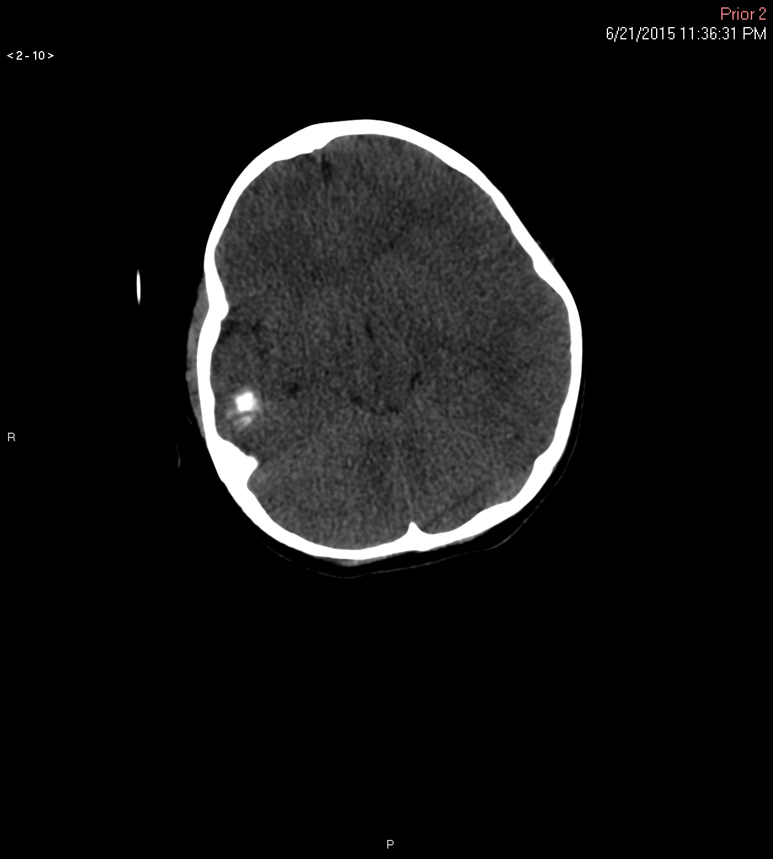
5 y
Notes:
5 y

Slide 5
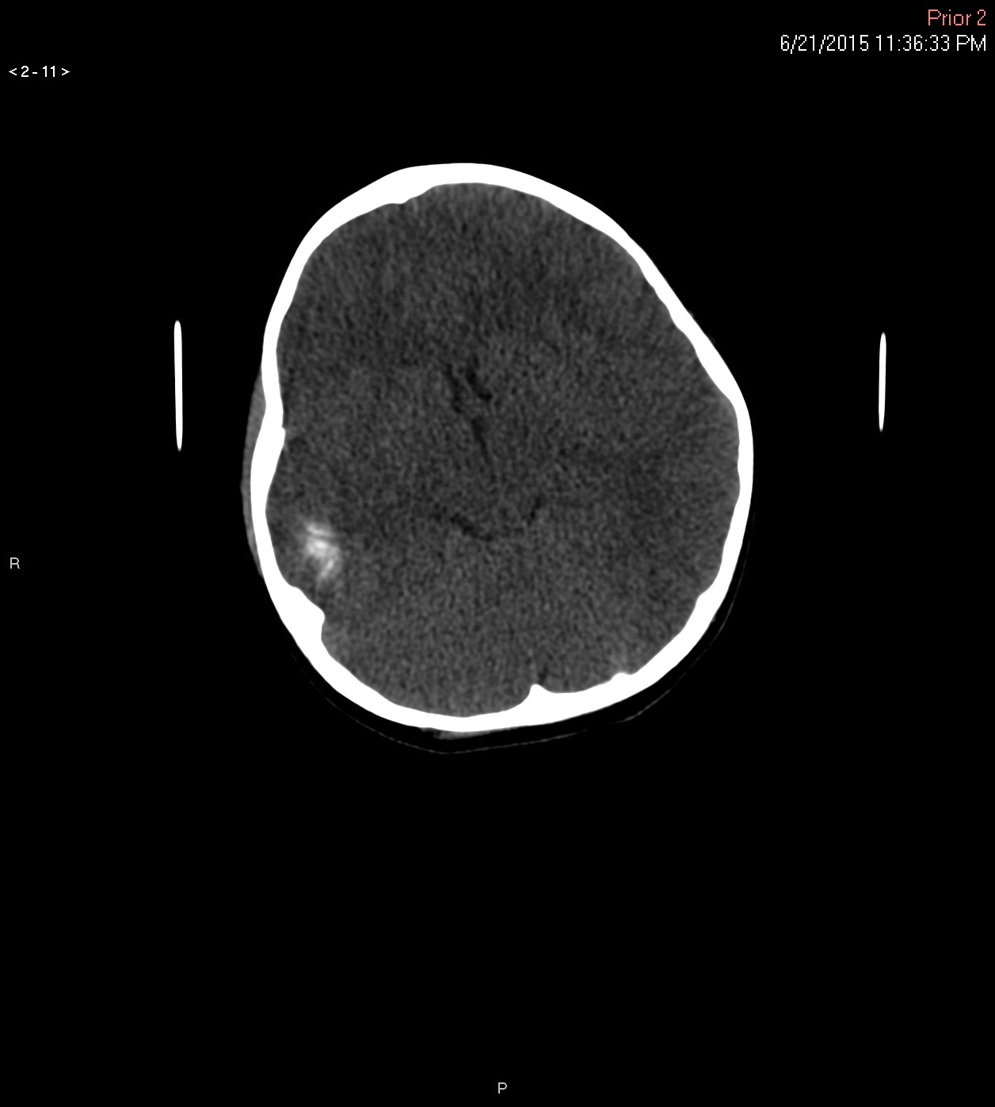

Slide 6
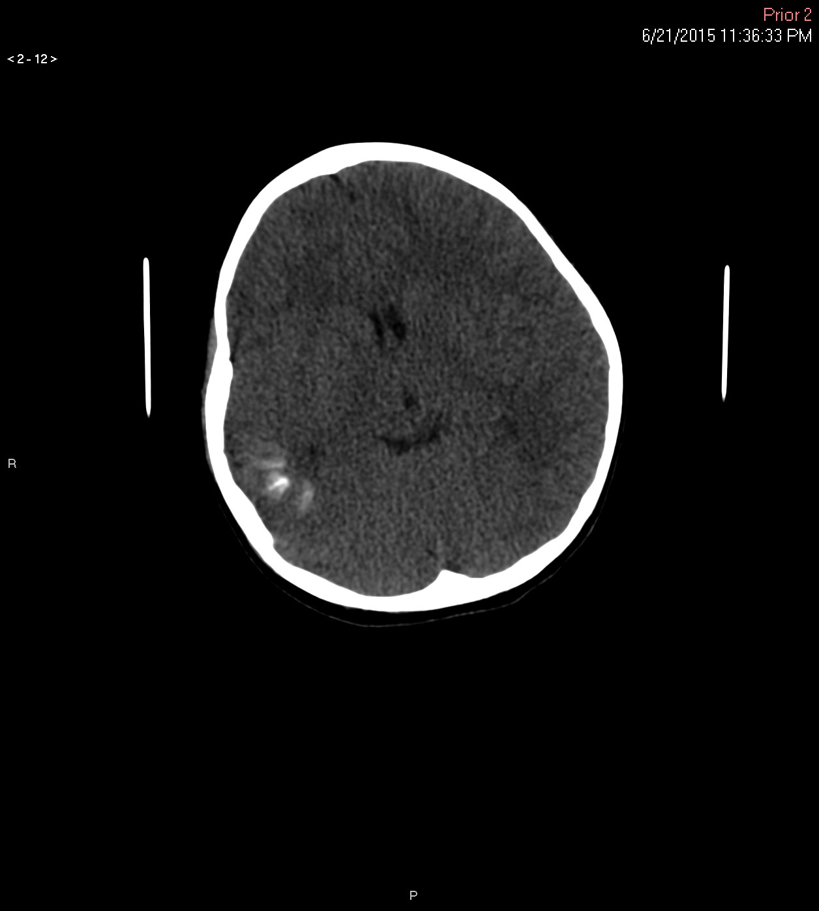

Slide 7
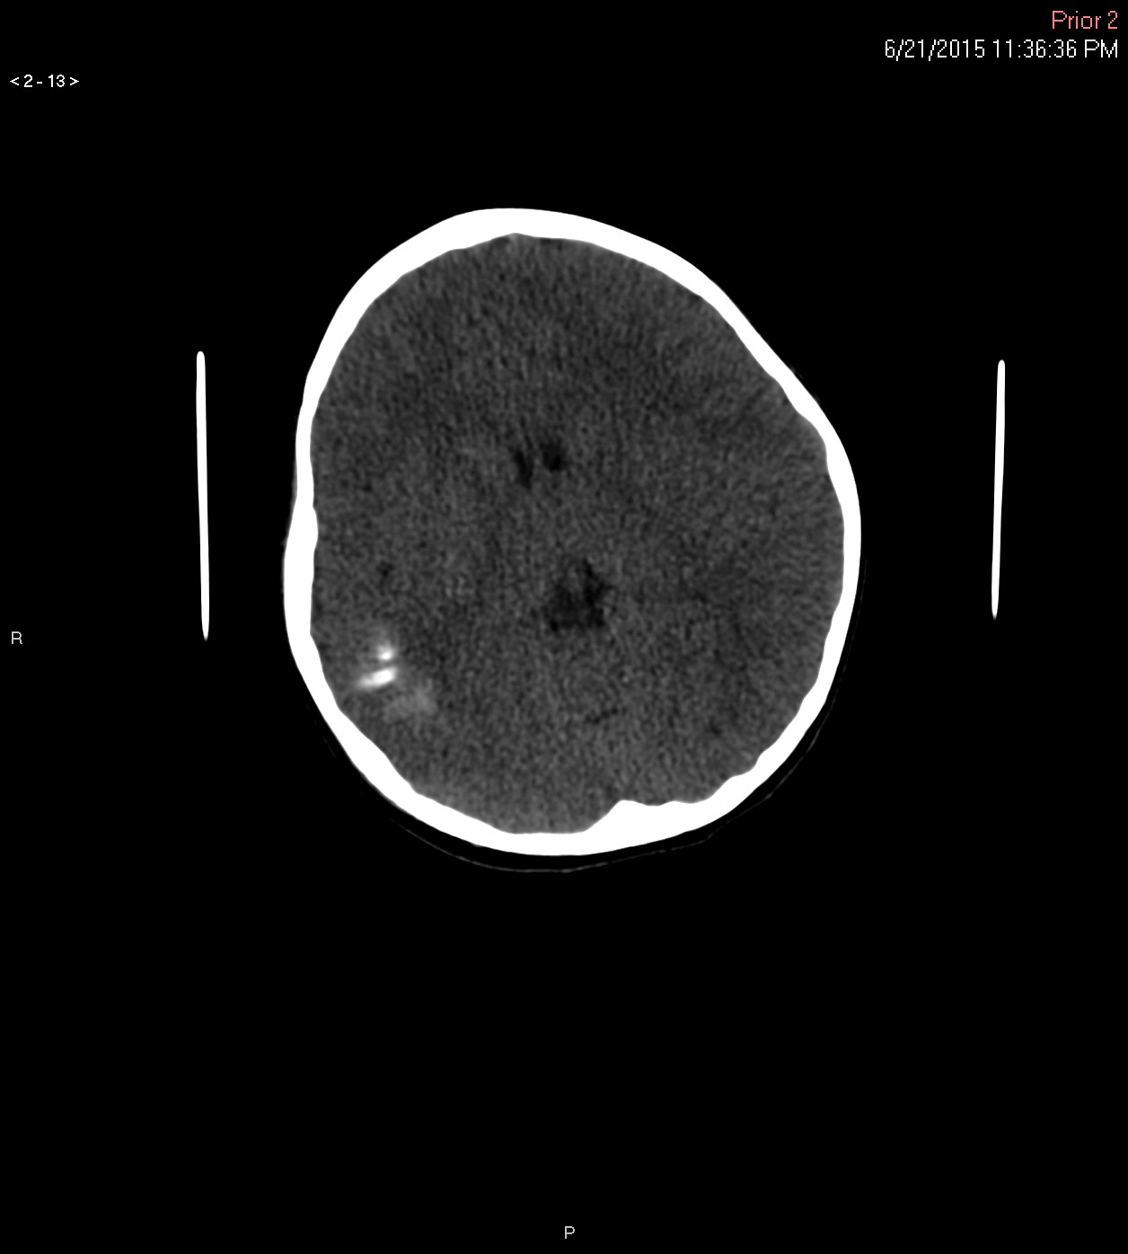

Slide 8
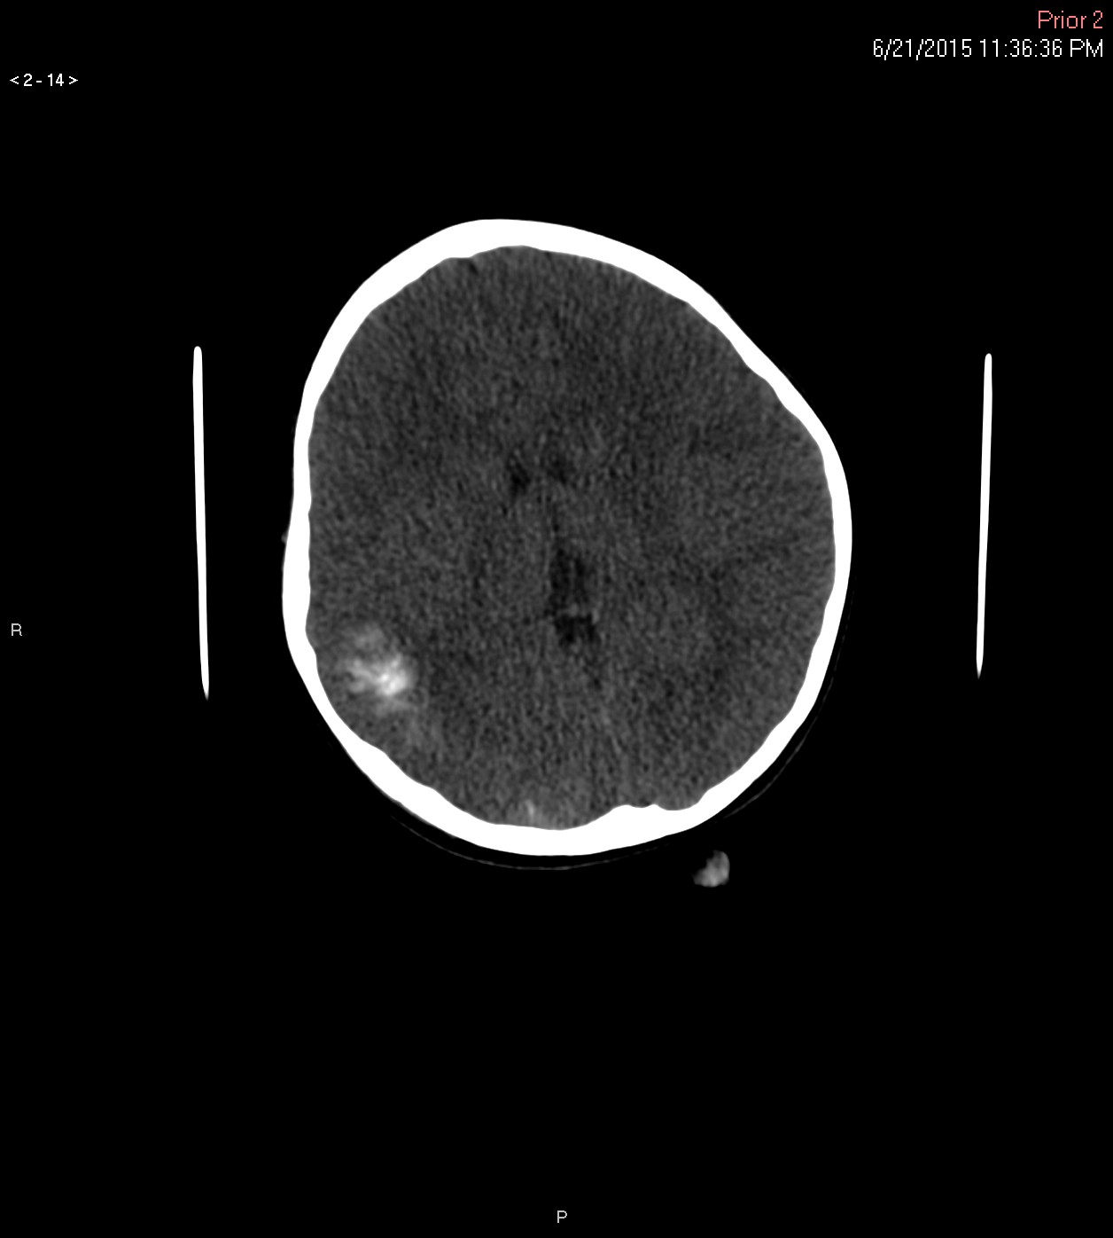

Slide 9
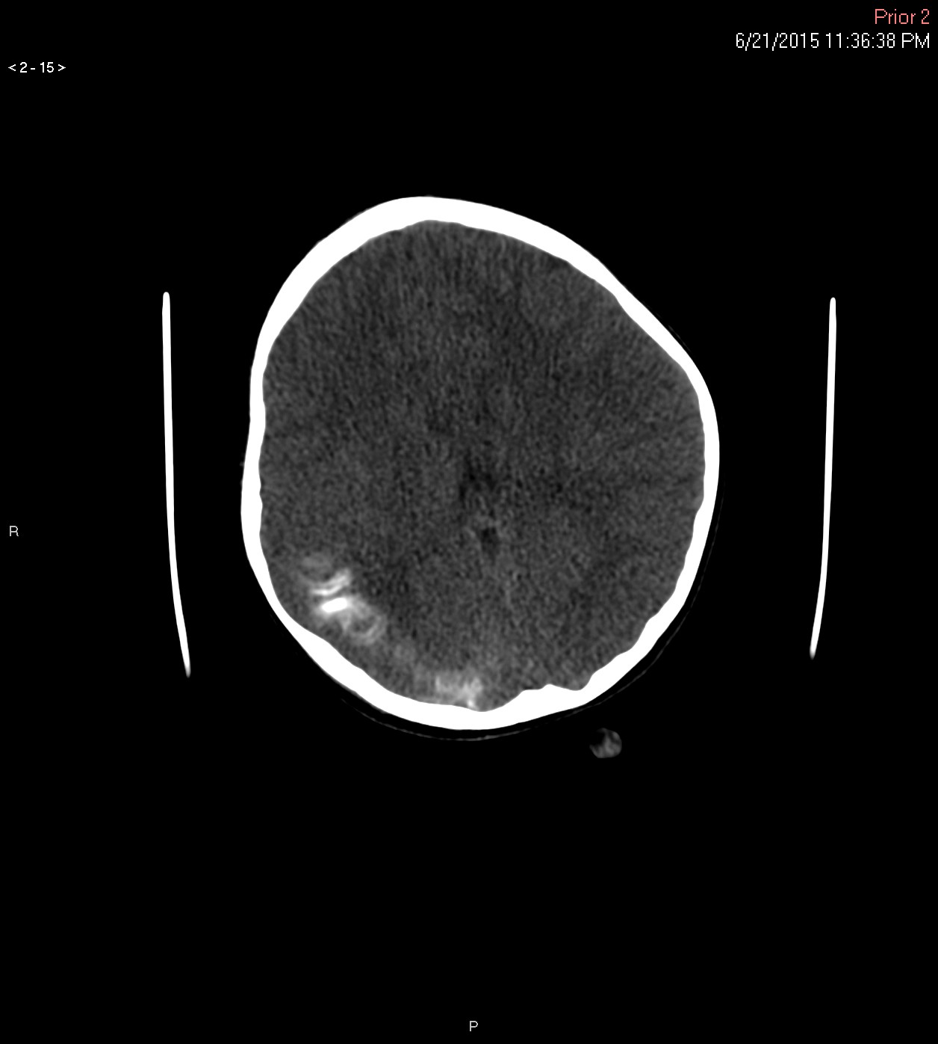

Slide 10
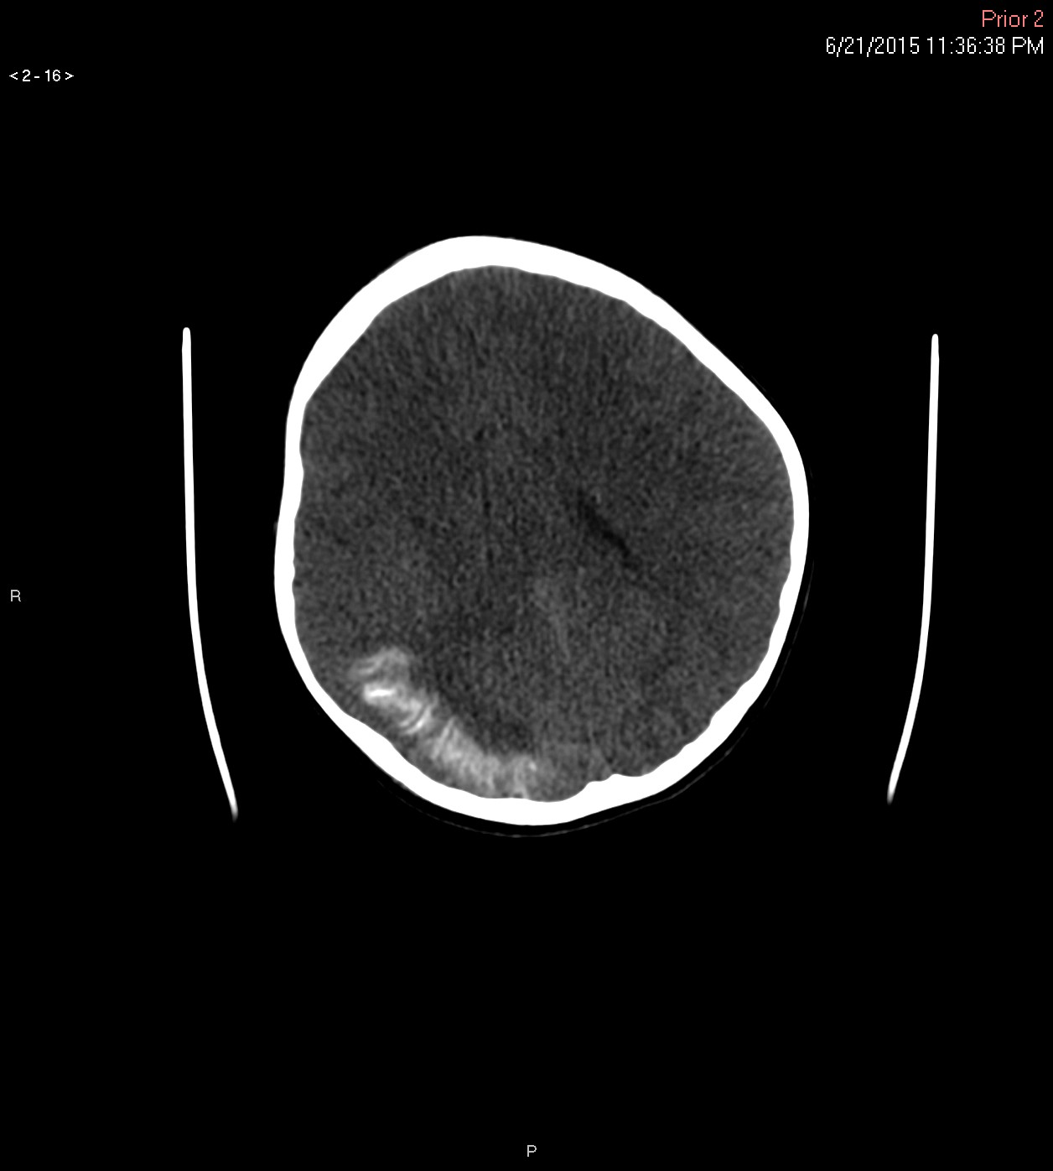

Slide 11
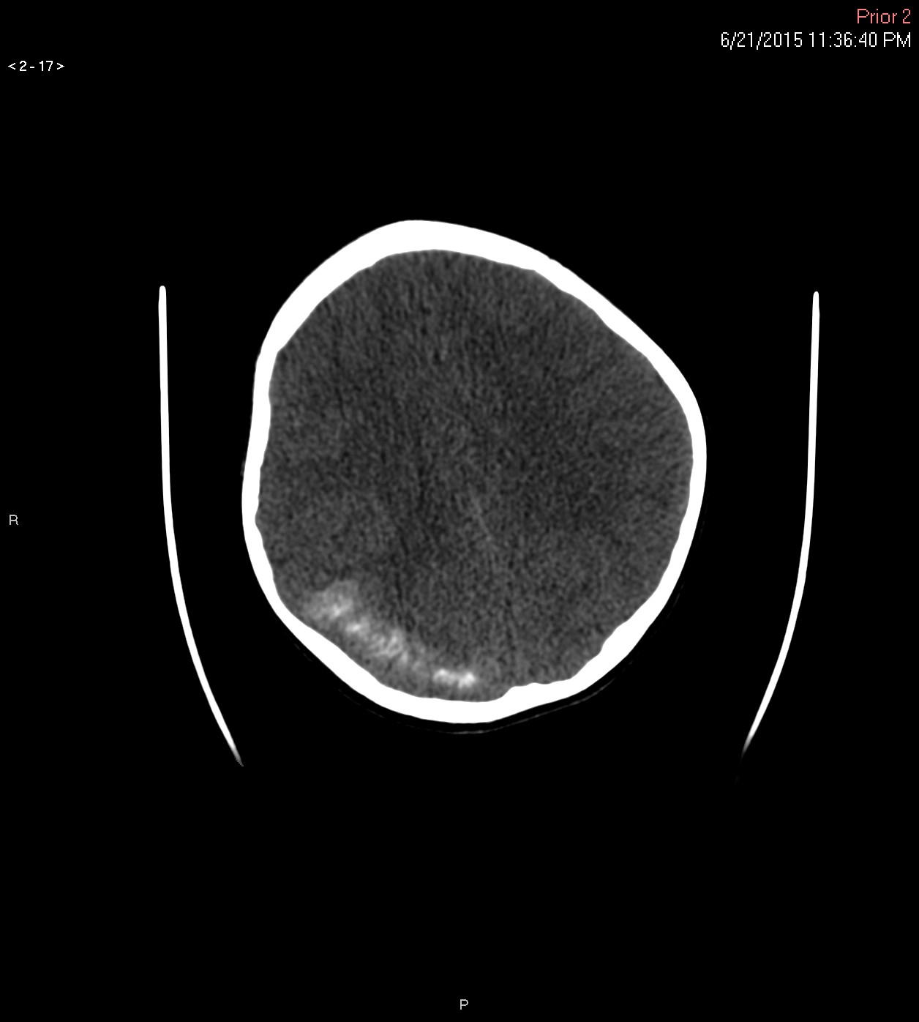

Slide 12
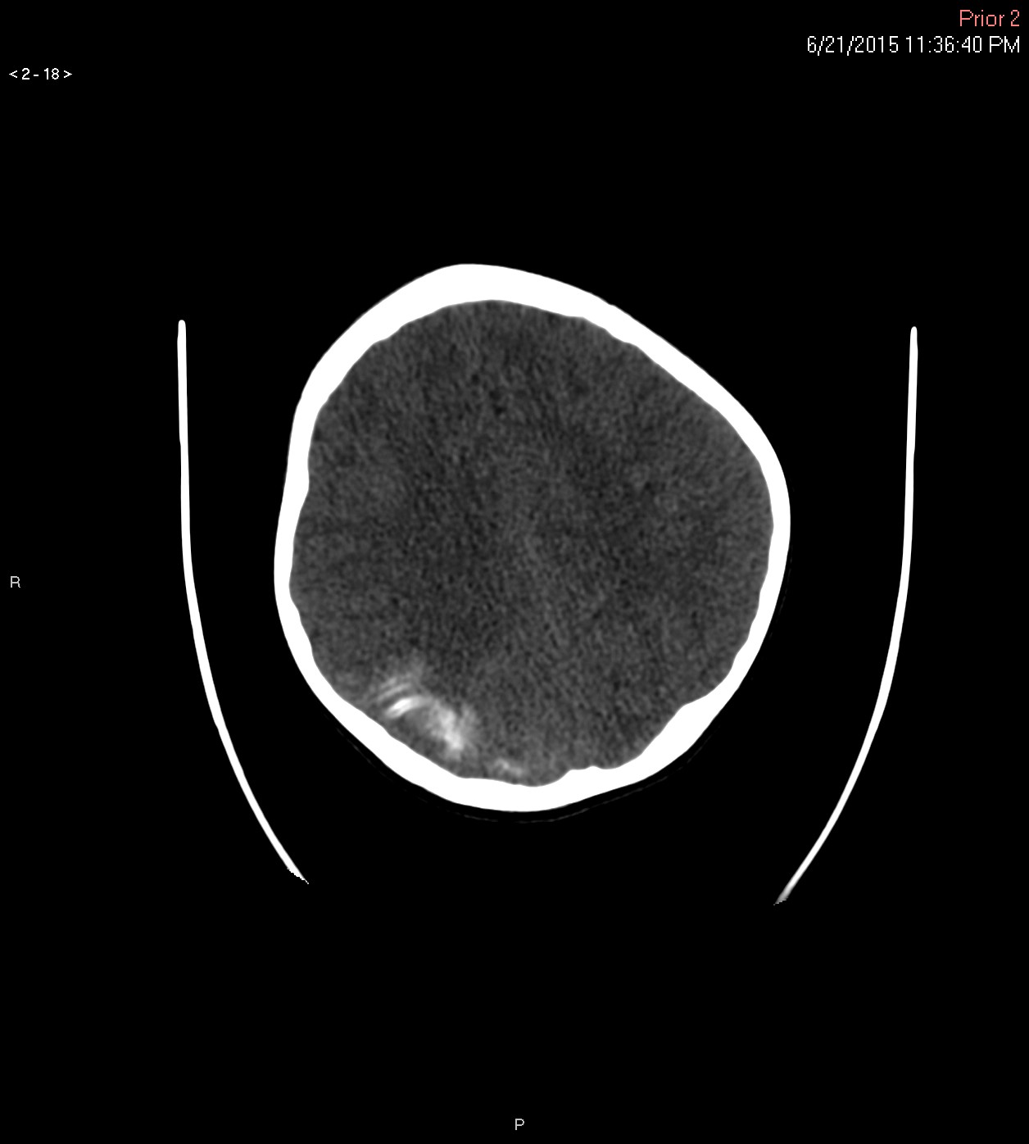

Slide 13
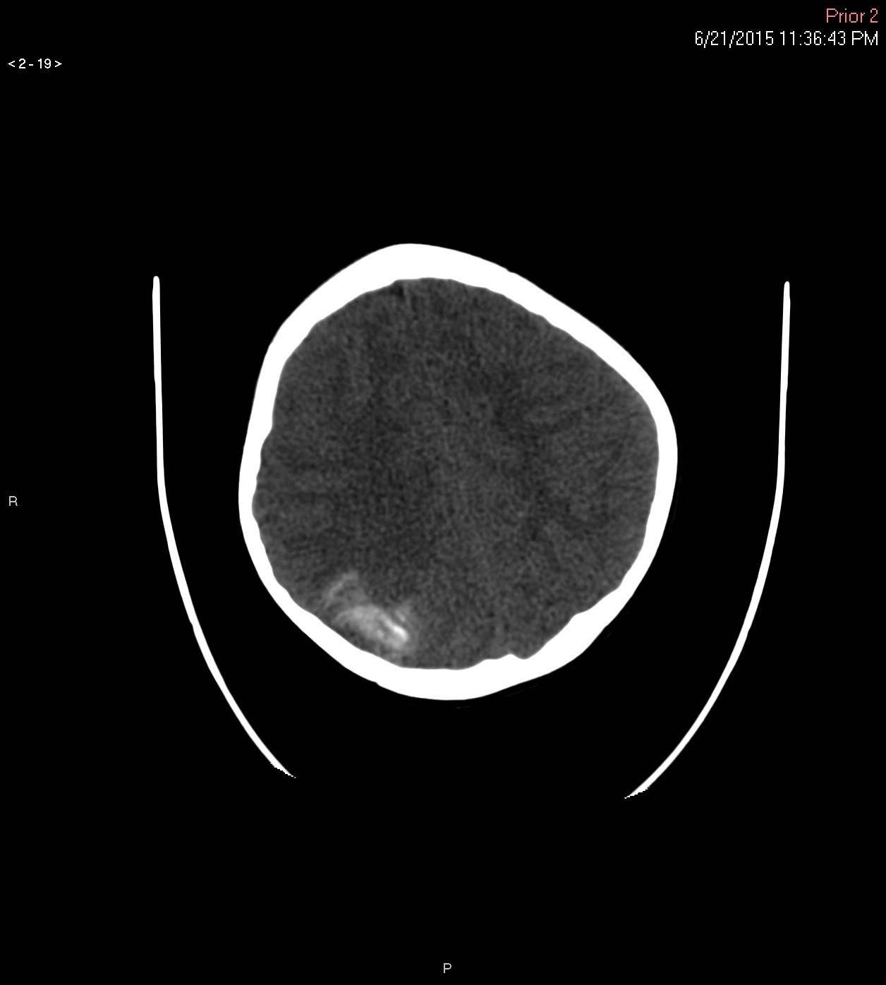

Slide 14
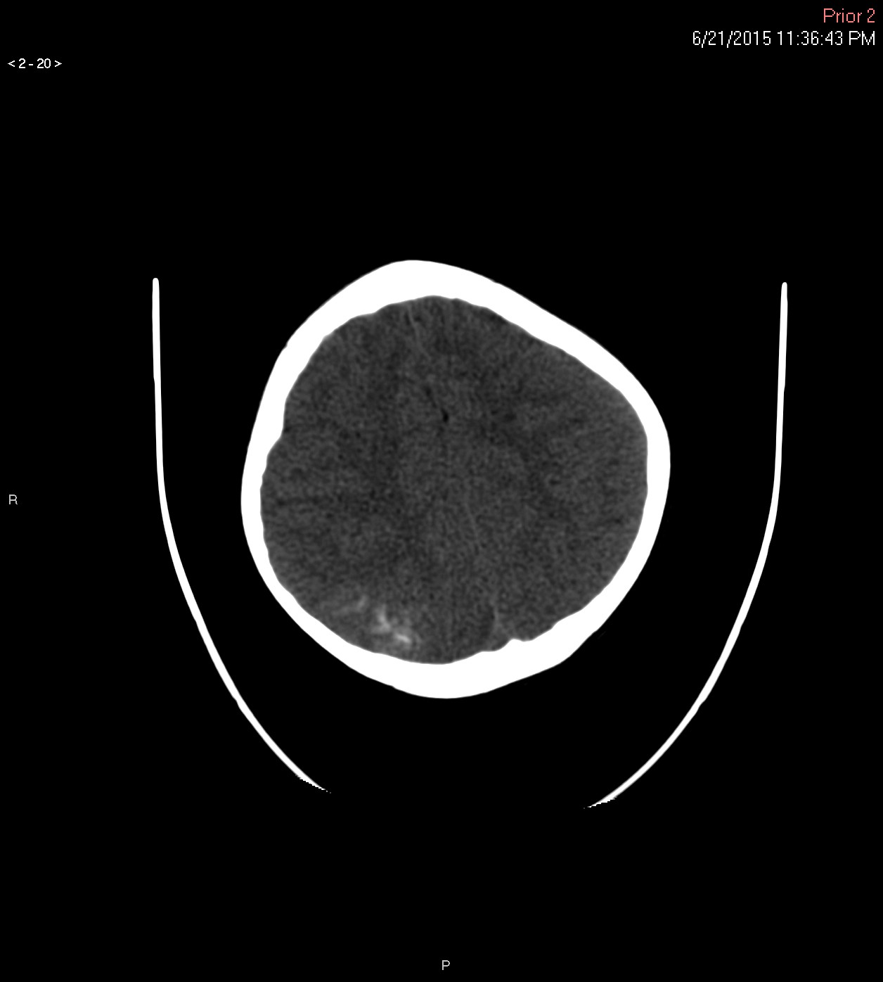

Slide 15
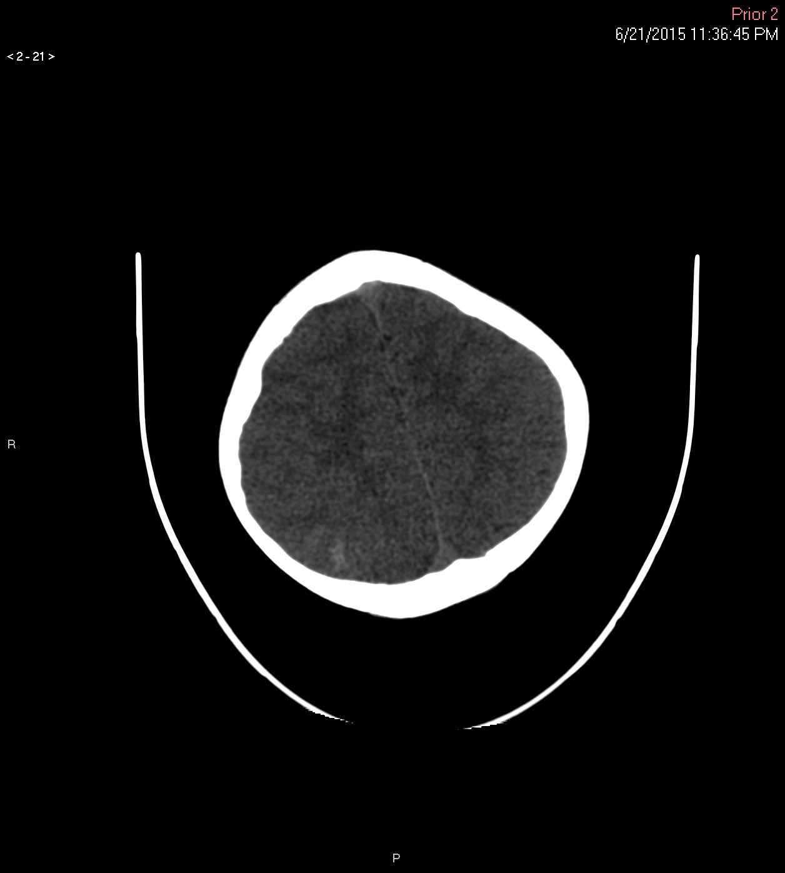

Slide 16
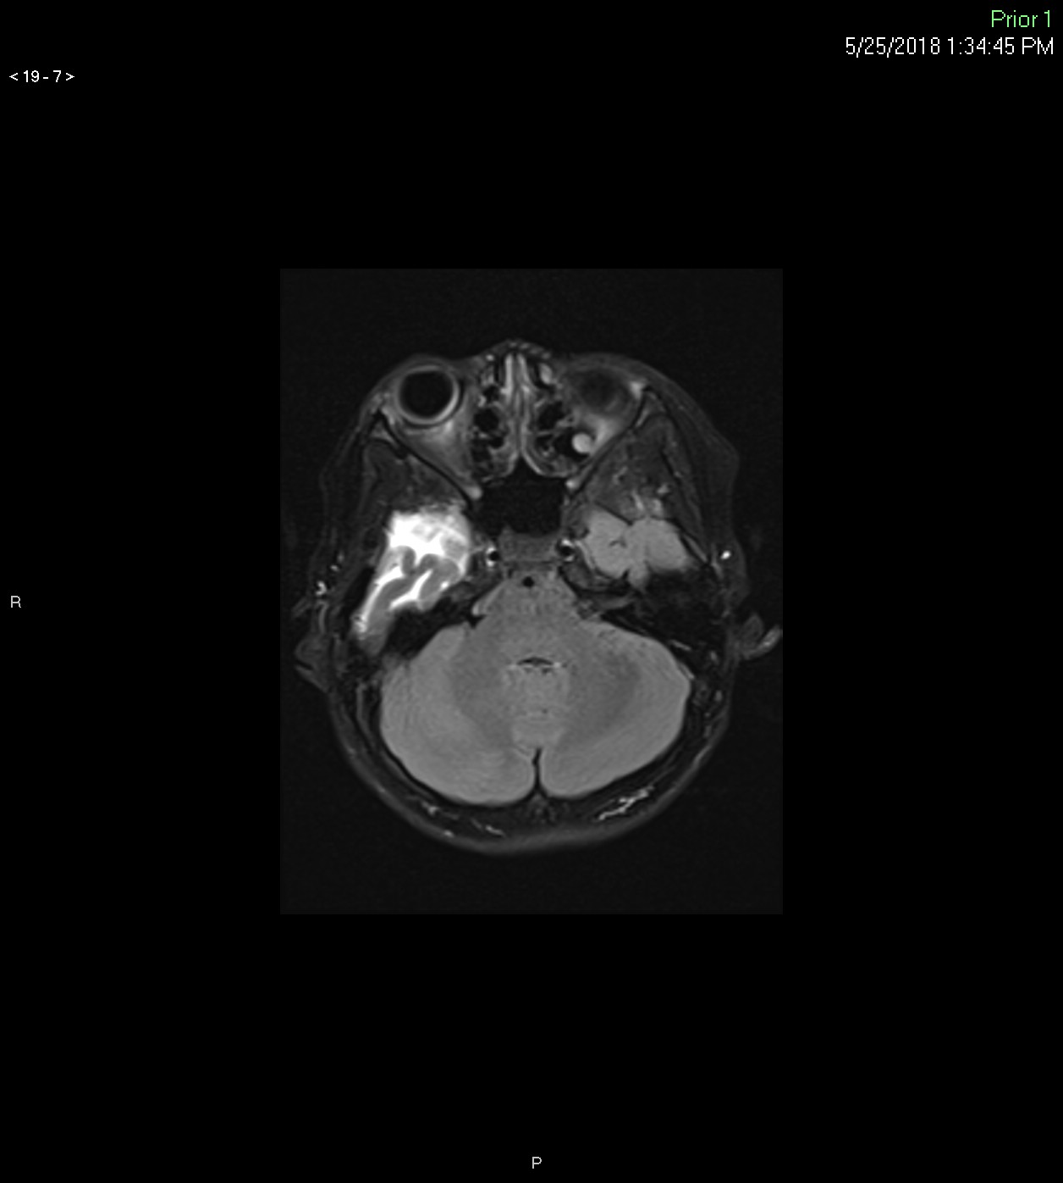

Slide 17
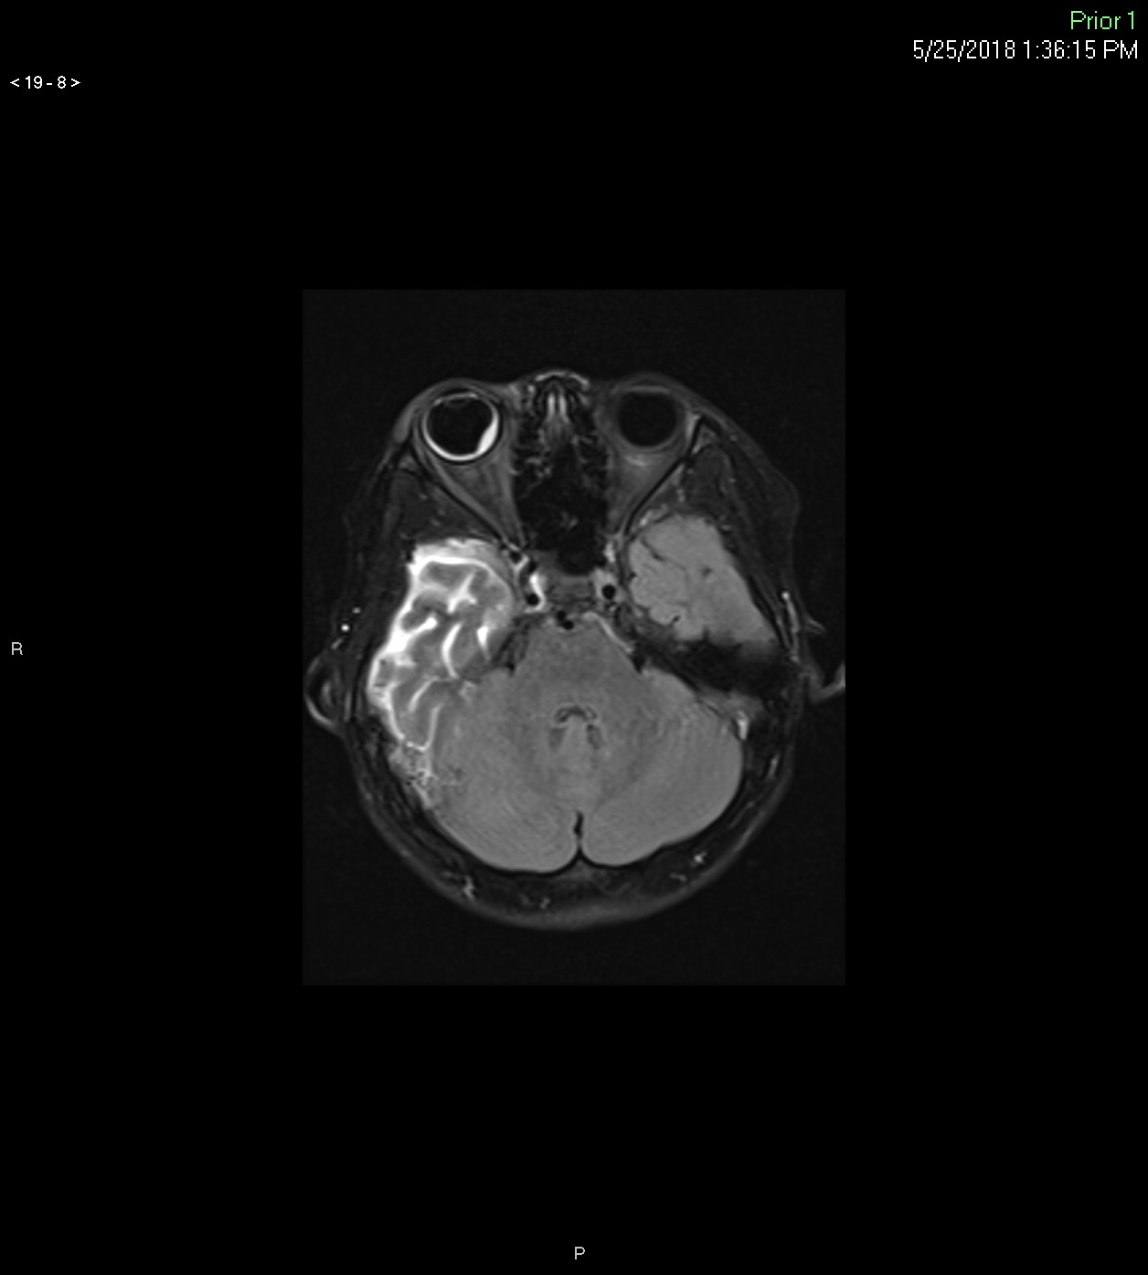

Slide 18
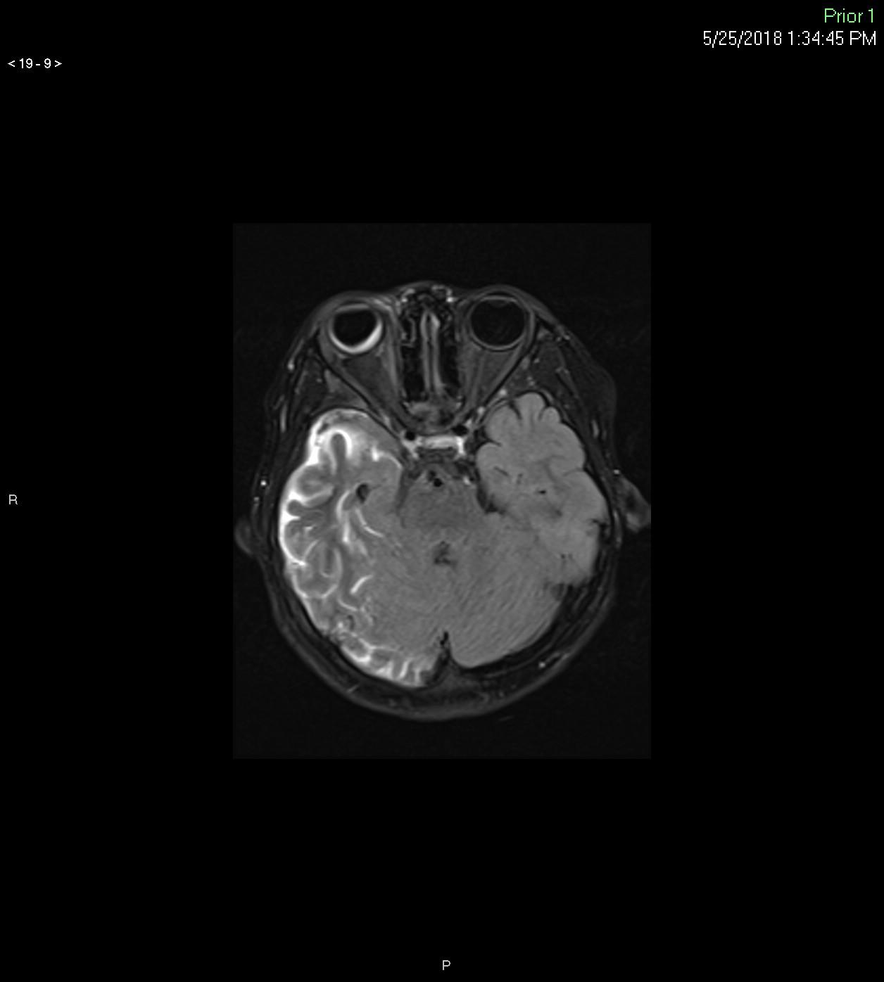

Slide 19
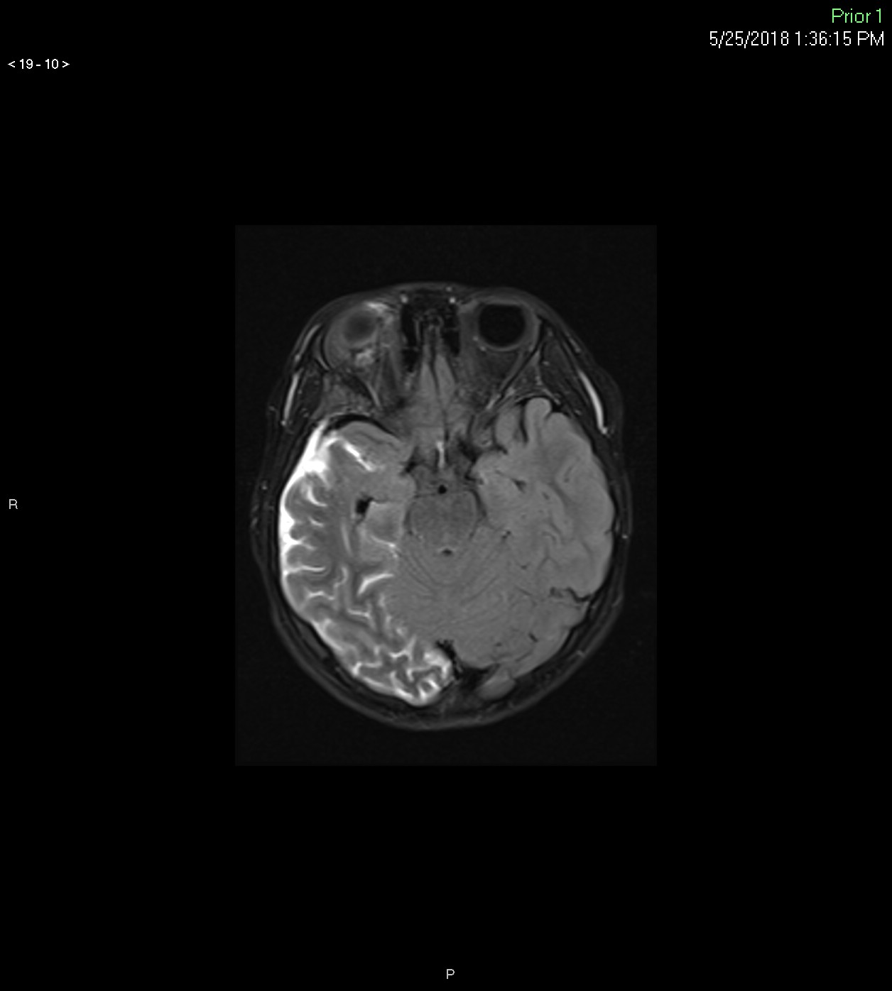

Slide 20
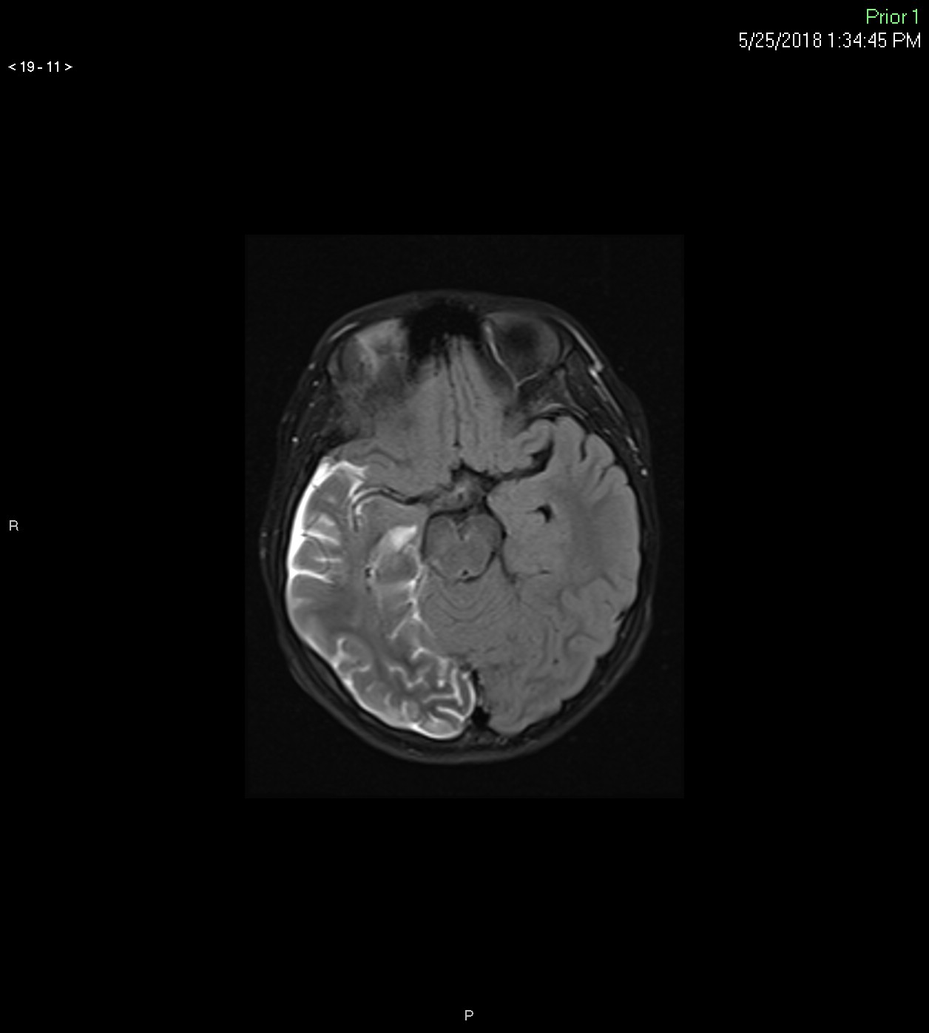

Slide 21
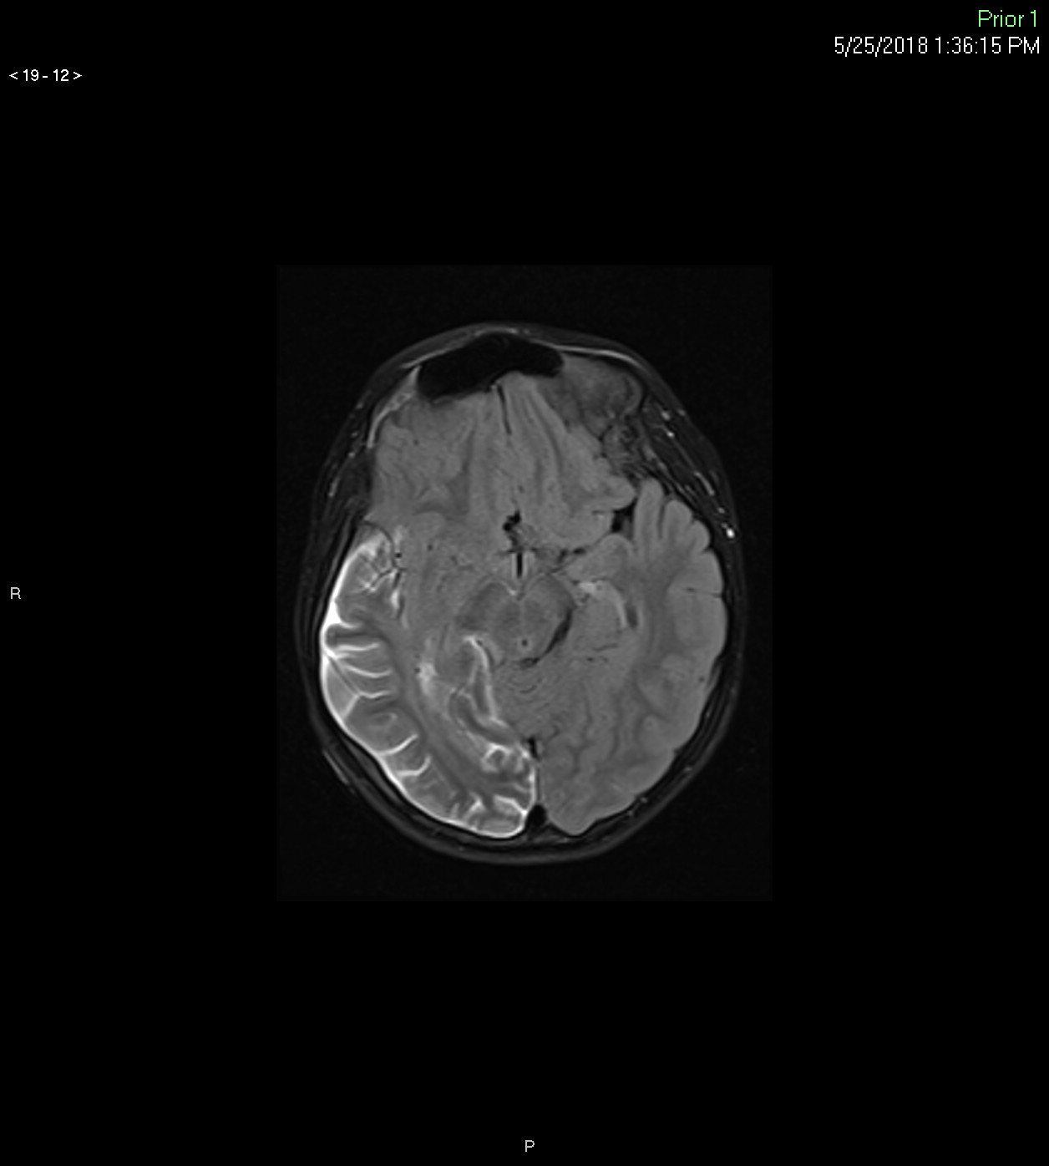

Slide 22
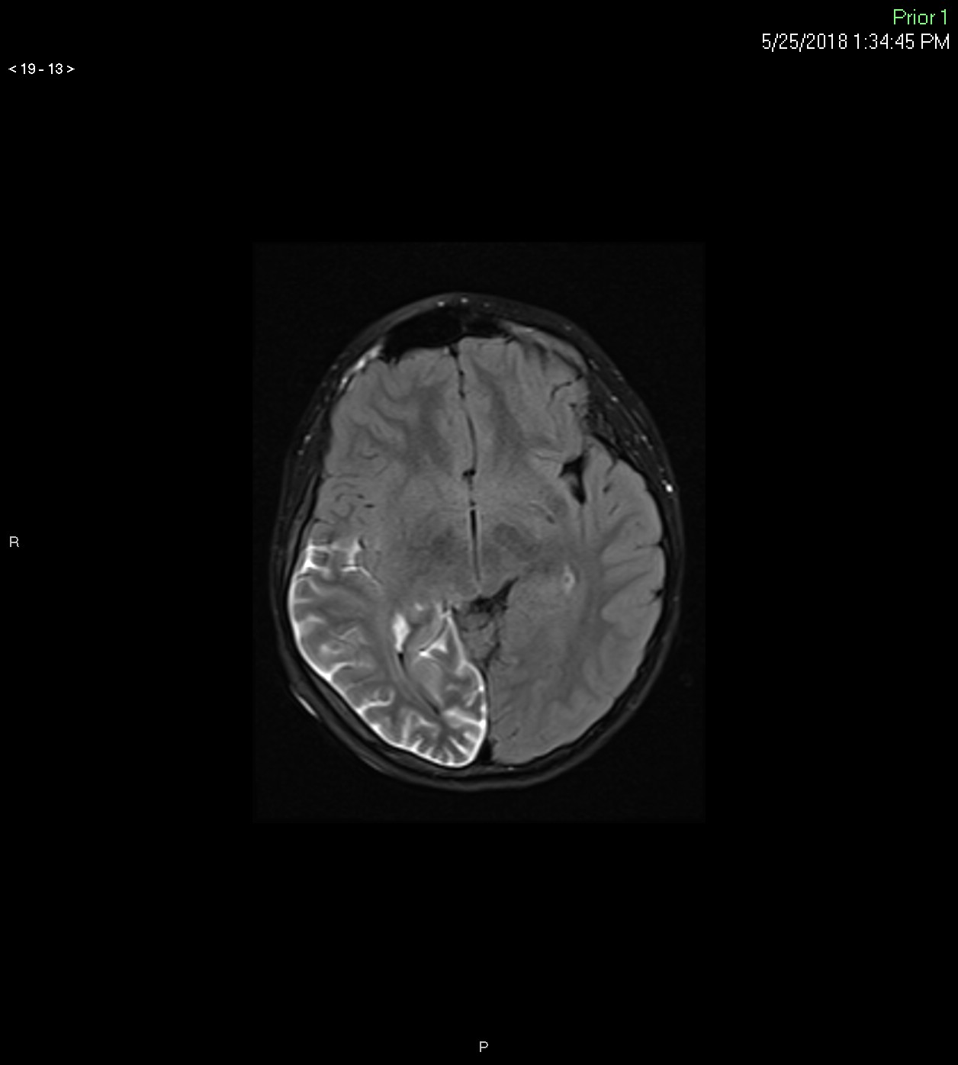

Slide 23
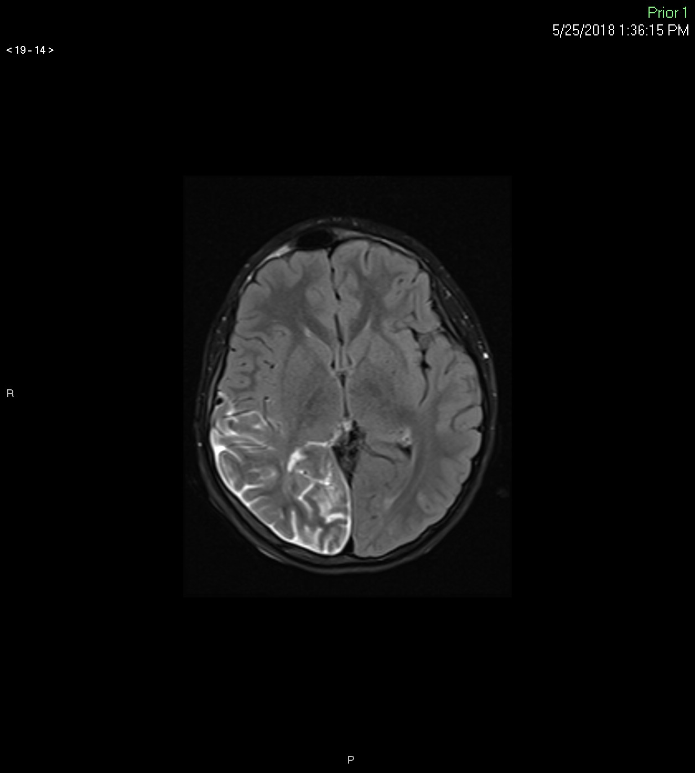

Slide 24
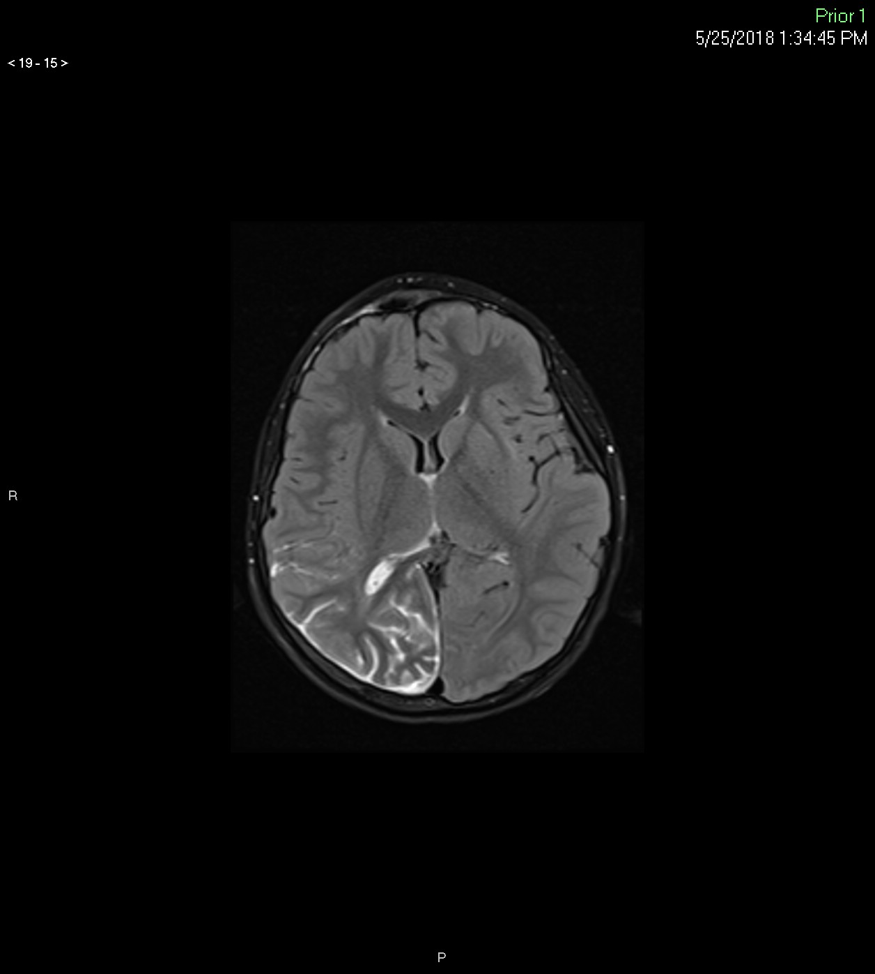

Slide 25
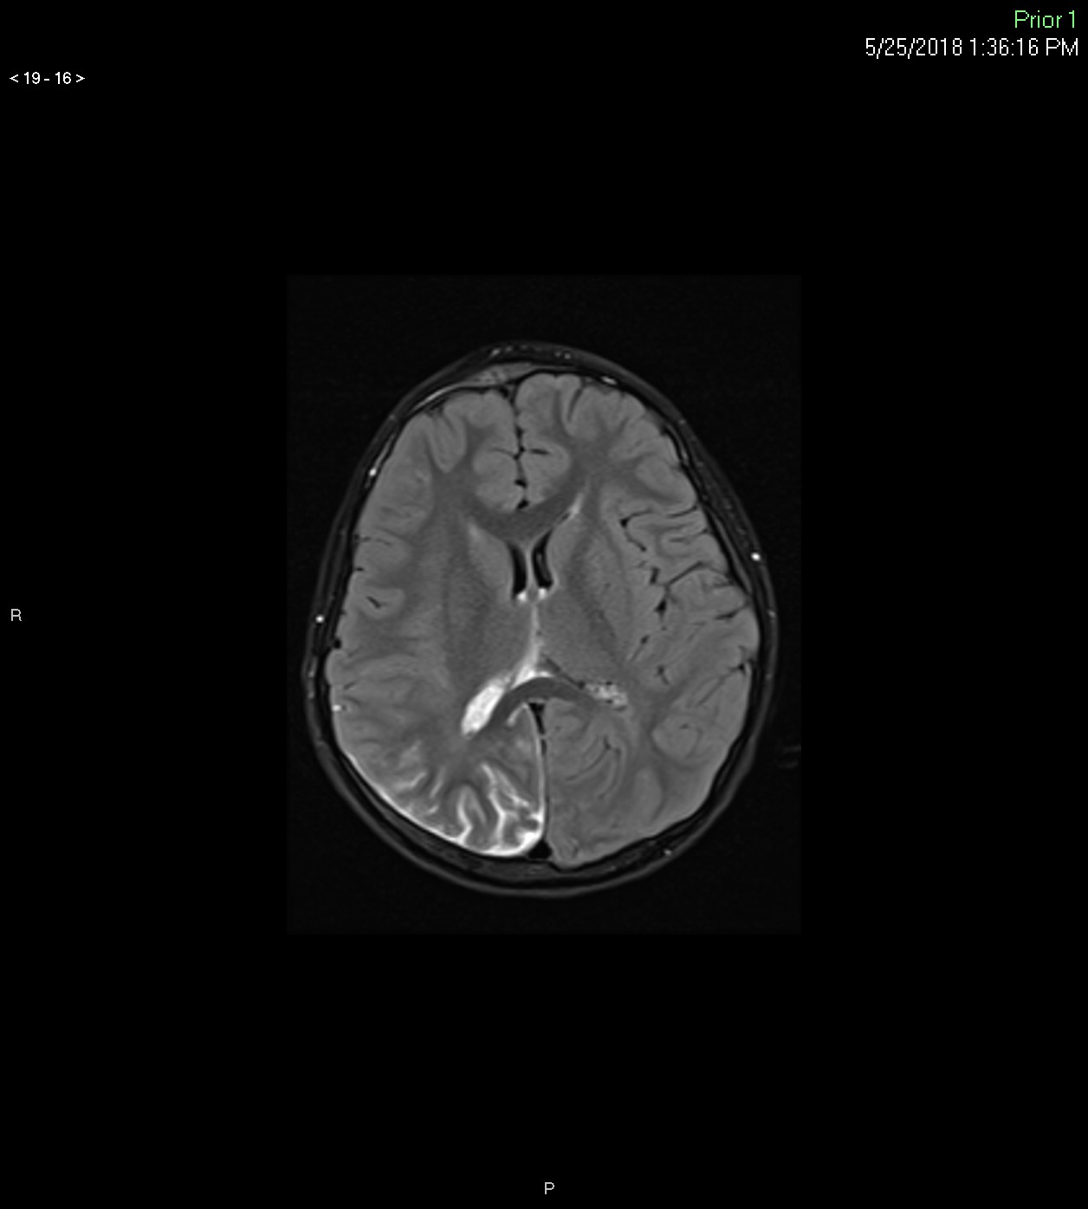

Slide 26
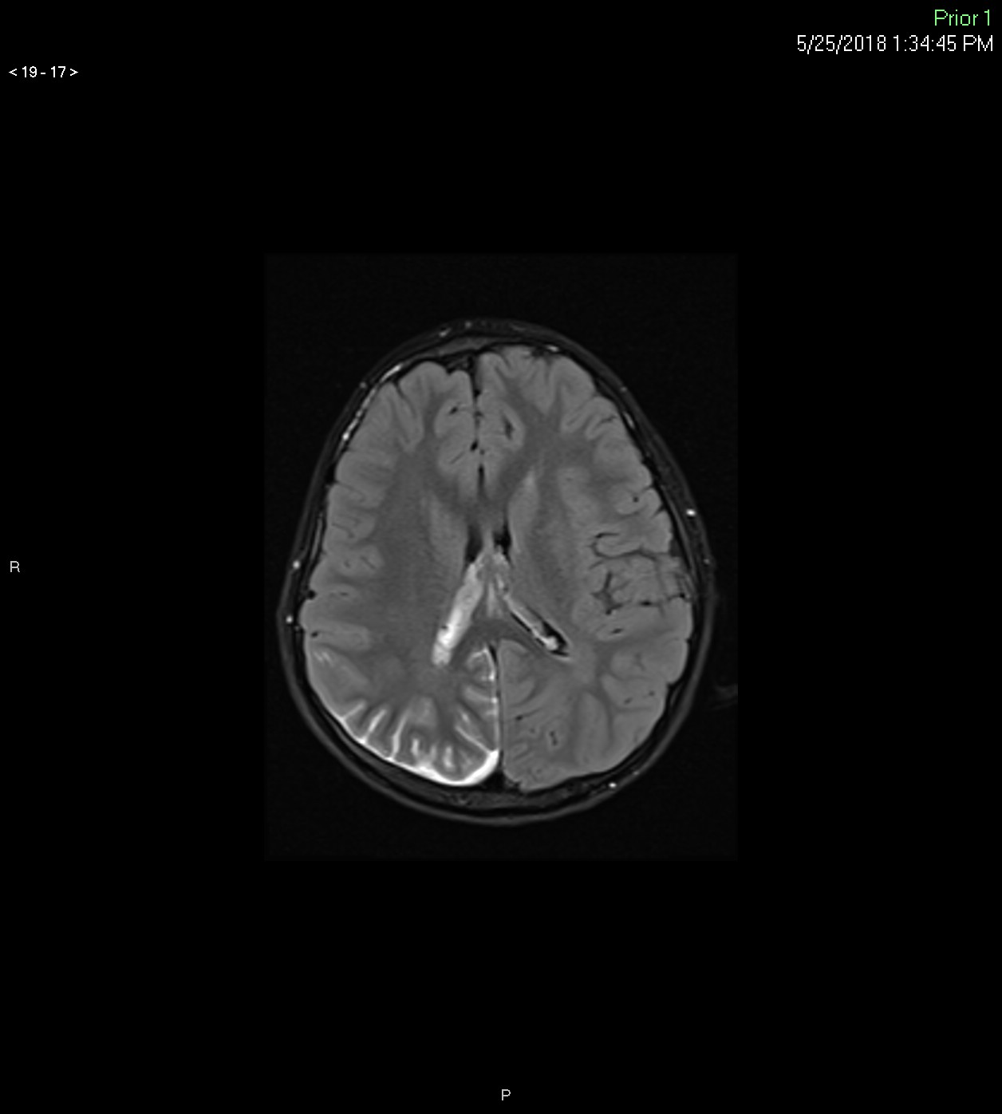

Slide 27
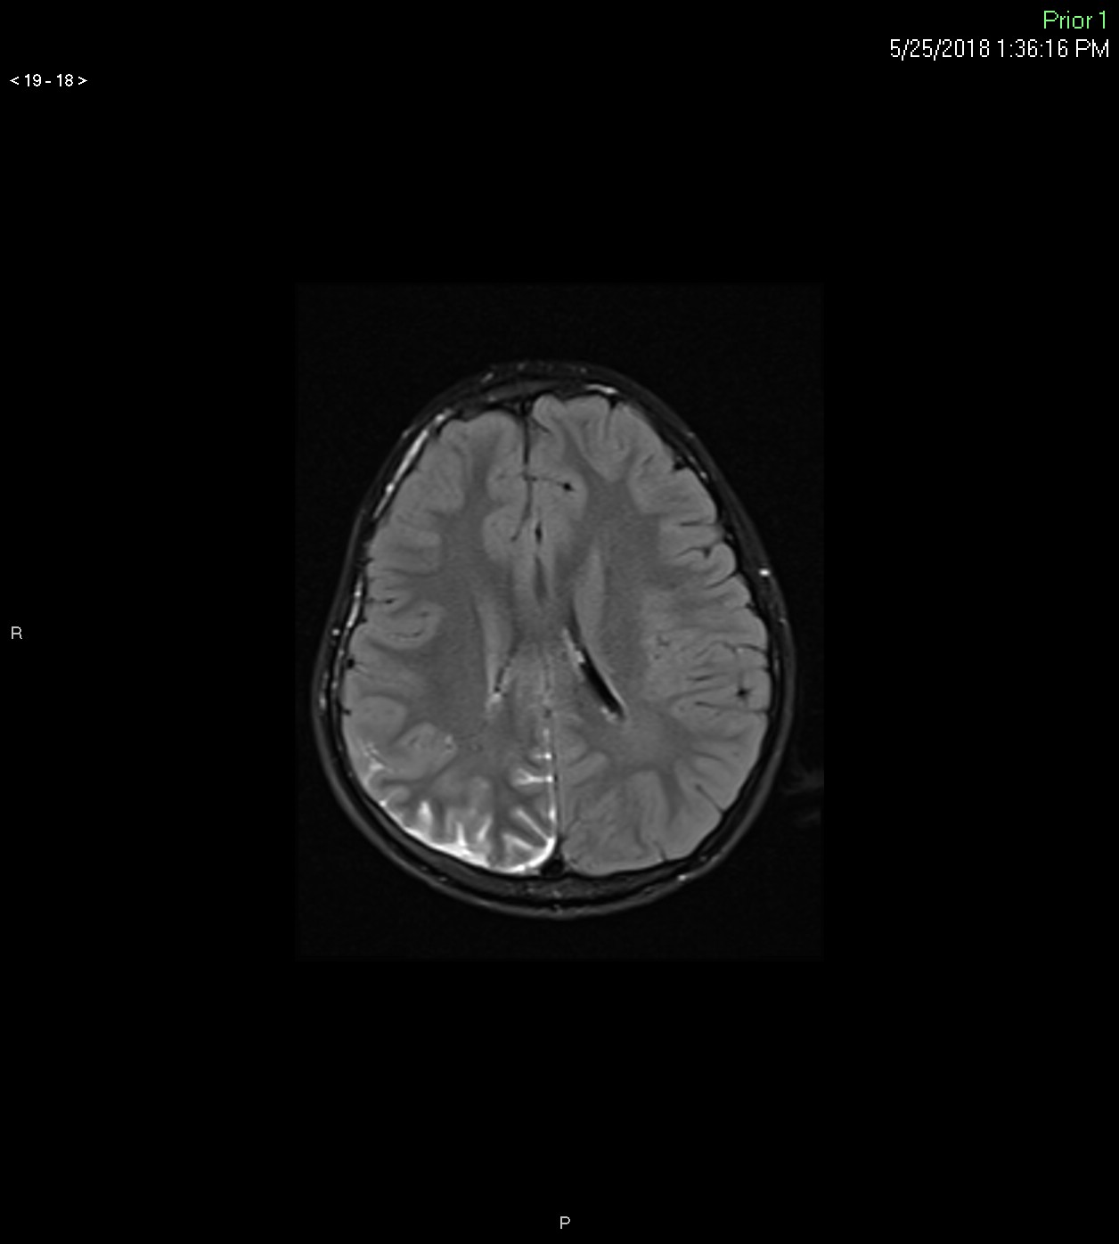

Slide 28
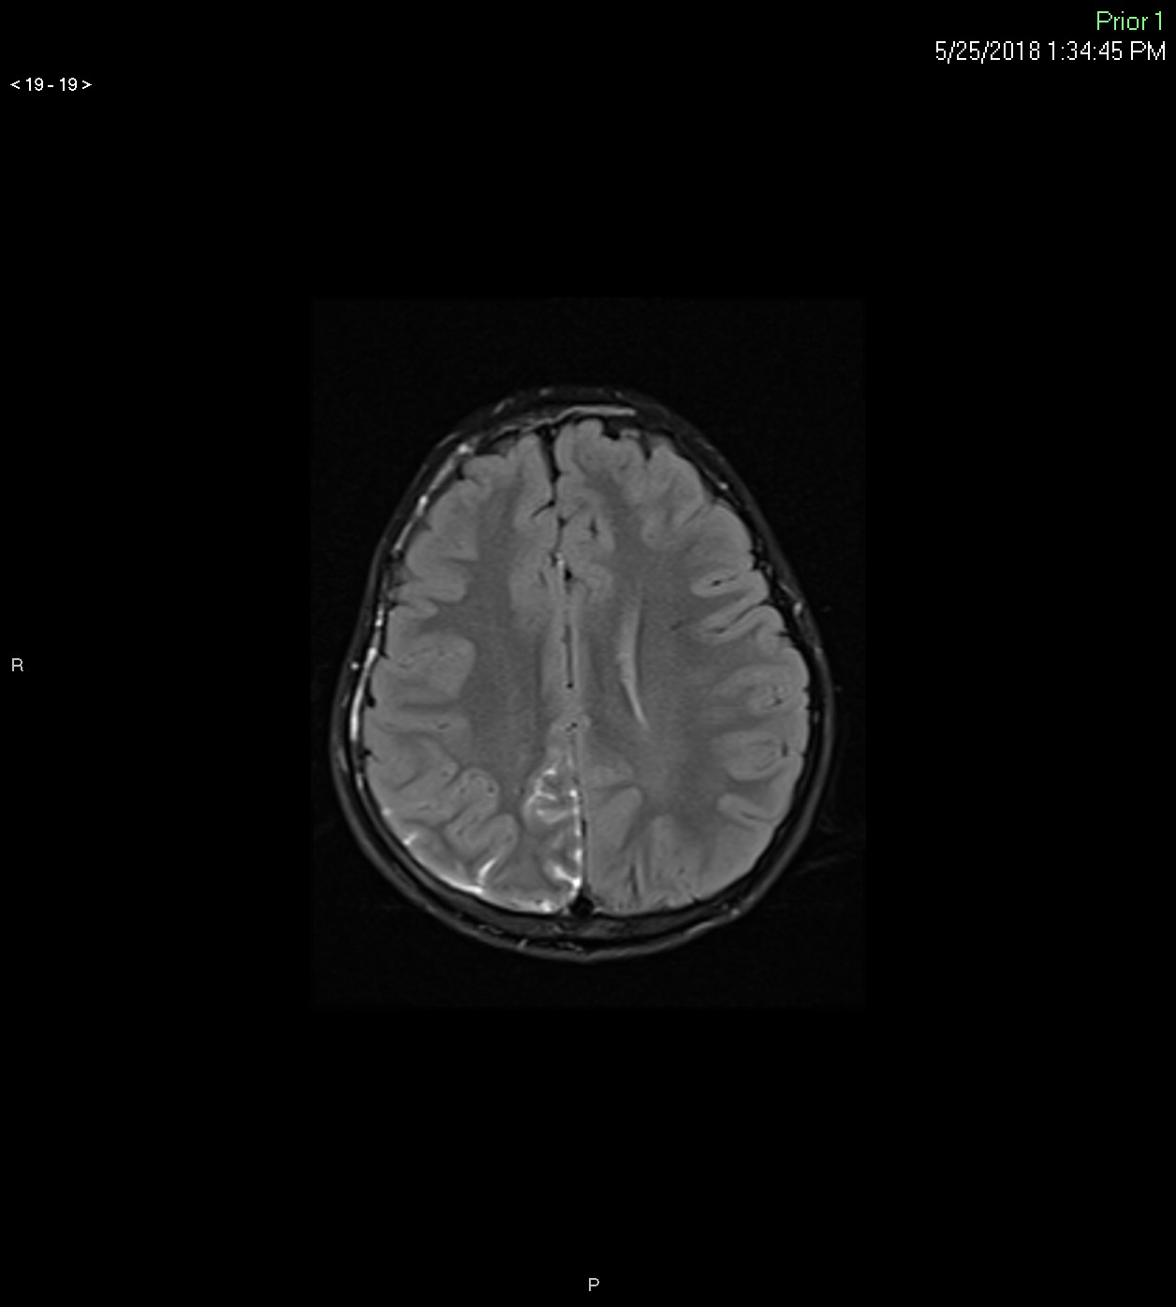

Slide 30
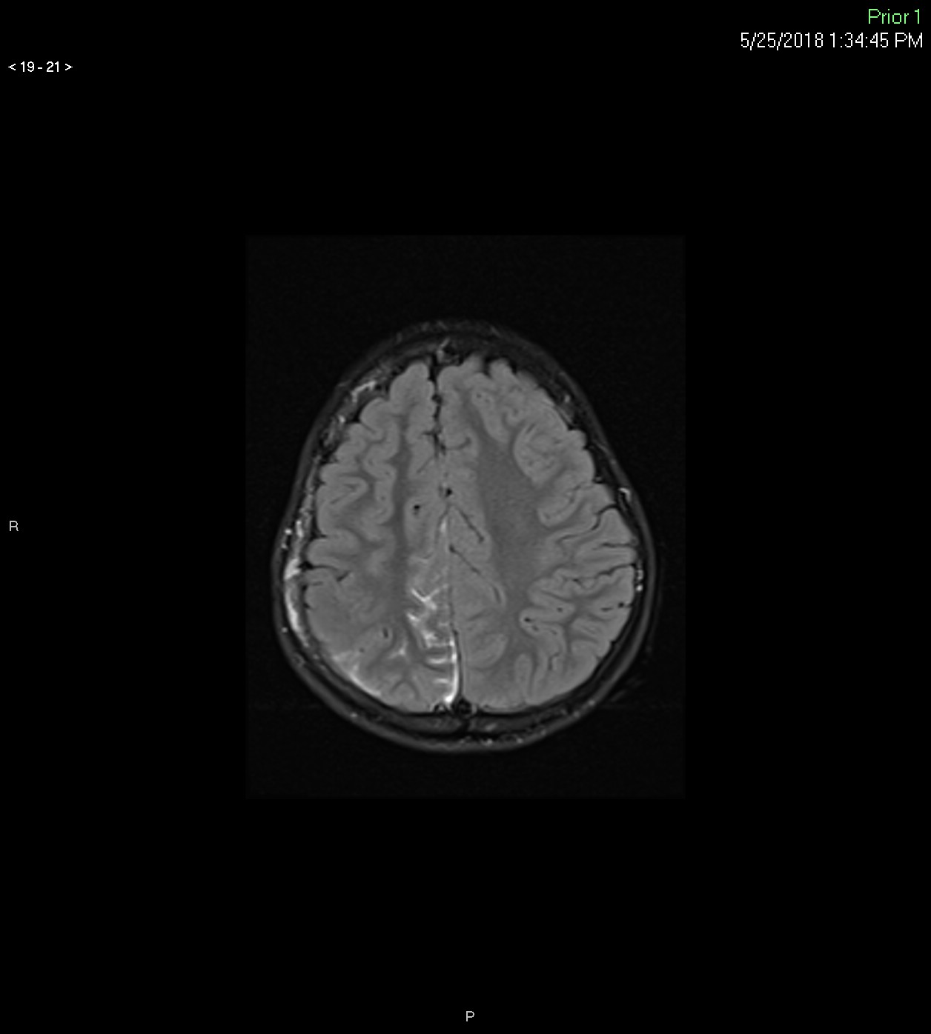

Slide 31
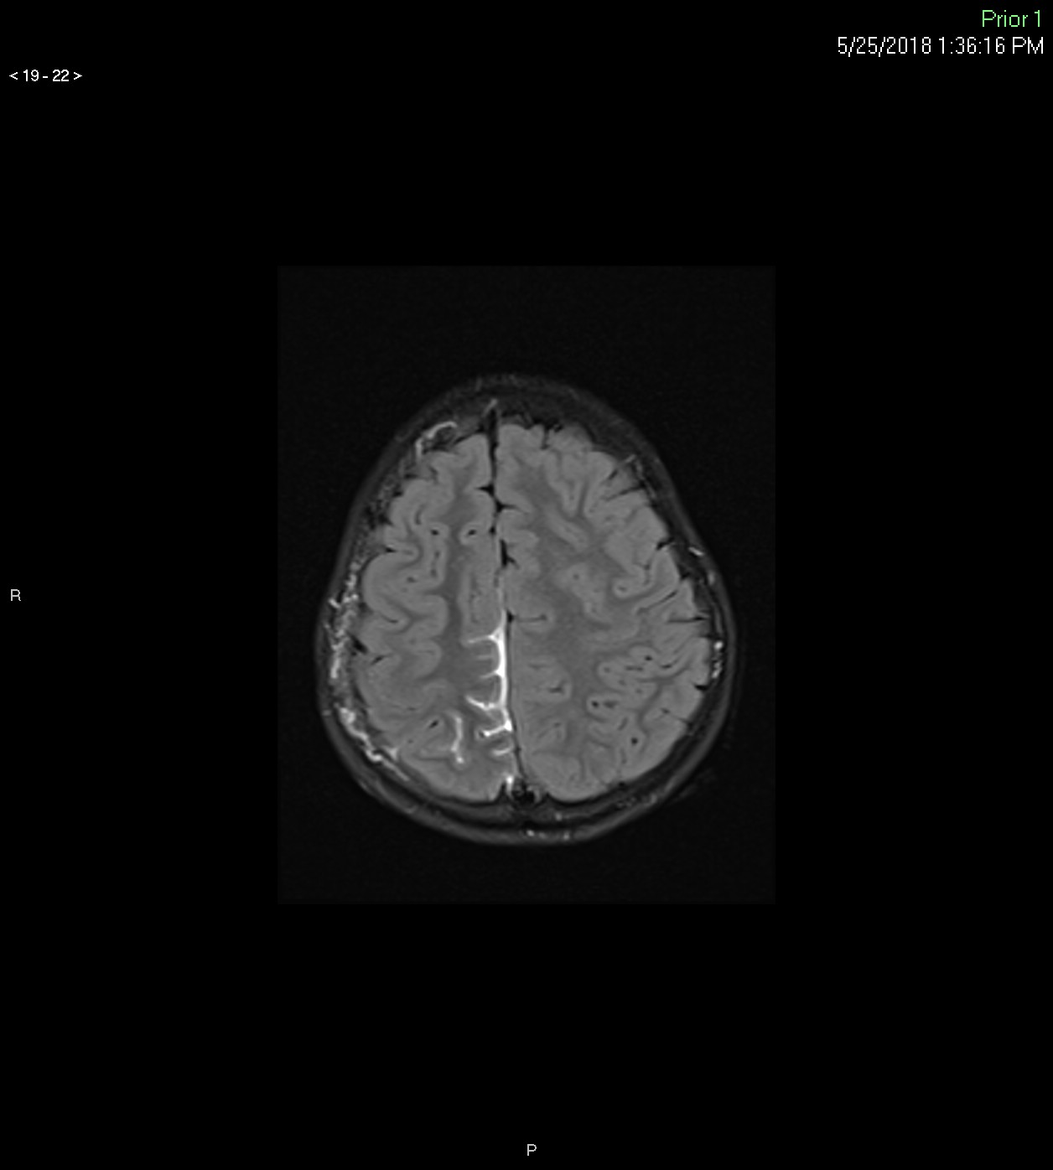

Slide 32
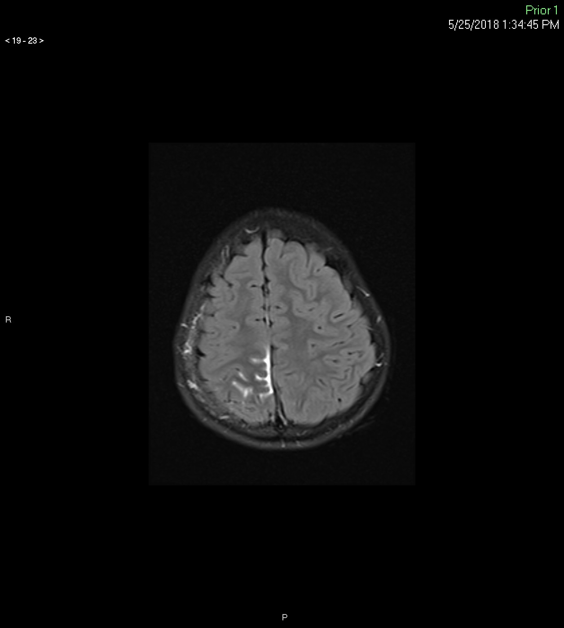

Slide 33
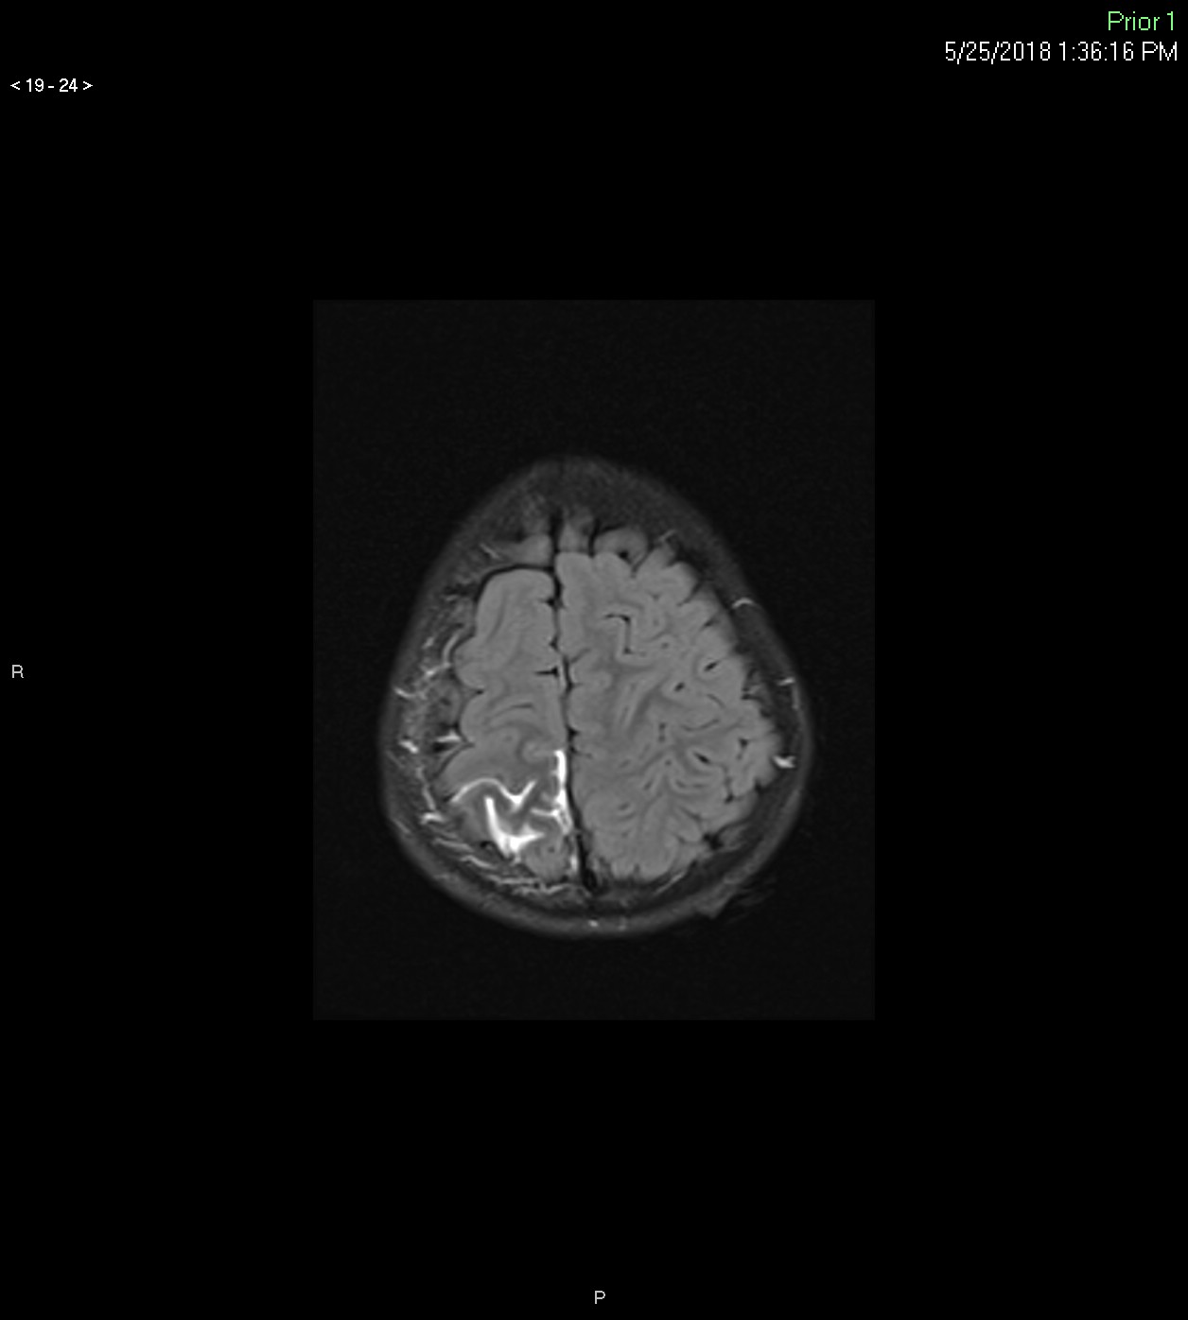

Slide 34
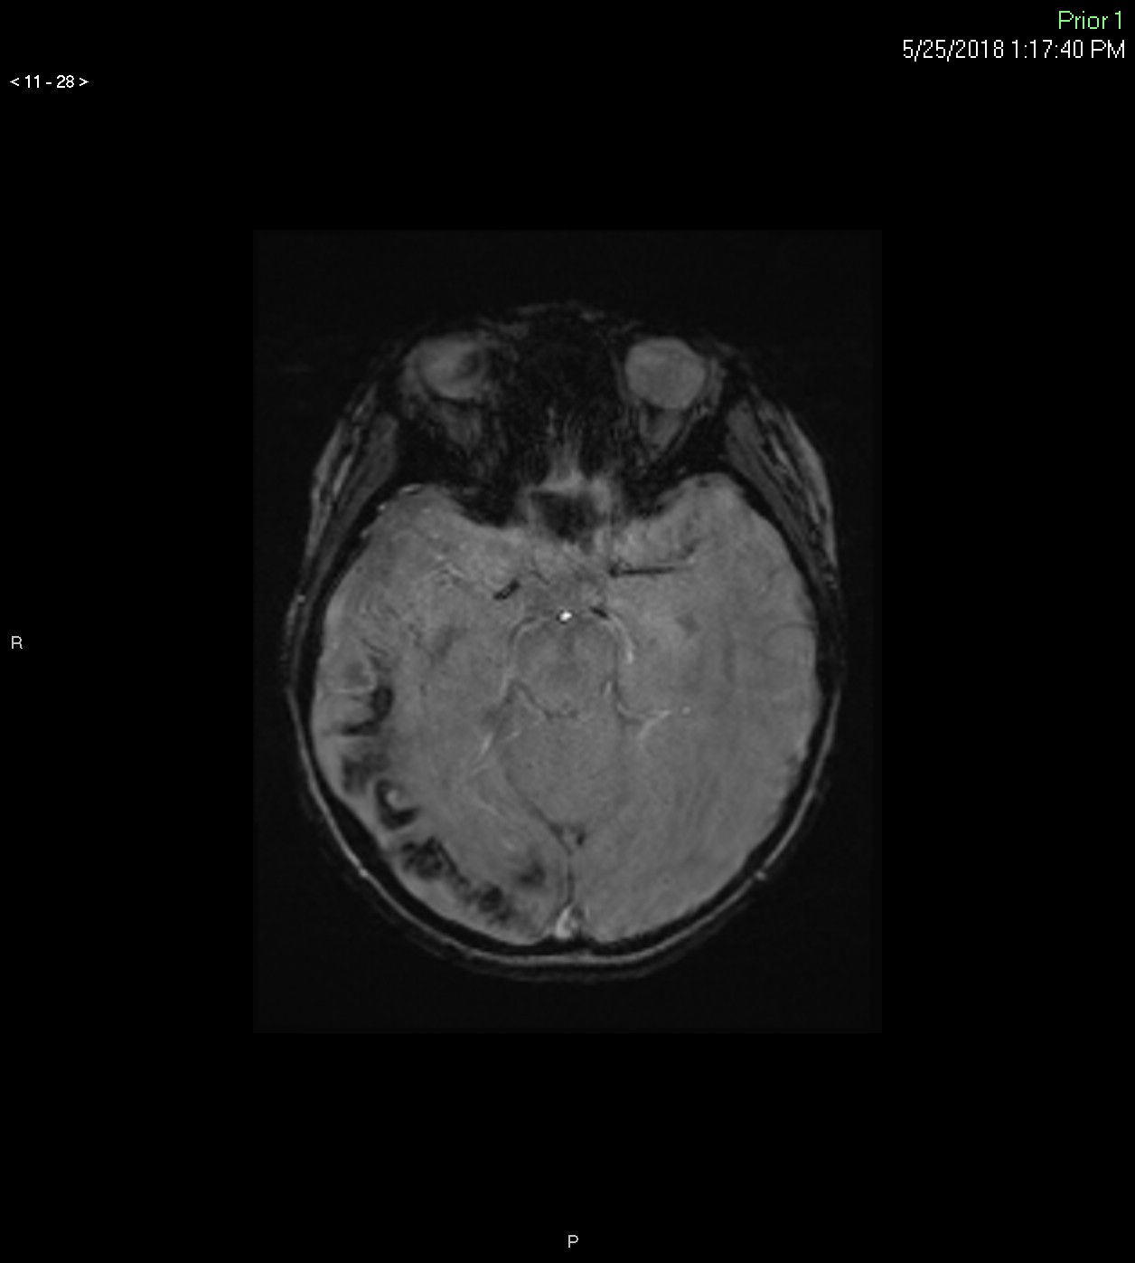
Notes:
8 y

Slide 35
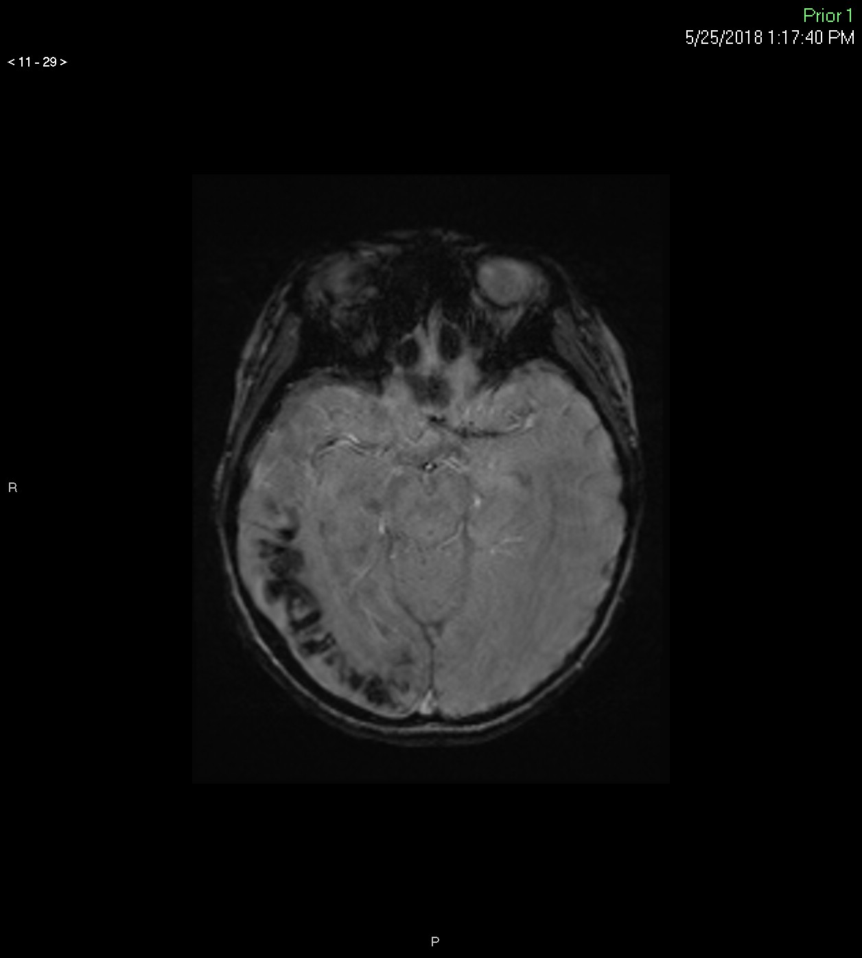

Slide 36
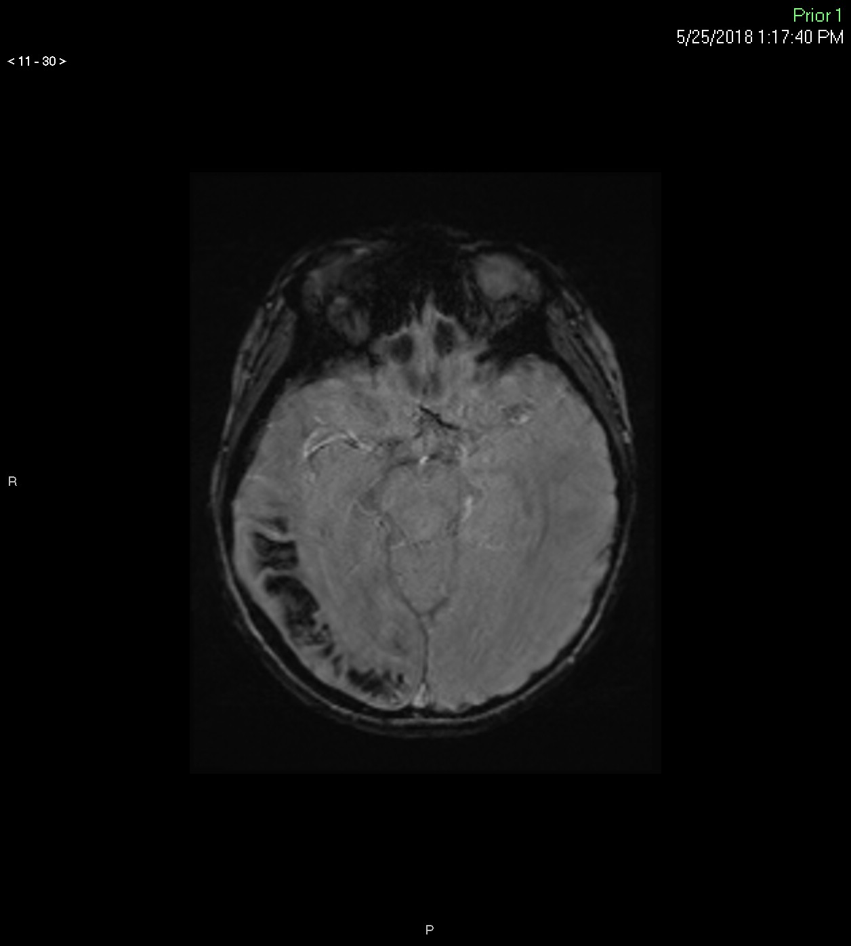

Slide 37
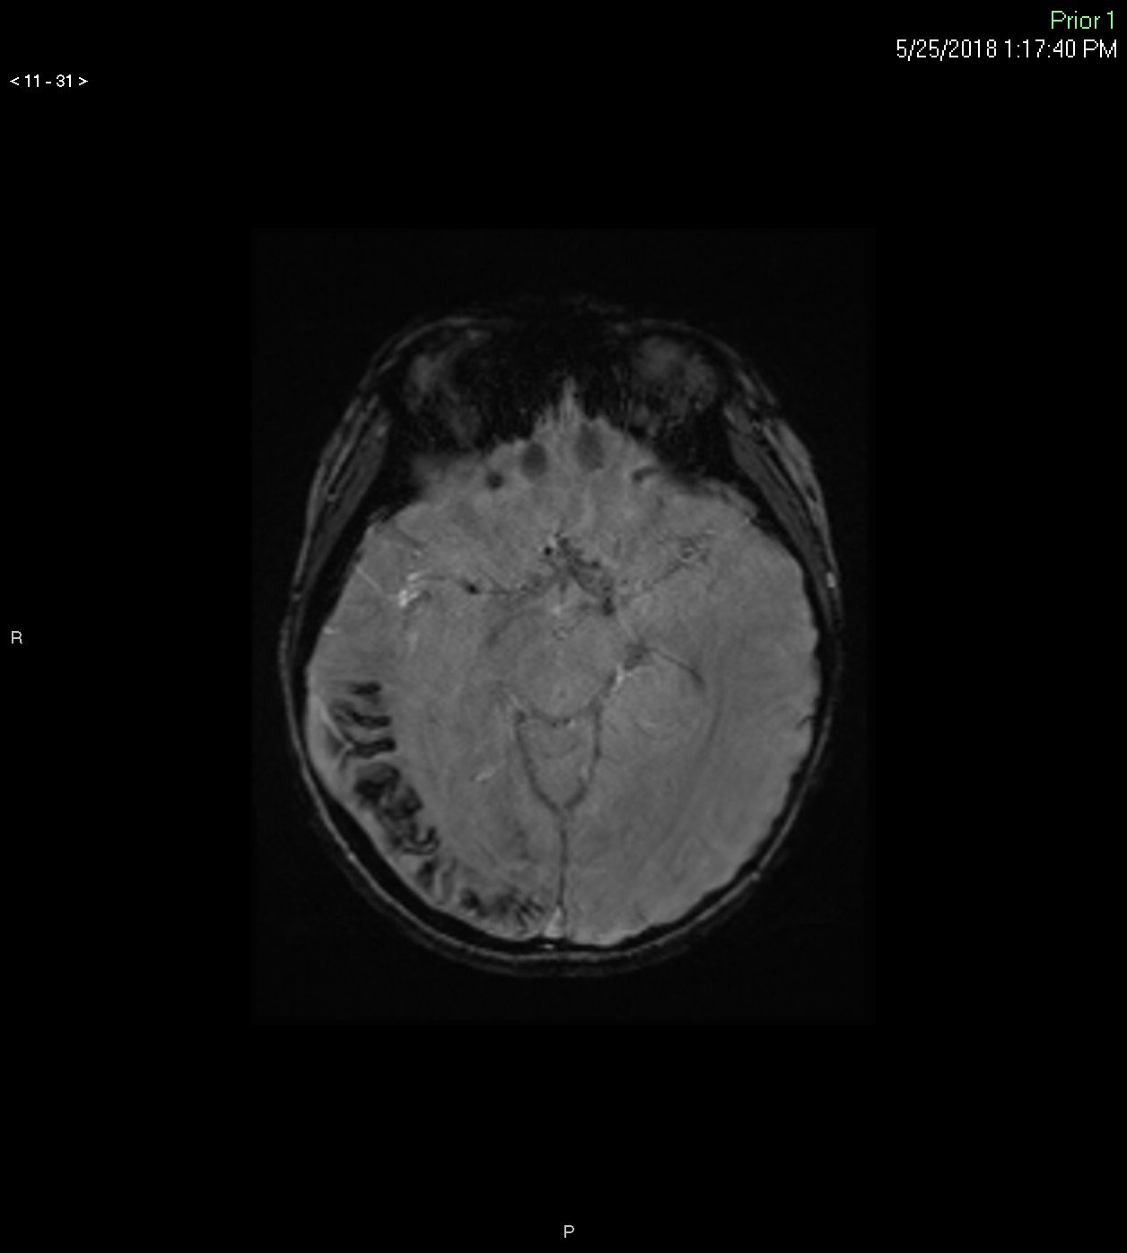

Slide 38
SWI
FLAIR +
5 y

Slide 39
What is the diagnosis?
Neurofibromatosis type I
Sturge-Weber syndrome
Tuberculous meningitis
Posttraumatic injury
Notes:
A is correct

Slide 40
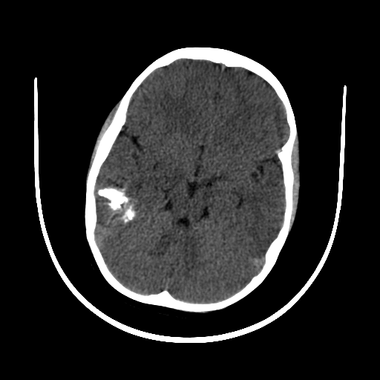
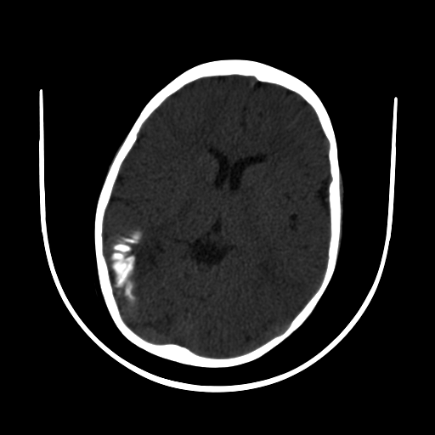
Companion Case 1: Sturge-Weber S.
2 y
Notes:
16; 2 months and 2 years

Slide 41
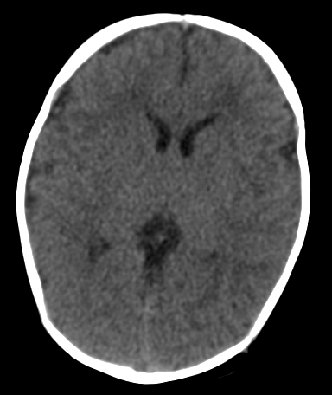
2 y
2 m
Notes:
16; 2 months and 2 years

Slide 42
Sturge-Weber Syndrome
Sturge-Weber-Dimitri
Encephalotrigeminal angiomatosis

Slide 43
Sturge-Weber Syndrome
Abnormal formation of cortical veins
Progressive venous occlusion and chronic venous ischemia
80% unilateral

Slide 44
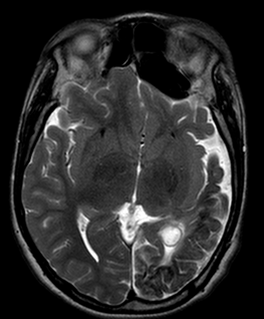
14 y
Notes:
19; 14 year old; uveal hemangioma

Slide 45
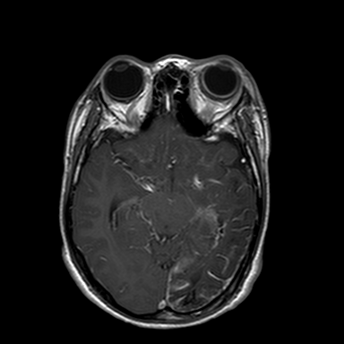
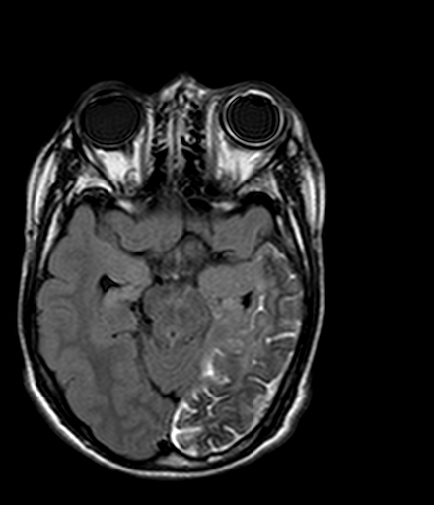
T1+
FLAIR+
14 y
Notes:
19; 14 year old; uveal hemangioma

Slide 46
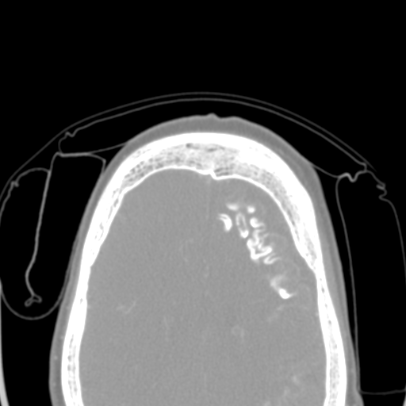
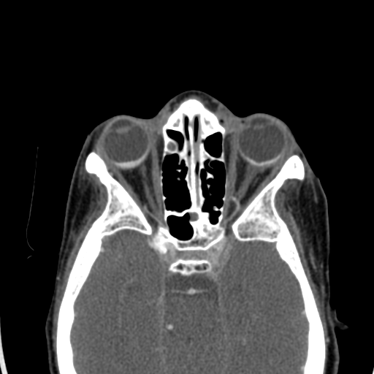
17 y
Notes:
21; 17 year old; choroideal hemangioma

Slide 47
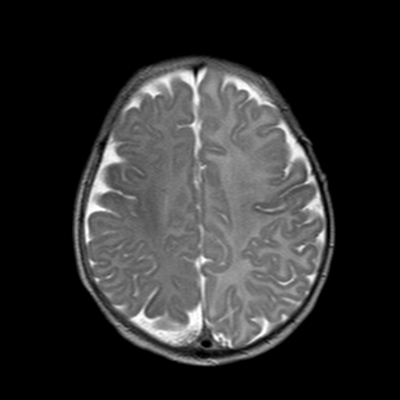
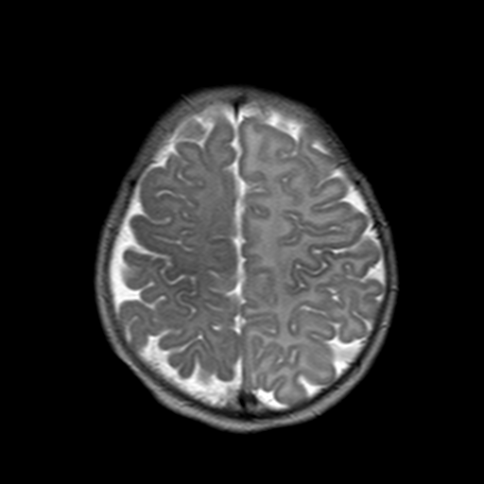
“Accelerated” myelination
1 m
Notes:
32; 1 month old, ‘accelerated myelination”

Slide 48
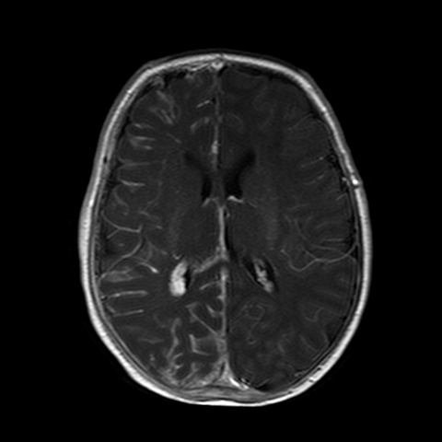
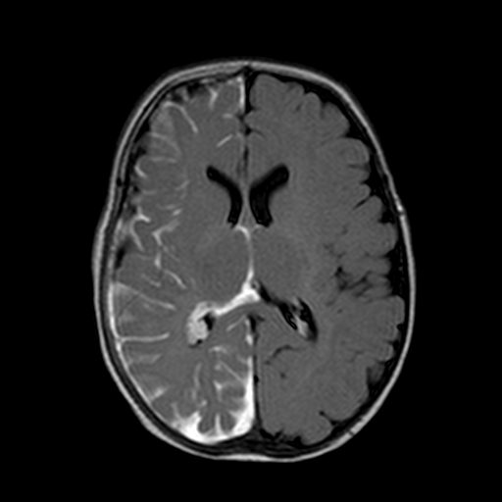
T1+
FLAIR+
Notes:
32; 1 month old, ‘accelerated myelination”

Slide 50
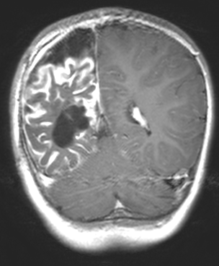
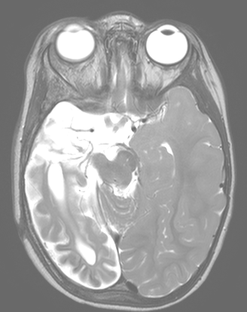
2 y
Notes:
2 years old

Slide 51
Tram track calcifications
7 y
Notes:
845861, SW

Slide 52
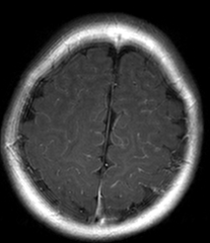
T2
T1+
FLAIR+
3 m
Notes:
54; 3 months;

Slide 53
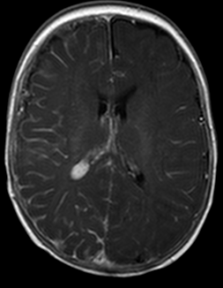
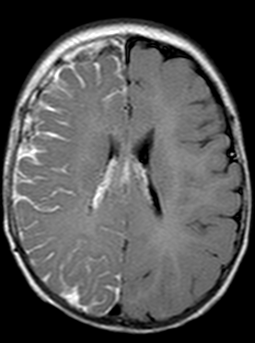
T1+
FLAIR+
4 m
Notes:
56; 4 month old;

Slide 54
2

Slide 55
T1
T2
T2*
5 w
Abnormal cranial US

Slide 56
What is this lesion called?
Subependymal cyst
Connatal cyst
Porencephalic cyst
Arachnoid cyst
Notes:
A is correct

Slide 57
2 m
+4 months
Subependymal Cyst

Slide 58
2 w
Abnormal US
Connatal Cyst

Slide 59
5 d
Abnormal
US
Connatal Cyst
+11 months

Slide 60
Connatal Cyst
Subependymal Cyst
Epelman et al. Radiographics 2006

Slide 61
3

Slide 62
2 d, term
SWI
DWI

Slide 70
Hematoma is
Parenchymal
Subpial
Subarachnoid
Subdural
Notes:
B is correct

Slide 71
Subpial hematoma

Slide 72
Companion Case
Subpial Hematoma
3 d, term

Slide 73
4

Slide 74
T2
3 y, M
Left CN3 palsy
Notes:
3120878; 3 year-old male

Slide 75
STIR
Notes:
3120878; 3 year-old male

Slide 76
T1
Notes:
3120878; 3 year-old male

Slide 77
STIR
T1+ fs

Slide 78
What is the next step in management?
FDG Positron emission tomography
Follow-up
Biopsy
Assurance
Notes:
D

Slide 79
Vidian Canal
STIR
T1+ fs
Arrested Sphenoid Sinus Pneumatization

Slide 80
Vidian Canal
STIR
T1+ fs
Fibrofatty “lesion” of the sphenoid bone

Slide 81
6 y, M
Notes:
1269095, 6-year-old male

Slide 82
T2
T2
T1
6 y, M

Slide 83
2 y, M
Notes:
3182558, arrested sphenoid sinus pneumatization, 2 year old, male

Slide 84
2 y, M
T2
T1

Slide 85
5

Slide 86
2 d, M

Slide 95
2 d, M
Notes:
1484098, piriform aperture stenosis

Slide 96
Imaging findings are consistent with
Congenital nasal piriform aperture stenosis
Pierre Robin sequence
Choanal atresia
Cleft palate
Notes:
A

Slide 97
4 mm
Normal: 13 mm
Belden et al. Radiology 1999
Piriform (Pyriform) Aperture Stenosis

Slide 98
Central Single Megaincisor
4 m, M
Piriform Aperture Stenosis
Notes:
3189034, 4 month-old, male

Slide 100
2 d, M
Choanal Atresia
Notes:
3073520, choanal atresia

Slide 101
Choanal Atresia
Piriform Aperture
Stenosis
Notes:
3073520, choanal atresia

Slide 102
Choanal
Atresia
Piriform Aperture
Stenosis
Notes:
3073520, choanal atresia

Slide 104
3 m, F
Notes:
3693778, 3 month old female

Slide 109
6

Slide 110
16 m, M
Notes:
cavernous sinus 1535669 16 m

Slide 115
The most acute concern for this patient is
Cavernous sinus thrombosis
Brain abscess
Hearing loss
Mastoiditis
Notes:
A

Slide 116
Cavernous Sinus Thrombosis

Slide 117
+2 days

Slide 118
+2 years

Slide 120
5 y, M

Slide 121
5 y, M
Notes:
3389623

Slide 124
T2
T2

Slide 127
FLAIR
FLAIR +

Slide 128
FLAIR
FLAIR +

Slide 129
7

Slide 130
3 y, M
Notes:
1284482, male, DOB 4/7/2004

Slide 131
What is the diagnosis?
Retinoblastoma
Coats disease
Persistent fetal vasculature
Phthisis bulbi
Notes:
A

Slide 132
3 y, M
RETINOBLASTOMA!!!
Notes:
1284482, male, DOB 4/7/2004

Slide 133
+9 months

Slide 135
STIR
STIR

Slide 136
DWI
ADC

Slide 137
T1+
T1+

Slide 138
+22 months
T1+
T1+

Slide 139
Companion Case 1: Retinoblastoma
4 y, M
7/2020
Notes:
4634833, 4 y E; 7/20

Slide 140
Notes:
4634833, 4 y E; 7/20

Slide 141
9 months earlier
Notes:
12/19

Slide 142
Companion Case 2: Retinoblastoma
6 y
9/2020
Notes:
3696205, 6 y M, 9/2020

Slide 143
17 months earlier
Notes:
4/20/2019

Slide 144
Persistent Fetal Vasculature
Chung et al. Radiographics 2007

Slide 145
Persistent Fetal Vasculature
2 y
Notes:
1498504, PHPV

Slide 146
Persistent Fetal Vasculature
5 y
Notes:
1351744, PHPV, coloboma, retinal detachment

Slide 147
Persistent Fetal Vasculature
2 y
Notes:
3973368, PHPV, 2 y F

Slide 148
Persistent Fetal Vasculature
2 y

Slide 149
Persistent Fetal Vasculature
8 y
Notes:
PFV, 3252106; 8 y, f

Slide 150
Persistent Fetal Vasculature
8 y

Slide 151
Coats Disease
Subretinal exudate with retinal detachment
Affected eye slightly smaller than normal eye
Typical V-shaped contour of retinal detachment

Slide 152
3 y
Coats
Notes:
3612382, 3 year old, male; Coats

Slide 153
3 y
Coats
Notes:
3612382, 3 year old, male; Coats

Slide 154
Subfoveal nodule
Coats

Slide 155
Phthisis Bulbi
15 y
Notes:
4697509, 15 y M

Slide 156
8

Slide 157
T1
STIR
13 y, F

Slide 158
STIR
DWI
ADC
13 y, F

Slide 159
T1+ fs
T1+ fs
13 y, F

Slide 160
13 y, F
Notes:
3021636, 13-year-old female

Slide 161
What is the most likely diagnosis?
Dermoid
Hemangioma
Pilomatricoma
Rhabdomyosarcoma
Notes:
C

Slide 162
~12% underwent imaging (of 623 lesions)
~3% pilomatricoma in clinical indication
~13% pilomatricoma in radiology DDx
Bulman,…,Koral AJR 2016
Notes:
623 specimens

Slide 163
10 y, M
Pilomatricoma, a.k.a Pilomatrixoma

Slide 164
T1+ fs
STIR
T1
3 y, F
Pilomatricoma
DWI

Slide 165
STIR
T1
T1+ fs
12 y, M
Pilomatricoma

Slide 166
9 y, F

Slide 168
9 y, F

