Slide 2
Pediatric Neuroradiology and
Head-Neck Imaging
Korgün Koral, MD, MBA

Slide 3
Congenital Brain Malformations
Macrocephaly & Hydrocephalus
Sellar & Suprasellar Region
Supratentorial Tumors
Infratentorial Tumors
Head & Neck
Congenital Spinal Malformations

Slide 4
Congenital Brain Malformations
Macrocephaly & Hydrocephalus
Sellar & Suprasellar Region
Supratentorial Tumors
Infratentorial Tumors
Head & Neck
Congenital Spinal Malformations

Slide 5
21

Slide 6
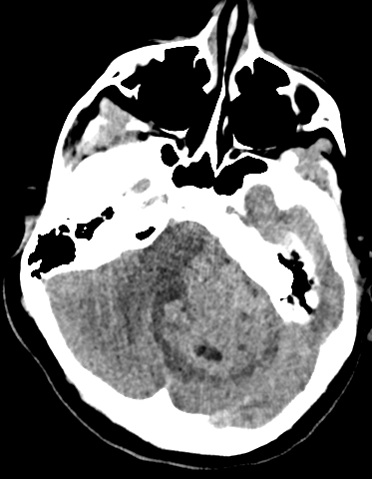
10 y
Notes:
3418661, 10 y, F; Medulloblastoma, Nodular/desmoplastic with anaplastic/large cell features, SHH-activated, WHO grade 4
TP53-wildtype

Slide 7
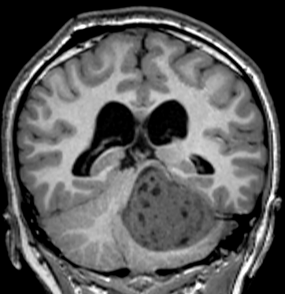

Slide 8
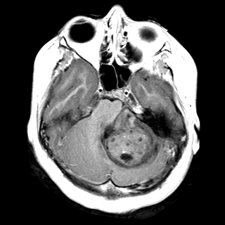
FLAIR
T1+

Slide 10
DWI
ADC
Desmoplastic/ Nodular MB
SHH activated

Slide 12
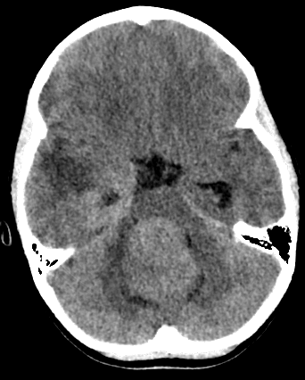
9 y
Notes:
3768181, 9 y, M; Medulloblastoma, NEC (see comment)
WHO grade 4
Desmoplastic/nodular histology
YAP-1 equivocal, GAB-1 negative, Beta-catenin negative for nuclear staining (by immunohistochemistry)

Slide 13
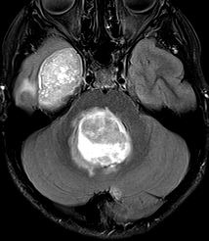
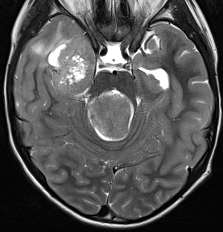
Desmoplastic/ Nodular
Medulloblastoma, NEC

Slide 14
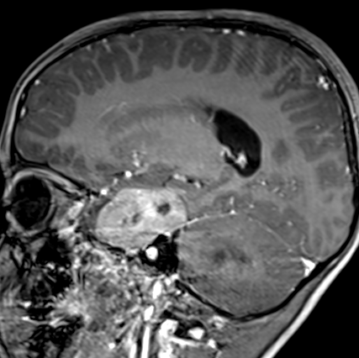
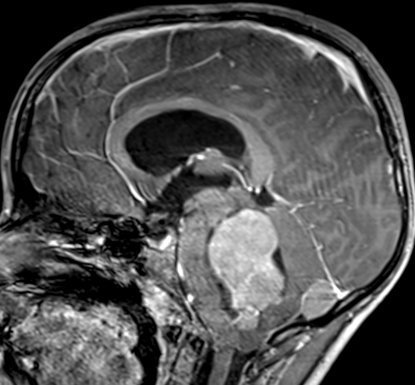
Desmoplastic/ Nodular
Medulloblastoma, NEC

Slide 15
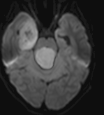
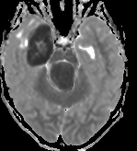
Desmoplastic/ Nodular
Medulloblastoma, NEC

Slide 17
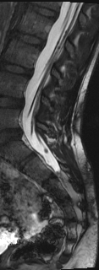
truFISP/ CISS
FIESTA
BFFE

Slide 18
Medulloblastoma
3/8 of pediatric cerebellar tumors
WHO grade 4
Midline (>90%), fourth ventricle
Spinal drop metastases (1/3)
Intracranial leptomeningeal dissemination

Slide 19
Medulloblastoma

Slide 20
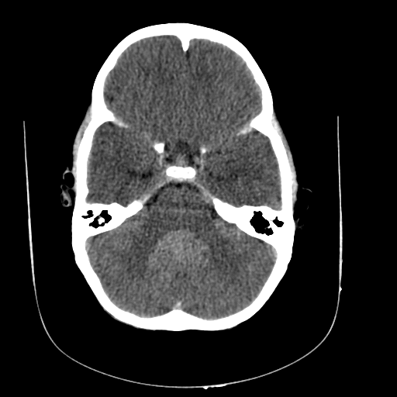
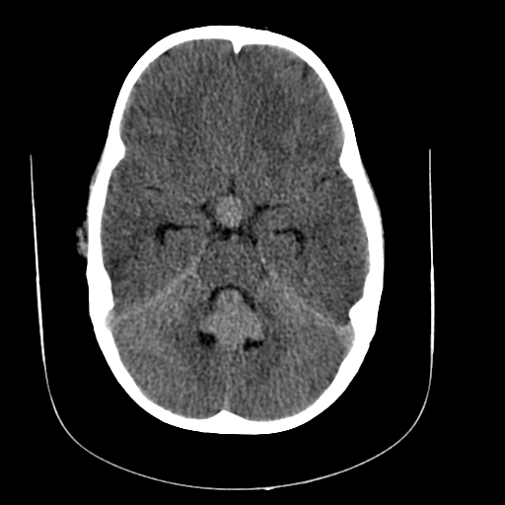
2 y
Notes:
49 from teaching file

Slide 21
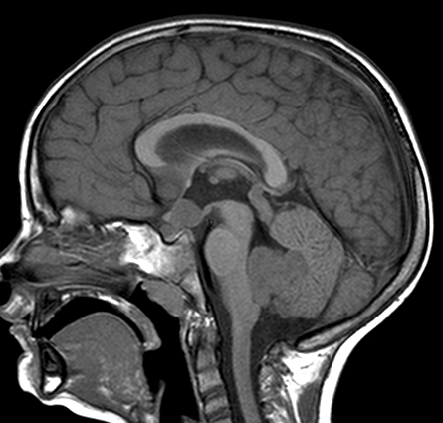

Slide 22
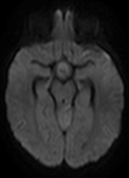
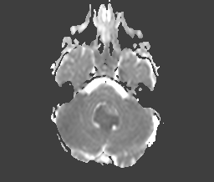
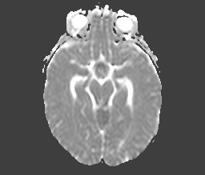

Slide 23
Medulloblastoma
Prediction of prognosis
Metastatic stage at diagnosis
Residual tumor post resection (< 1.5 cm²)
Histological subtype

Slide 24
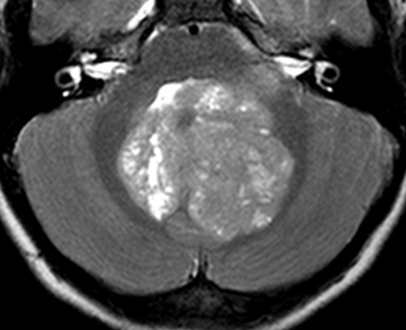
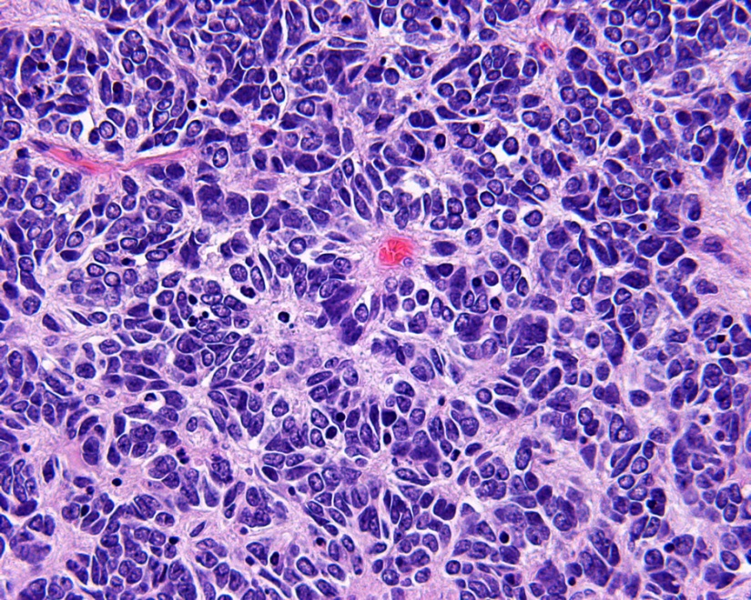
Medulloblastoma
10 y, F
Koral et al. Radiology 2013

Slide 25
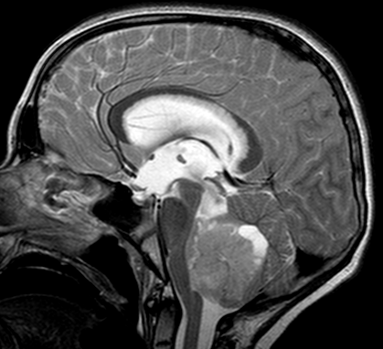
9 y

Slide 26
+4 years

Slide 27
07/28
10/27
01/27
Notes:
3094552, medulloblastoma leptomeningeal spread seen only on FLAIR

Slide 28
Leptomeningeal tumor
Contrast enhanced FLAIR

Slide 29
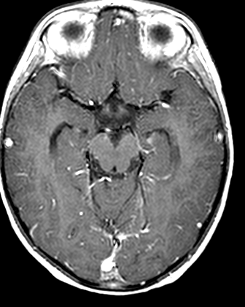
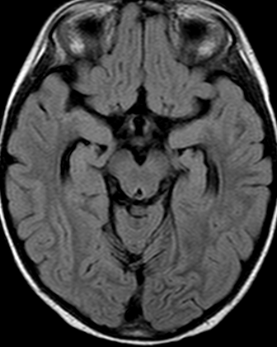
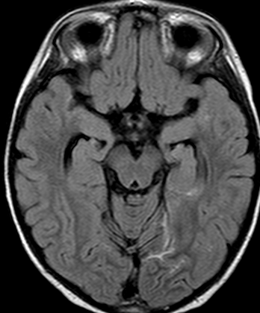
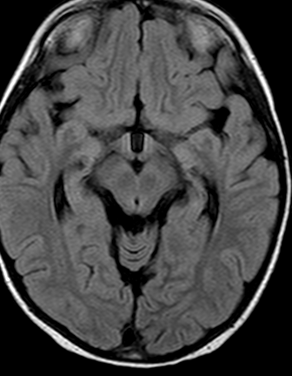
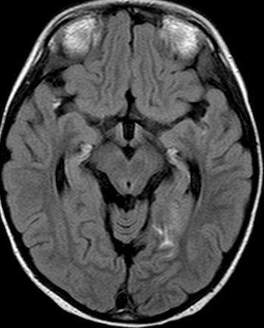
T1 C+
FLAIR
FLAIR C+
Notes:
3094552, medulloblastoma leptomeningeal spread seen only on FLAIR

Slide 30
Medulloblastoma
Heterogeneous tumor group
MEDULLOBLASTOMA (Classic)
Desmoplastic/ nodular MB
MB- extensive nodularity
Anaplastic MB
Large cell MB

Slide 31
Medulloblastoma
Medulloblastomas?
Acta Neuropathol 2012

Slide 32
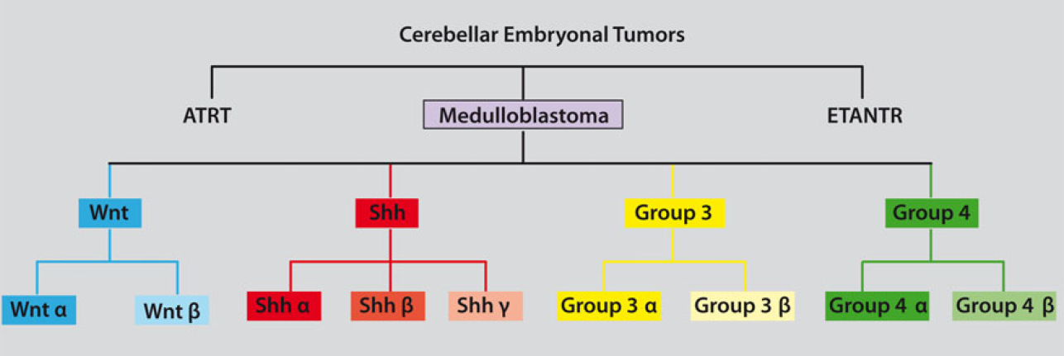
Acta Neuropathol 2012

Slide 33
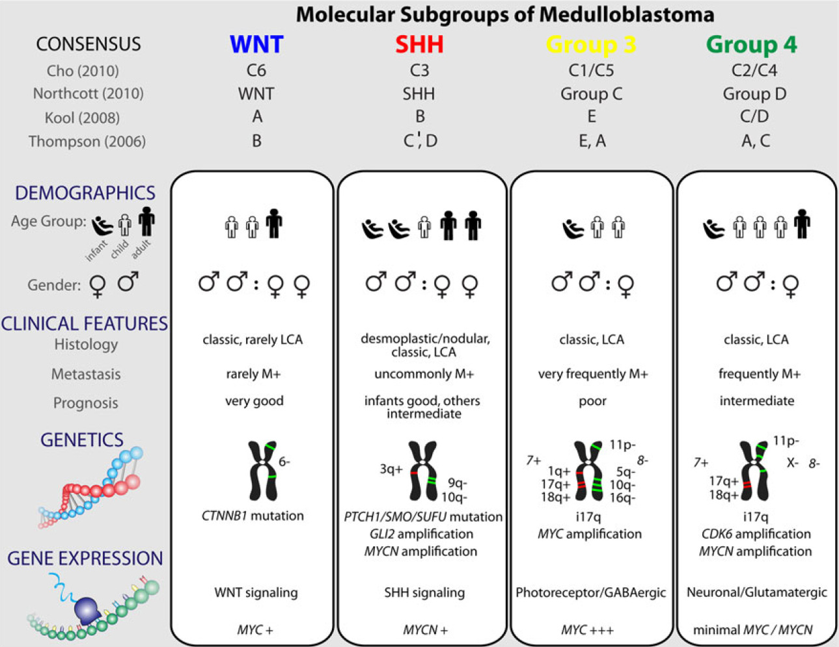
Acta Neuropathol 2012

Slide 34
Molecular Subtypes
Wnt: Cerebellopontine angle
SSH: Cerebellar hemisphere, middle cerebellar peduncle
Group 3 & Group 4: midline
NOS (not otherwise specified)
NEC (not elsewhere classified)

Slide 35
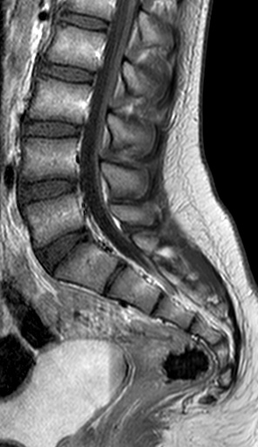
B-FFE, FIESTA, TrueFISP
Notes:
1042497, 13-year-old, female, medulloblastoma

Slide 36
B-FFE, FIESTA, TrueFISP
Notes:
1042497, 13-year-old, female, medulloblastoma

Slide 37
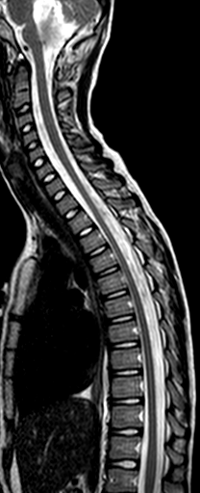
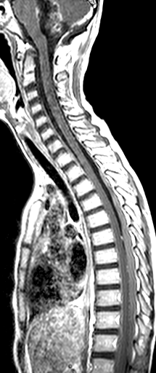
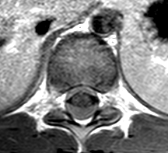
9 y, M
Medulloblastoma
s/p surgery
Avoid immediate
postop spine imaging
Notes:
1085715, 9 y male, medulloblastoma, spine after surgery

Slide 38
Vertebral column
s/p therapy

Slide 39
3/2008
7/2008
12/2008
6/2009
6 y, M
Notes:
1029546, medulloblastoma, radiation changes spine

Slide 40
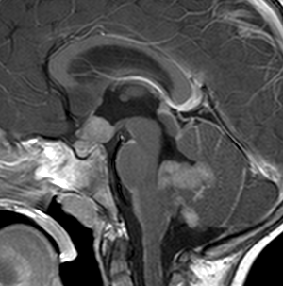
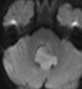
3 y, M
Notes:
3014629, medulloblastoma

Slide 41
12/2008
2/2009
4/2009
10/2009
3/2010
Notes:
3014629, medulloblastoma

Slide 43
22

Slide 44
8 m
AT/RT
Notes:
1536115, AT/RT renal and CNS

Slide 45
Acta Neuropathol 2012
CNS Atypical Teratoid/Rhabdoid Tumor
Worse prognosis than medulloblastoma

Slide 46
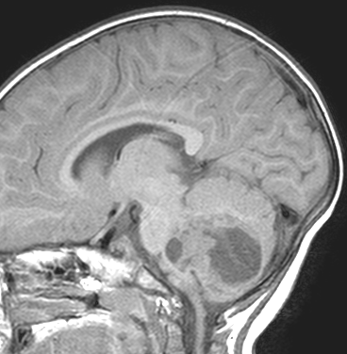
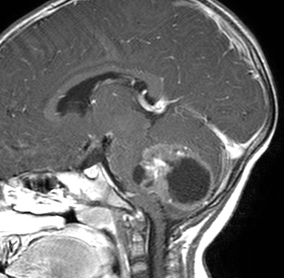
21 m
AT/RT
Notes:
1437267, AT/RT

Slide 47
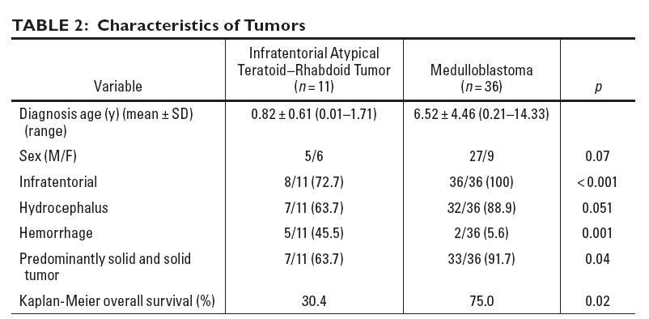
Koral et al. AJR 2008

Slide 48
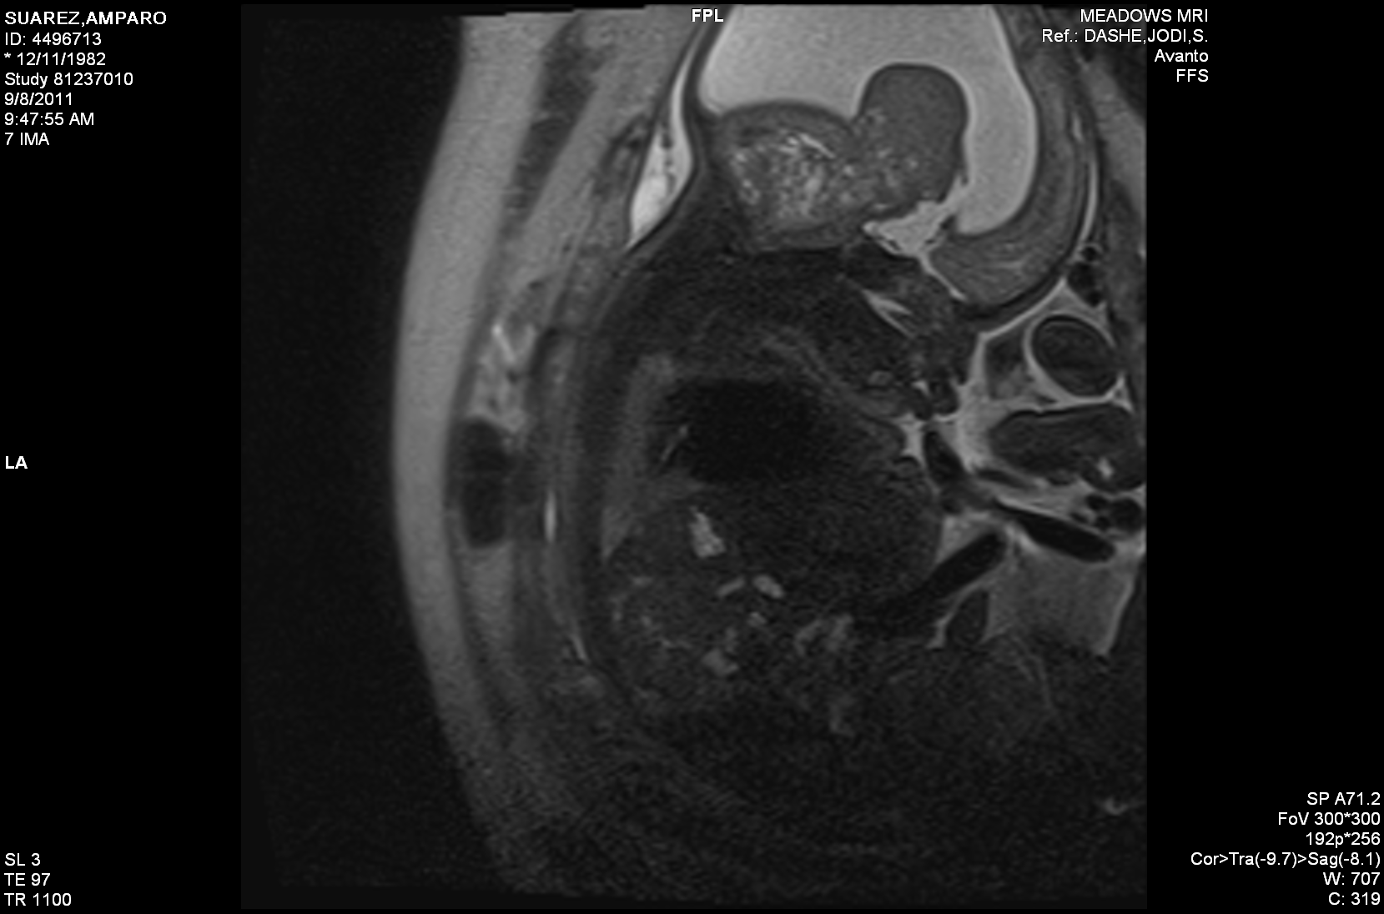

Slide 50
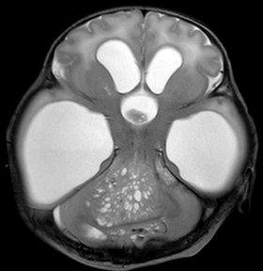
1 d, E
AT/RT
Notes:
3269924,AT/RT

Slide 51
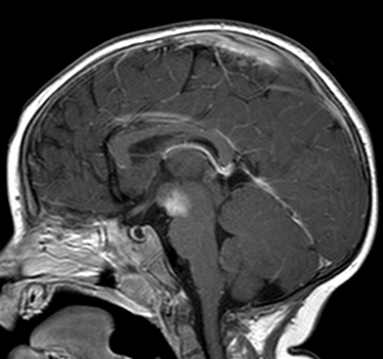
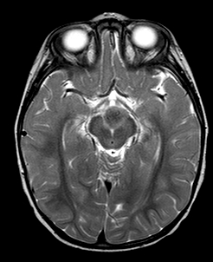
13 m

Slide 53
Oh et al. J Neurooncol 2015

Slide 54
23

Slide 55
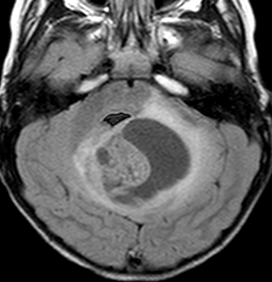
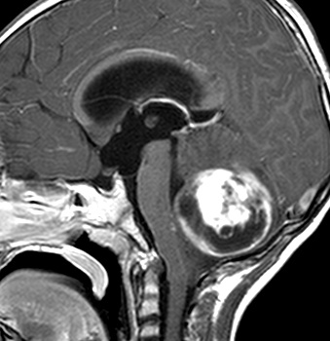
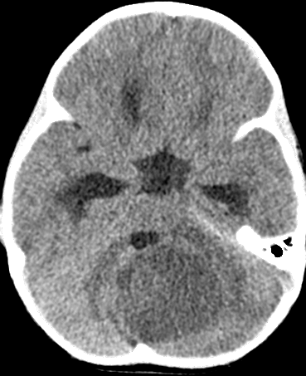
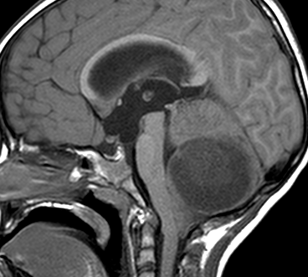
3 y
Notes:
3615146, 3 y/o, PA, F

Slide 56
Pilocytic Astrocytoma
Cerebellar hemispheric
Cystic (50%)
Enhancement of the solid component (50%)
Increased diffusivity (100%)
WHO grade 1

Slide 57
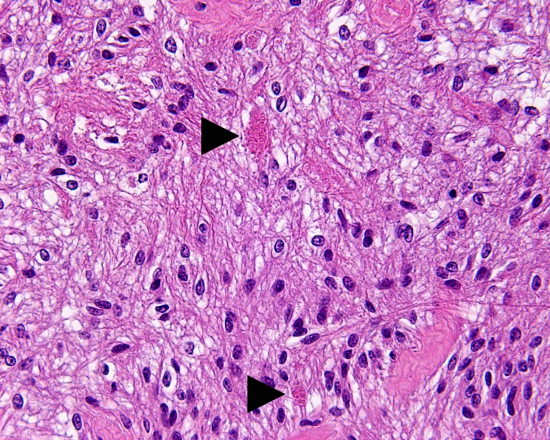
Pilocytic Astrocytoma
10 y, F
Koral et al. Radiology 2013

Slide 58
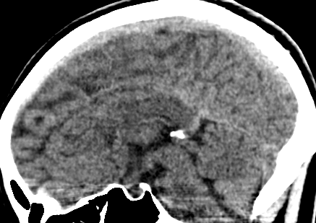
21 y, F
Pilocytic Astrocytoma
Notes:
3553776, 21 y, F; pilocytic

Slide 59
Notes:
1400/600

Slide 60
24

Slide 61
19 m, F
Ependymoma
Notes:
4708127; 19 m, F, ependymoma

Slide 62
19 m, F

Slide 63
19 m, F
Ependymoma

Slide 64
19 m, F
Ependymoma

Slide 65
Ependymoma
Spreads at the surfaces of the cerebellum and brain stem
Involvement of foramina Luschka and Magendie
WHO grade 2 and 3
v
PF-A (lateral): worse
PF-B (midline): better

Slide 66
8 y, M
Notes:
1176331, 8 y, male

Slide 67
2 y
Ependymoma
Notes:
1557876, 2 y, ependimoma

Slide 68
2 y
Ependymoma
Notes:
1557876, 2 y, ependimoma

Slide 69
Koral et al. Neuroradiology 2014

Slide 70
25

Slide 71
7 y, M
Diffuse Midline Glioma – WHO 2016
DIPG- Diffuse intrinsic pontine glioma

Slide 72
7 y
Diffuse Midline Glioma
H3-K27M mutation
Notes:
3257922, 7 y/o, M

Slide 74
10 y, F
Notes:
4573067, 10 y; F

Slide 75
1/2021
3/2021
7/2021
Notes:
1/16/2021; 3/9/2021; 7/6/2021

Slide 76
1/2021
3/2021
7/2021
Notes:
1/16/2021; 3/9/2021; 7/6/2021

Slide 77
8/2021
Diffuse Midline Glioma
H3-K27M mutation
Notes:
8/12/2022

Slide 78
Diffuse Midline Glioma
H3-K27M mutation
6 y, F
Notes:
5003664; 6 y, F

Slide 79
Diffuse Midline Glioma
H3-K27M mutation
6 y, F

Slide 80
4 y
Diffuse Midline Glioma
H3-K27M mutation
Notes:
43123006

Slide 81
5 y
Diffuse Midline Glioma
H3-K27M mutation

Slide 82
26

Slide 83
2 y, M
Notes:
4963272, 2 y, male, Lhermitte Duclos

Slide 84
Dysplastic Cerebellar Gangliocytoma
(Lhermitte-Duclos)
2 y, M

Slide 85
Dysplastic Cerebellar Gangliocytoma
(Lhermitte-Duclos)
2 y, M

Slide 86
Dysplastic Cerebellar Gangliocytoma
(Lhermitte-Duclos)

Slide 87
Congenital Brain Malformations
Macrocephaly & Hydrocephalus
Sellar & Suprasellar Region
Supratentorial Tumors
Infratentorial Tumors
Head & Neck
Congenital Spinal Malformations

Slide 88
27

Slide 89
T1
STIR
3 w
Fibromatosis Colli
Notes:
3717403, 3-week-old, female

Slide 90
T1+ fs
T1+ fs
3 w
Fibromatosis Colli
Notes:
3717403, 3-week-old, female

Slide 91
Long.
Trans.
3 w
Fibromatosis Colli
Notes:
3717403, 3-week-old, female

Slide 92
Fibromatosis Colli
Nonneoplastic enlargement of the SCM in infancy
Ultrasound is the first and only modality
Torticollis (~30%)
Normal

Slide 93
2 m
Fibromatosis Colli
Notes:
3537713, fibromatosis colli, 2-month-old male

Slide 94
3 w

Slide 95
27

Slide 96
hemangioma

Slide 97
15 mo
Infantile Hemangioma
Hemangioma

Slide 99
4 mo
Hemangioma

Slide 100
Hemangioma
Hemangioma
months
Proliferation
Mitosis
years
Involution

Slide 101
Hemangioma
Infantile Hemangioma
GLUT-1
Congenital Hemangioma
RICH (rapidly involuting congenital hemangioma)
NICH (non-involuting congenital hemangioma)
Partially involuting congenital hemangioma

Slide 102
STIR
T1
T1+ fs
6 w
Infantile Hemangioma
Parotid Space

Slide 103
STIR
STIR
6 w
+17 months

Slide 104
STIR
T1
T1+ fs
7 mo
Hemangioma

Slide 105
STIR
T1
T1+ FS
12 mo
Hemangioma
Notes:
3176649, DOB 4/9/2010, 4/6/2011

Slide 106
STIR
15 mo
Hemangioma

Slide 111
Hemangioma
Kasabach-Merritt phenomenon
=consumptive thrombocytopenia
Phlebolith

Slide 112
Cavernous
Hemangioma

Slide 113
PHACES
Posterior fossa abnormalities
Hemangiomas
Arterial abnormalities
Coarctation of aorta
or other cardiac defects
Eye abnormalities
Sternal clefts

Slide 114
Hemangioma

Slide 115
28

Slide 116
T2
T1
1 d
Lymphatic Malformation
Notes:
1545073, lymphatic malformation, 1 day old female

Slide 117
10 y
Lymphatic Malformation
Notes:
3133521, lymphatic malf

Slide 118
Trans-spatial
10 y
Lymphatic Malformation
Notes:
3133521, lymphatic malf

Slide 119
10 y
Lymphatic Malformation

Slide 120
Lymphatic Malformation
Lymphangioma
Cystic Hygroma

Slide 121
Venous Malformation
Phlebolith

Slide 122
T2
Venolymphatic Malformation

Slide 123
29

Slide 124
THYROGLOSSAL DUCT CYST

Slide 125
2 y
Thyroglossal Duct Cyst
Notes:
3273301, thyroglossal duct cyst, 2-year-old

Slide 126
2 y
STIR
Thyroglossal Duct Cyst
Notes:
3273301, thyroglossal duct cyst, 2-year-old

Slide 127
Sistrunk Procedure

Slide 128
T1
STIR
2 y
Thyroglossal Duct Cyst
Notes:
1281910, 2-year-old male, thyroglossal duct cyst

Slide 129
12 y
Thyroglossal Duct Cyst

Slide 130
6 y
Thyroglossal Duct Cyst

Slide 131
30

Slide 132
ranula

Slide 133
Ranula
Simple or diving (plunging)
Sublingual gland retention cyst
Diving ranula: ruptured simple ranula to submandibular space through myohyoid sling

Slide 134
11 y
Ranula
Notes:
1556796, 11 y, ranula

Slide 135
11 y
Ranula

Slide 136
11 y
Ranula

Slide 137
31

Slide 138
Cephalohematoma
11 m
Notes:
5231212, 1 m M

Slide 139
2 m
Cephalohematoma
16 m
Notes:
5065509, 2 month and 16 month, F

Slide 140
10 m
Cephalohematoma
Notes:
5170398, 10 m, M

Slide 141
NEUROBLASTOMA

Slide 142
2 y
Neuroblastoma

Slide 143
2 y
Neuroblastoma
Notes:
4480135; 2 y M, neuroblastoma

Slide 144
2 y
Neuroblastoma

Slide 145
7 mo
Neuroblastoma

Slide 146
32

Slide 147
Dermoid (CYST)

Slide 148
14 y
Dermoid

Slide 149
14 y
Dermoid

Slide 150
STIR
T1
T1 +fs
14 y
Dermoid

Slide 151
DWI
ADC
14 y
Dermoid

Slide 152
Bag of Pearls

Slide 153
DWI
ADC
14 y
Dermoid
Notes:
3027209, 14-year-old, male; dermoid

Slide 154
STIR
T1
T1+ fs
14 y
Dermoid
Notes:
3027209, 14-year-old, male; dermoid

Slide 155
4 mo
Dermoid
Notes:
1424356, 4-month-old, male; dermoid

Slide 156
4 m
Dermoid
Notes:
1424356, 4-month-old, male; dermoid

Slide 157
33

Slide 158
Node of Rouvier
5 y
Retropharyngeal Phlegmon and Lymphadenitis
Notes:
5323095, 5 y, F

Slide 159
5 y
Retropharyngeal Phlegmon and Lymphadenitis
Notes:
5323095, 5 y, F

Slide 160
5 y
Retropharyngeal Phlegmon and Lymphadenitis

Slide 161
1 y
Retropharyngeal Abscess
with Mediastinal Extension
Notes:
1469145; 14 m F

Slide 162
Congenital Brain Malformations
Macrocephaly & Hydrocephalus
Sellar & Suprasellar Region
Supratentorial Tumors
Infratentorial Tumors
Head & Neck
Congenital Spinal Malformations

Slide 163
34

Slide 164
Chiari I
≥5 mm below foramen magnum (McRae line)
Syringohydromyelia (14-75%)
Elongation of the fourth ventricle
>12 mm ~100% symptomatic

Slide 165
?

Slide 166
10 y
Notes:
1385881

Slide 167
14 y
4 months later
Notes:
1587949

Slide 168
3 y
6 years later
Notes:
1099998

Slide 169
2 y
Notes:
3103450, 2-year-old, male, Chiari I hydrocephalus

Slide 170
Chiari I, Persistent Craniopharyngeal canal
5 y
Notes:
3110445, panhypopituitarism

Slide 172
35

Slide 173
MYELOMENINGOCELE
Rufener et al.
AJR 2010
Neural Placode

Slide 174
18 weeks
MYELOMENINGOCELE

Slide 175
18 weeks
MYELOMENINGOCELE

Slide 176
1 d
MYELOMENINGOCELE
Notes:
3426945, 1 day old female

Slide 177
CHIARI II
1 d

Slide 178
4 y
Neural Placode
Notes:
3065516, 4-year-old male

Slide 179
Chiari II Malformation
Arnold-Chiari malformation
Lumbar myelomeningocele: 100%
Small posterior fossa
“Cascading” cerebellum / brain stem
Cervicomedullary kink (70%)
Tectal beaking
“Towering” cerebellum
Elongated, small fourth ventricle
Hydrosyringomyelia (20-90%)

Slide 180
2 d

Slide 181
2 d
Notes:
1539235

Slide 182
4 w
“Lückenschadel”
Lacunar skull
Notes:
1574025

Slide 183
Scalloping of Basiocciput
3 y, E
Notes:
1267933, scalloping of basiocciput

Slide 184
Gyral interdigitation
8 y
Notes:
3116950

Slide 185
10 y
Notes:
1480984

Slide 186
26 w gestation
Notes:
3422338

Slide 187
26 w gestation
Notes:
3422338

Slide 189
Notes:
3422338

Slide 190
1 y
Notes:
3065516,

Slide 191
1 y

Slide 192
36

Slide 193
1 d
TERMiNAL ventrICLE
Notes:
5103060, 6 m terminal ventricle, fatty filum, low conus

Slide 194
9 m
TERMINAL VENTRICLE
Notes:
1492564, 9 m old, female

Slide 195
11/418
2.6%
9 m
Coleman et al. AJNR 1995
TERMINAL VENTRICLE
Notes:
1492564, 9 m old, female

Slide 196
FILAR CYST
11%
Irani et al.
Ped Radiol 2006
6 w, F
Notes:
3384145, 6 week old female

Slide 197
37

Slide 198
LIMITED DORSAL MYELOSCHISIS
2 m
Notes:
3490767, 2 month old female;

Slide 199
Lee et al. AJNR 2017
LIMITED DORSAL MYELOSCHISIS

Slide 200
LIMITED DORSAL MYELOSCHISIS
Lee et al. AJNR 2017

Slide 201
8 m
LIMITED DORSAL MYELOSCHISIS
Notes:
3286356, 8 month male dermal sinus

Slide 202
LIMITED DORSAL MYELOSCHISIS

Slide 203
LIMITED DORSAL MYELOSCHISIS

Slide 204
LIMITED DORSAL MYELOSCHISIS

Slide 205
LIMITED DORSAL MYELOSCHISIS

Slide 206
LIMITED DORSAL MYELOSCHISIS

Slide 207
LIMITED DORSAL MYELOSCHISIS

Slide 208
LIMITED DORSAL MYELOSCHISIS

Slide 209
CONGENITAL DERMAL SINUS
Rufener et al.
AJR 2010

Slide 210
DERMAL SINUS AND CYST
2 m
Notes:
3040388, dermal sinus/ dermoid

Slide 211
DERMAL SINUS AND CYST
4 y
Notes:
3850125, 4 y, dorsal dermal sinus

Slide 212
DERMAL SINUS AND CYST
4 y
Notes:
3850125, 4 y, dorsal dermal sinus

Slide 213
CONGENITAL DERMAL SINUS
Lee et al.AJNR 2017

Slide 214
38

Slide 215
TERMINAL MYELOCYSTOCELE
Rufener et al.
AJR 2010

Slide 216
TERMINAL MYELOCYSTOCELE
Notes:
4859429, 4 day, terminal myelocystocele

Slide 217
TERMINAL MYELOCYSTOCELE

Slide 218
TERMINAL MYELOCYSTOCELE

Slide 219
TERMINAL MYELOCYSTOCELE

Slide 220
39

Slide 221
Notes:
3313373, 3 year-old male, normal

Slide 222
CAUDAL REGRESSION
6 y, F
Notes:
1483968, 6 year old female

Slide 223
CAUDAL REGRESSION
6 d, F
Notes:
3213208, 6 day old female

Slide 224
CAUDAL REGRESSION
3 m, M
Notes:
1489098, 3 month old male

Slide 225
6 w, M
SEGMENTAL SPINAL DYSGENESIS
Notes:
1505207, hypoplastic thoracic vertebra; segmental spinal dysgenesis; 6 w m

Slide 226
40

Slide 227
2 y
DIASTEMATOMYELIA
Notes:
diastematomyelia 1561101 2 y F

Slide 229
DIASTEM

Slide 230
Congenital Brain Malformations
Macrocephaly & Hydrocephalus
Sellar & Suprasellar Region
Supratentorial Tumors
Infratentorial Tumors
Head & Neck
Congenital Spinal Malformations

