Slide 2
Dr. Abdulla Alremeithi

Slide 3
Nothing to disclose

Slide 4
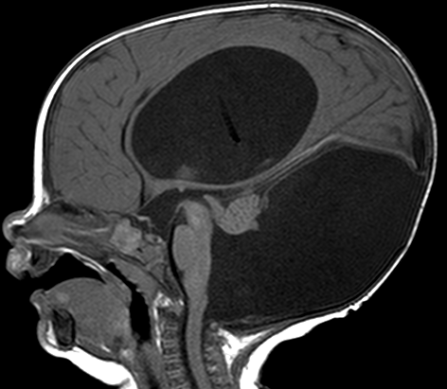
5 m

Slide 5
What is the diagnosis?
Dandy-Walker malformation
Blake pouch cyst
Dandy-Walker variant
Retrocerebellar arachnoid cyst
Notes:
A is correct

Slide 6
Dandy-Walker
Malformation
Enlarged Posterior Fossa

Slide 7
Dandy-Walker
Malformation
Elevated Torcula

Slide 8
Dandy-Walker
Malformation
Hydrocephalus

Slide 9
Dandy-Walker
Malformation
Absent Inferior
Cerebellar Vermis
Notes:
Elevation of the superior vermis

Slide 10
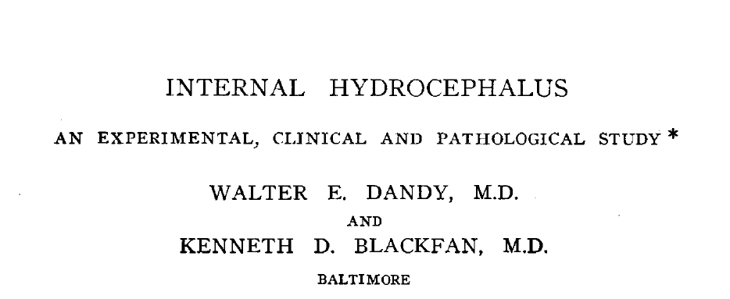
Dandy & Blackfan Am J Dis Child 1914

Slide 11
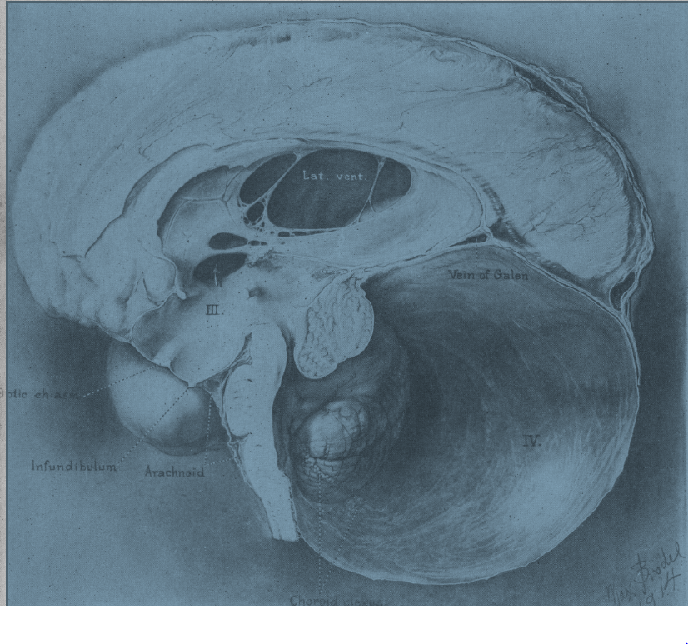
Dandy & Blackfan Am J Dis Child 1914

Slide 12
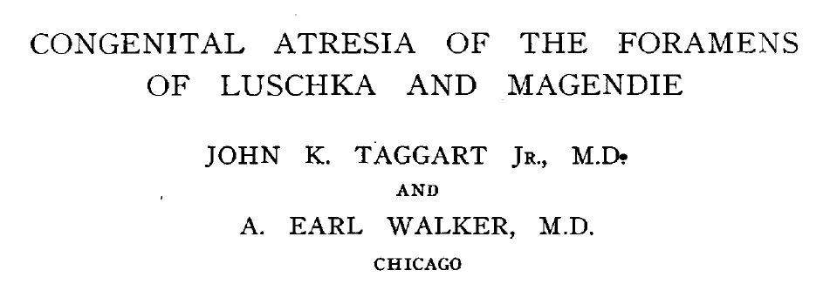
Arch Neurol Psycyhiatry 1942

Slide 13
Sahs Arch Path 1941
Taggart & Walker Arch Neurol Psycyhiatry 1942

Slide 14
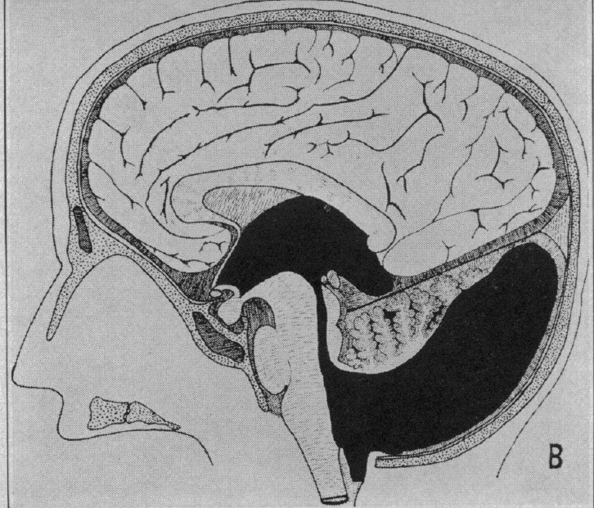
Taggart & Walker Arch Neurol Psycyhiatry 1942

Slide 15
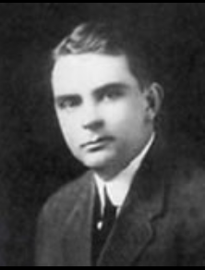
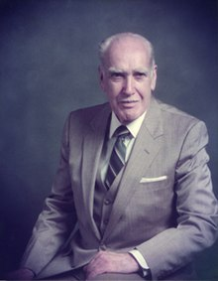
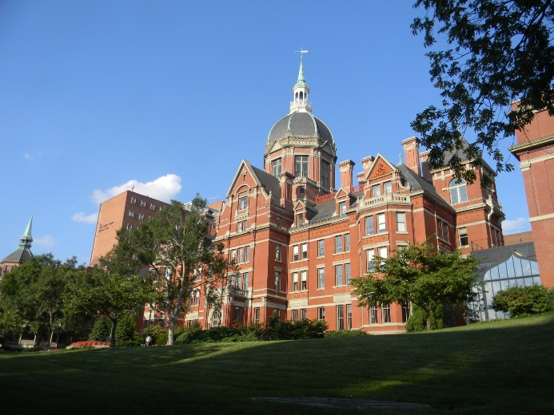
W. Dandy (1886-1946)
A. E. Walker (1907-1995)

Slide 16
Barkovich et al. AJNR 1989

Slide 17
Barkovich et al. AJNR 1989

Slide 18
Dandy-Walker Variant
Dandy-Walker Continuum
Dandy-Walker Complex
Dandy-Walker Spectrum

Slide 19
Dandy-Walker
Malformation

Slide 20
Whitehead et al. AJNR 2022

Slide 21
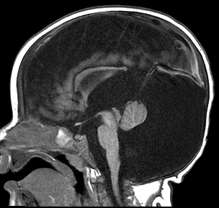
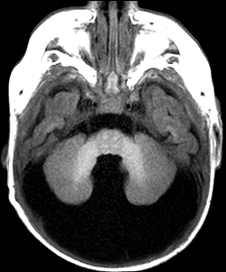
Dysgenesis
6 m
Dandy-Walker Malformation

Slide 22
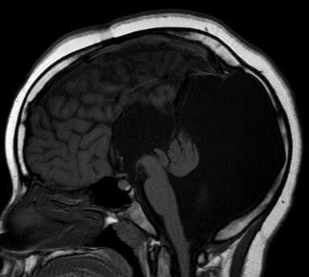
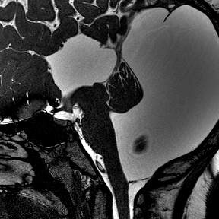
Agenesis
12 y
Dandy-Walker Malformation
Notes:
Additional malformations, including dysgenesis or agenesis of the corpus callosum, occipital encephalocele, polymicrogyria, and heterotopia.

Slide 23
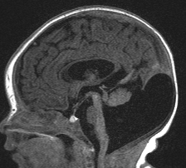
3 d
Dandy-Walker Malformation
Notes:
4708023; DW, 3 day F

Slide 24
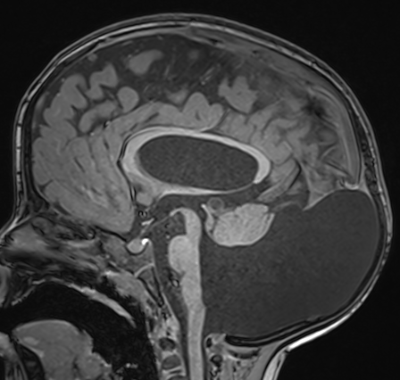
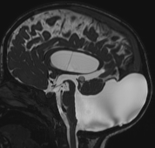
+ 3 y
Dandy-Walker Malformation
Notes:
3 year

Slide 25
Tegmentovermian angle > 40֯
Notes:
71694316, CUH; fetal

Slide 26
Tail sign
Bernardo et al. Prenatal Diagnosis 2015
Notes:
71694316, CUH; fetal

Slide 27
11 d
Dandy-Walker Malformation
Notes:
4994821, 11 day old. m

Slide 28
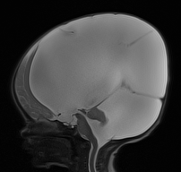
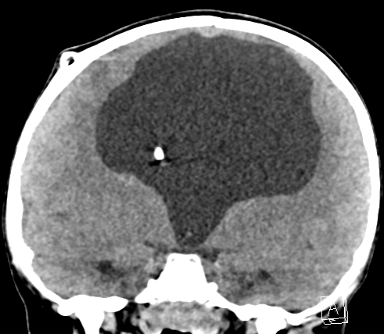
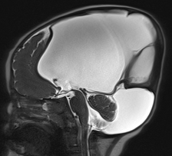
1 d
2 y
Dandy-Walker Malformation
Notes:
4701779, 1 day old versus 2 year old, male

Slide 29
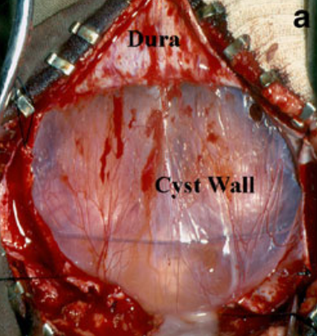
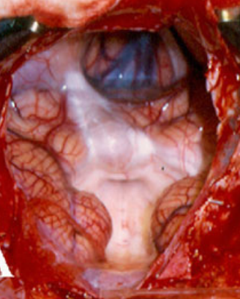
Dura
Cyst wall
CH
CH
Spennato et al. Childs Nerv Syst 2011

Slide 30
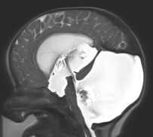
1 d
4 m
Notes:
5265980, 1 day old, female versus 4 month

Slide 31
Notes:
5265980, 1 day old, female versus 4 month

Slide 32
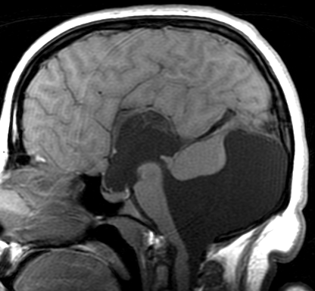
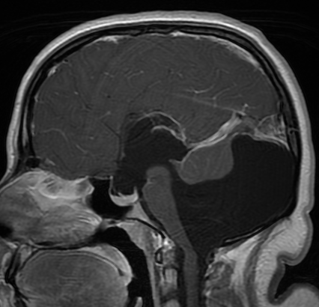
18 y
Dandy-Walker Malformation
Notes:
1407526, 18 y F, 11/13/2020

Slide 33
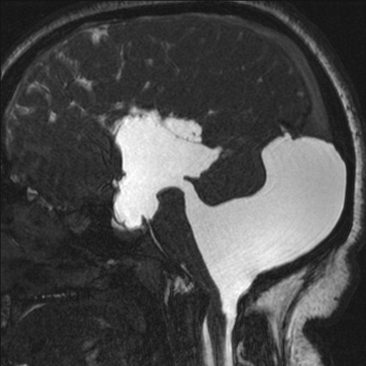
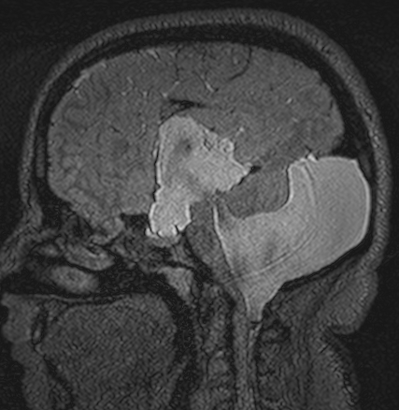
18 y
Dandy-Walker Malformation

Slide 34
Blake Pouch
Cyst
Choroid
Plexus

Slide 35
Blake Pouch Cyst
Notes:
Blake pouch cyst is caused by lack of fenestration of the Blake pouch, resulting in absence of communication between the fourth ventricle and the subarachnoid space

Slide 36
Blake Pouch Cyst

Slide 37
s/p Endoscopic
ventriculostomy
T2 SPACE

Slide 38
Hypoplastic
Inferior Vermis
Notes:
More than 75% of patients with isolated inferior vermian hypoplasia have a favorable outcome

Slide 39
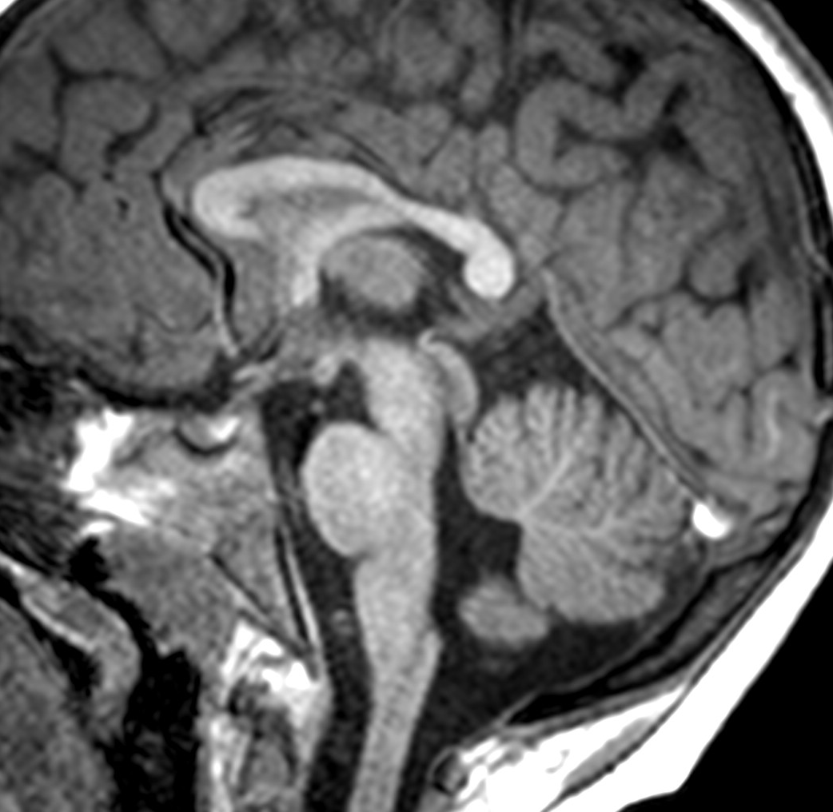
Hypoplastic
Inferior Vermis

Slide 40
Fastigial
Point
Primary
Fissure
Notes:
3891309, 10 y M

Slide 41
1
2
Notes:
3891309, 10 y M

Slide 42
Retrocerebellar
Arachnoid Cyst

Slide 43
Retrocerebellar Arachnoid Cyst
scalloping

Slide 44
Retrocerebellar
Arachnoid Cyst
Normal
T2 SPACE

Slide 45
Mega Cisterna Magna
32 w
>10 mm
Notes:
Mega cisterna magna is an enlarged cisterna magna (10 mm on midsagittal images) with an intact vermis, a normal fourth ventricle, and, in some patients, an enlarged posterior fossa

Slide 46
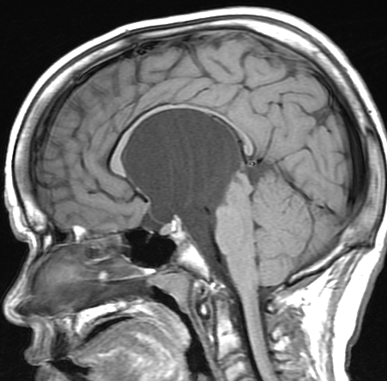
Suprasellar
10 y

Slide 47
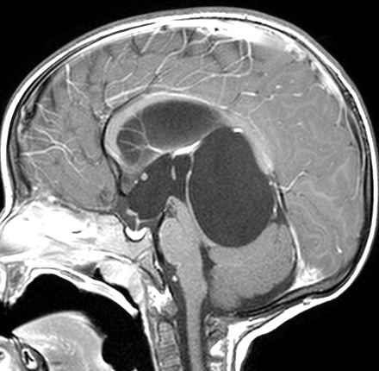
Superior vermian cistern
2 y

Slide 48
Cerebellopontine Angle
3 y

Slide 49
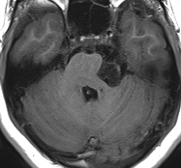
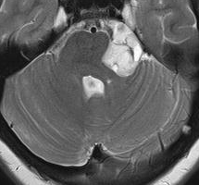
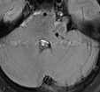
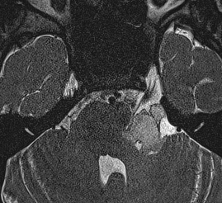
T1
T2
FLAIR
Epidermoid
11 y
BFFE
DWI
ADC

Slide 50
3 y

Slide 51
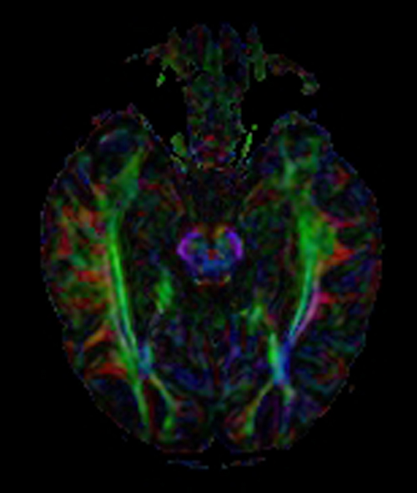
Joubert
Syndrome
Normal

Slide 55
Ventral pontine fibers
Corticospinal tract
Dorsal pontine fibers

Slide 60
Decussation of Superior
Cerebellar Peduncles

Slide 61
Decussation of Superior
Cerebellar Peduncles

Slide 62
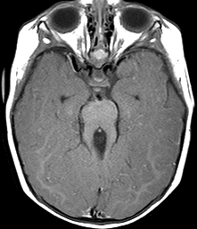
Joubert Syndrome
6 m
Molar tooth
Notes:
Joubert syndrome is characterized by hypotonia, ataxia, ocular motor apraxia, neonatal breathing dysregulation, and intellectual disability of varying severity. The molar tooth sign is the diagnostic criterion for Joubert syndrome and consists of elongated, thickened, and horizontally oriented superior cerebellar peduncles; a deep interpeduncular fossa; and vermian hypoplasia.

Slide 63
Joubert Syndrome
29 w

Slide 64
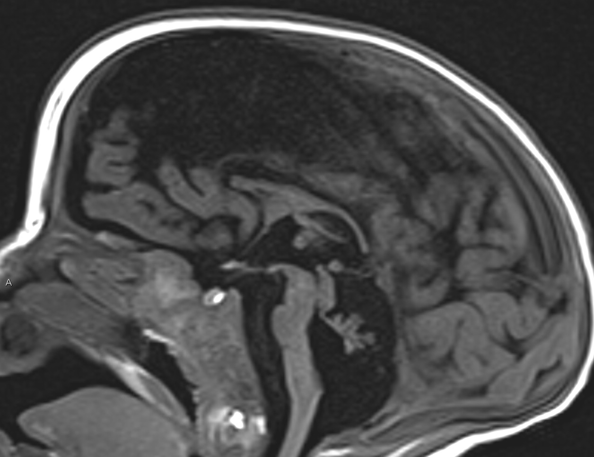
Pontocerebellar Hypoplasia

Slide 65
Dandy-Walker Variant
Dandy-Walker Continuum
Dandy-Walker Complex
Dandy-Walker Spectrum

