Slide 1
Thyroid Incidentalomas in Cervical Spine MRI: Are We Doing Enough For Our Patients?
Obada Abusheikha
Supervised by: Dr.Nosaiba Ryalat

Slide 2
Introduction
An incidentaloma is an incidentally found nodule
Thyroid incidentalomas may be malignant or benign
Prevalence of thyroid incidentalomas globally ranges from 67% on US to 16% on MRI and CT.
Notes:
2. Check numbers from manuscript
4. Get source
5. Check manuscript

Slide 3
Introduction
A common presentation of thyroid CA is being found incidentally on imaging related to the neck.
Prevalence of thyroid CA has tripled between 1975 and 2009.
Risk of malignancy in incidentalomas was found to be between 5-13%
Notes:
2. Check numbers from manuscript
4. Get source
5. Check manuscript

Slide 4
Introduction
Jordan lacks any valid data about incidentalomas and their malignancy risk
This research will establish baseline values in Jordan which could be extrapolated to
the Middle Eastern region as they share some cultural and genetic makeup.
Notes:
2. Check numbers from manuscript
4. Get source
5. Check manuscript

Slide 5
Aims
Investigations
US/FNA
Management and diagnosis
Prevalence
1
2
3
4
5
6
Follow up
Bethesda score
Thyroid state

Slide 6
Methods
This study was a retrospective cohort study at Jordan University Hospital
Cervical MRIs from January 2018 till December 2022
Exclusion criteria:
above 18 years old
No history of neck trauma
No history of thyroid disease or surgery
MRI reports checked for incidentalomas.

Slide 7
Results
190 images included from Jan 2018 to Dec 2021.
Ages: 18 - 83 years (mean 52 years, SD 12.8),
38 males(20.0%) and 152 females(80.0%).
A total of 128 images(67.4%) showed thyroid nodules, while 62 (32.6%) didn’t.
ONLY 33 WERE FOLLOWED UP.
Notes:
2. Check numbers from manuscript
4. Get source
5. Check manuscript

Slide 8
Results
Notes:
2. Check numbers from manuscript
4. Get source
5. Check manuscript

Slide 9
Results
In total 18 FNAs were performed, 5 of which were to patients who didn’t undergo ultrasound and 13 did.
The findings of the FNA were staged per the Bethesda Classification and are distributed as follows:
Notes:
2. Check numbers from manuscript
4. Get source
5. Check manuscript

Slide 10
FNA Results | Number |  | Management | Definitive Diagnosis
Bethesda I—nondiagnostic or unsatisfactory | 3 | 1 | Complete Thyroidectomy | Papillary CA
 |  | 1 | Observation | Benign Nodule
 |  | 1 | Observation | Unsatisfactory
Bethesda II—benign | 7 |  | Observation | Benign Nodule
Bethesda III—atypia of undetermined significance or follicular lesion of undetermined significance | 2 |  | Complete Thyroidectomy | Papillary CA
Bethesda IV—follicular neoplasm or suspicious for follicular neoplasm | 3 | 1 | Complete Thyroidectomy | Benign Follicular Adenoma
 |  | 1 | Complete Thyroidectomy | Adematous Nodule
 |  | 1 | Observation | Suspicious
Bethesda V—suspicious for malignancy | 3 | 1 | Complete Thyroidectomy | Papillary CA
 |  | 1 | Hemithyroidectomy | Suspicious
 |  | 1 | Observation | Suspicious
Bethesda VI—malignant | 0 |  | - | -
FNA Results | N |  | Management | Definitive diagnosis
Bethesda I—nondiagnostic or unsatisfactory | 3(16.67%) | 1 | Complete Thyroidectomy | Papillary CA
 |  | 1 | Observation | Benign Nodule
 |  | 1 | Observation | Unsatisfactory
Bethesda II—benign | 7(38.89%) |  | Observation | Benign Nodule
Bethesda III—atypia of undetermined significance or follicular lesion of undetermined significance | 2(11.11%) |  | Complete Thyroidectomy | Papillary CA
Bethesda IV—follicular neoplasm or suspicious for follicular neoplasm | 3(16.67%) | 1 | Complete Thyroidectomy | Benign Follicular Adenoma
 |  | 1 | Complete Thyroidectomy | Adenomatous Nodule
 |  | 1 | Observation | Suspicious
Bethesda V—suspicious for malignancy | 3(16.67%) | 1 | Complete Thyroidectomy | Papillary CA
 |  | 1 | Hemithyroidectomy | Suspicious
 |  | 1 | Observation | Suspicious
Bethesda VI—malignant | 0 |  | - | -
Notes:
2. Check numbers from manuscript
4. Get source
5. Check manuscript

Slide 11
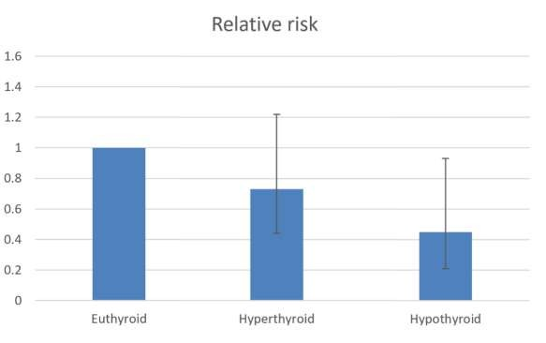
Thyroid State
Thyroid state | Incidentaloma | No Incidentaloma | Total | Risk of Incidentaloma
Euthyroid (reference group) | 113 | 40 | 153 | 0.74
Hyperthyroid | 7 | 6 | 13 | 0.54
Hypothyroid | 5 | 10 | 15 | 0.33
Total | 125 | 56 | 181 | 0.69
Notes:
2. Check numbers from manuscript
4. Get source
5. Check manuscript

Slide 12
Discussion
Female predominance(80.2%) is consistence with several studies.
Higher number of thyroid nodules in MRI reports incidentally, 67.4% vs. 16%.
95 patients were not followed up.
Malignancy rate in our study is higher than the literature.
No consensus in investigations done and management.
Only study in the Middle East to provide a full picture from imaging to definitive diagnosis.
Only study to take Thyroid state into consideration.
Notes:
2. Check numbers from manuscript
4. Get source
Slide 7: 6. check for UAE study
5. Check manuscript

Slide 13
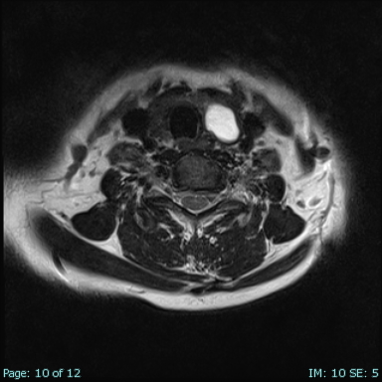
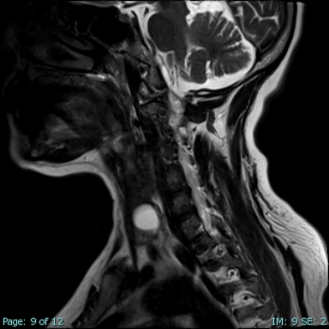
1a
1b
Patient 1: this image shows a patient with a cystic nodule.
Notes:
2. Check numbers from manuscript
4. Get source
5. Check manuscript

Slide 14
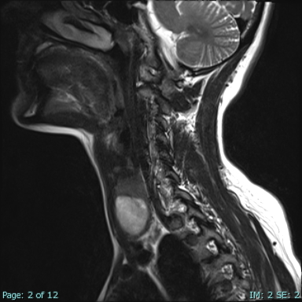
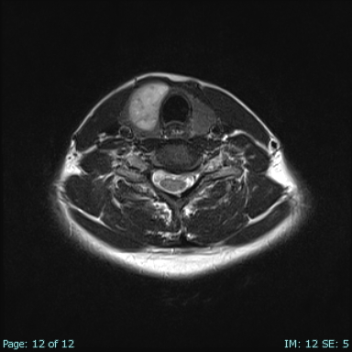
Patient 3: The patient underwent right extended hemithyroidectomy after getting an FNA result with atypia of undetermined significance. The final diagnosis after surgery was Non-invasive follicular neoplasm with papillary like nuclear features.
3a
3b
Notes:
2. Check numbers from manuscript
4. Get source
5. Check manuscript

Slide 15
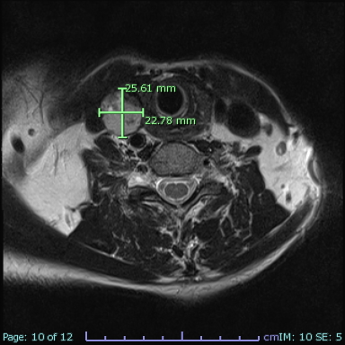
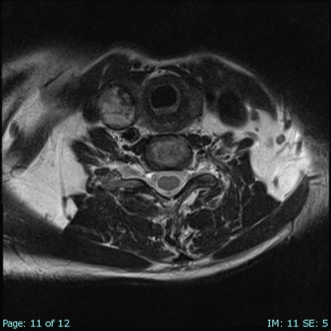
Pateint 4 underwent FNA that came back with Atypia of undetermined significance. Total thyroidectomy was performed and the patient was diagnosed with classic papillary carcinoma.
4b
4a
Notes:
2. Check numbers from manuscript
4. Get source
5. Check manuscript

Slide 16
Conclusion
On cross-sectional neck images of patients being checked for unrelated conditions, incidental thyroid lesions are frequently found.
It is critical that we increase our familiarity and awareness with identifying and notifying accidental thyroid lesions; radiologists, internists, and surgeons must question a well-established strategy for diagnosis, referral, and then proper management.
Our findings support the idea that any incidental thyroid lesion found on MRI deserves further clinical or imaging testing to rule out the possibility of cancer.
Notes:
2. Check numbers from manuscript
4. Get source
5. Check manuscript

Slide 17
Limitations and Recommendations
Limitation:
Relatively limited sample size
Reduced number of follow up (missed cases)
Recommendation
Guidelines to report thyroid incidantelomas in every cervical spine MRI report.
An imaging screening program for thyroid CA is suggested.
Further larger scale research in our region regarding incidentalomas and their relation with Thyroid state.
Notes:
2. Check numbers from manuscript
4. Get source
5. Check manuscript

