Slide 1
Future AI Opportunities in Pediatric Imaging: Data Driven Approach
Presented by: Eman Nabrawi

Slide 2
Outlines
Introduction
A glance at past (radiologist workstation)
Imaging informatics data formats
Imaging informatics standard and interoperability
Future AI Pediatric imaging applications (patient imaging journey)
AI Pediatric imaging predictive modeling
AI Pediatric Challenges
Conclusion
References
Discussion

Slide 3
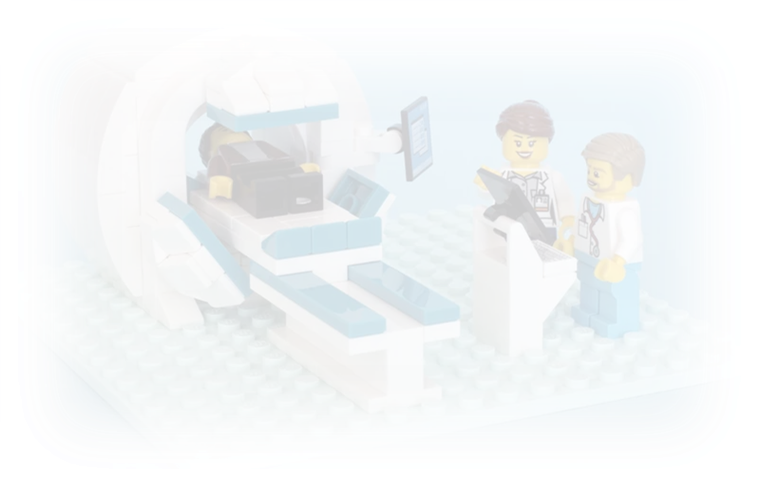
Introduction
Artificial intelligence (AI) is a global trend, it is mainly used as a method to reduce cost, time and enhance efficiencies, it is particularly significant to pediatric imaging due to workforce shortage. Today we will explore its future potentials, applications and challenges.

Slide 4
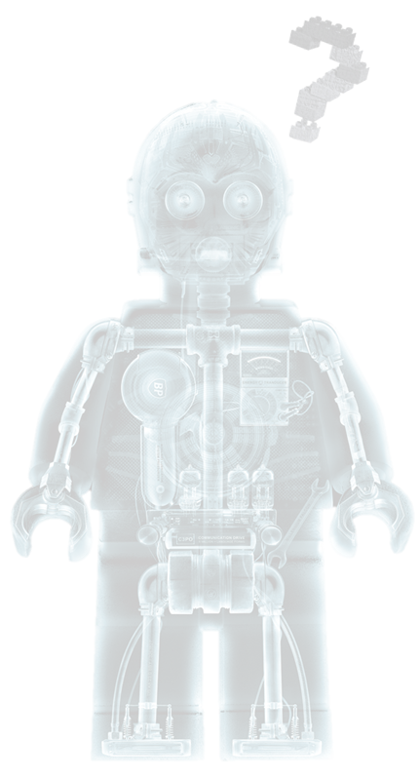
Do you believe that AI can replace Radiologists?

Slide 5
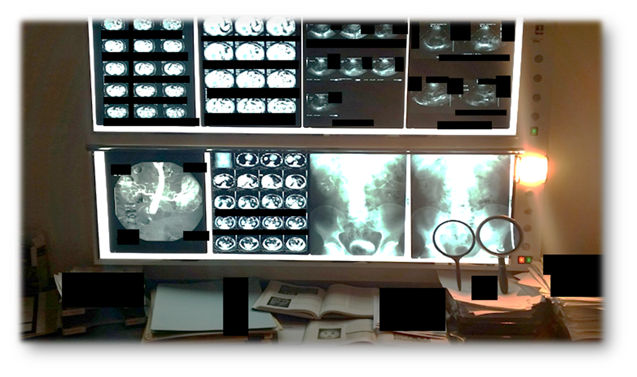
A glance at the past
Notes:
A glance at the past

Slide 6
Data driven approaches
Notes:
How does the data look in imaging systems

Slide 7
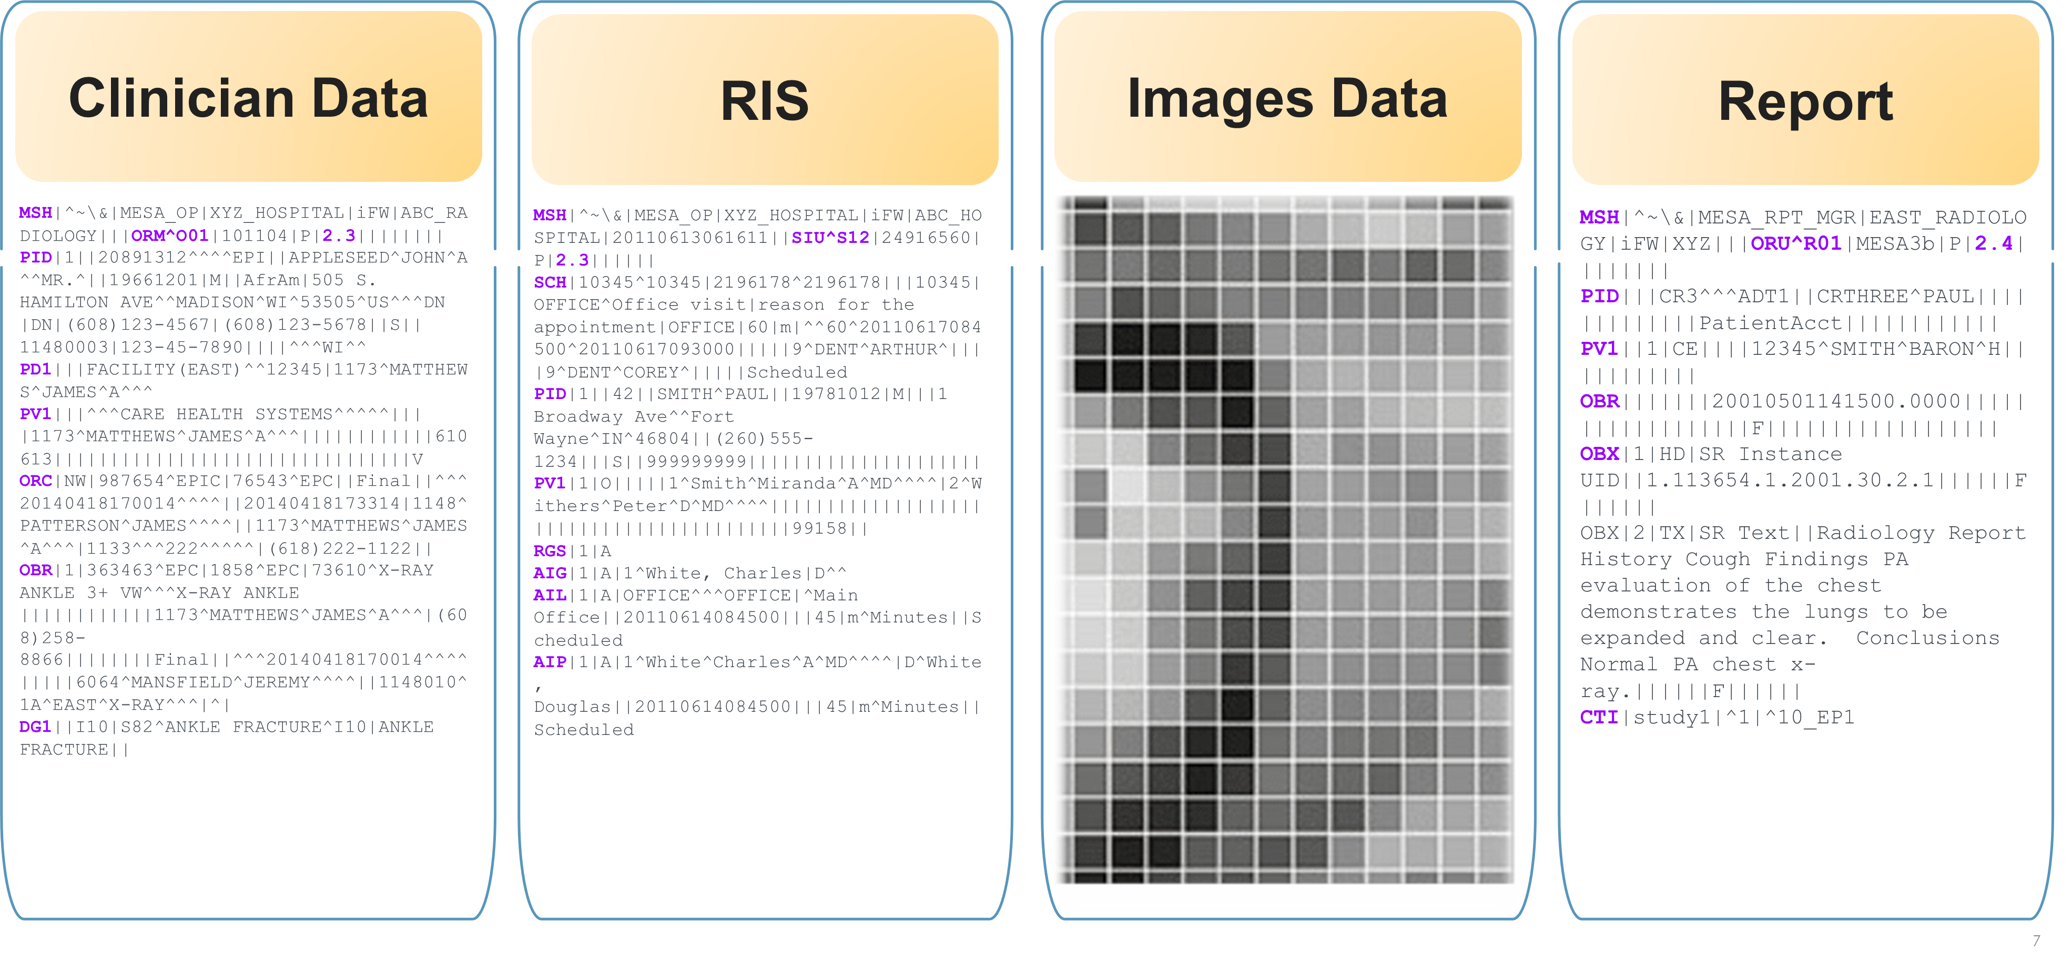
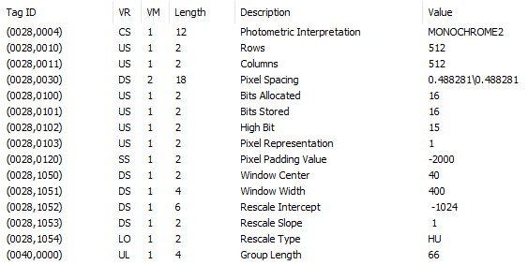
Imaging Data

Slide 8
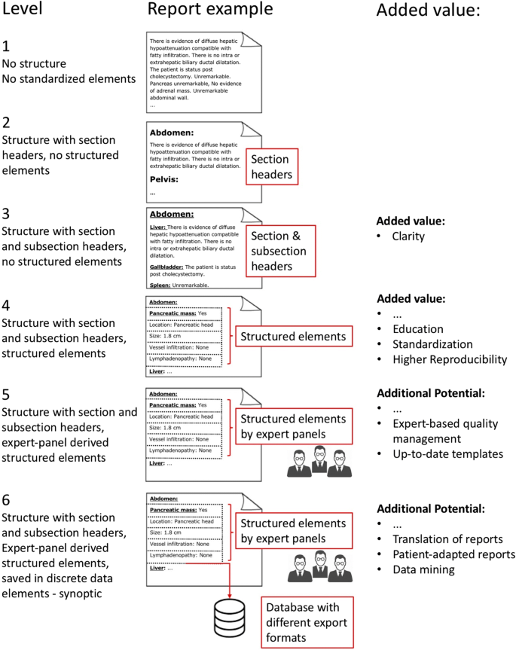
Structured Reporting
Structured reporting creates communications that use a standardized vocabulary and report schemas that are generally template-based

Slide 9
Standards and Interoperability
Notes:
In imaging informatics, the terms "Digital Imaging and Communications in Medicine" (DICOM) and "Integrating the Healthcare Enterprise(IHE) health Level 7 (HL7) standard communicates textual information between medical apps and equipment
IHE promotes the coordinated use of established standards such as DICOM and HL7 to address specific clinical needs in support of optimal patient care

Slide 10
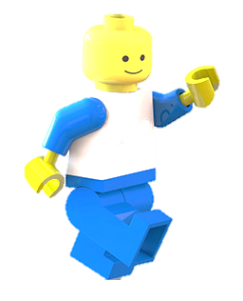
AI Applications that may enhance clinical practice and patient experience
Notes:
Pediatric journey within imaging dept

Slide 11
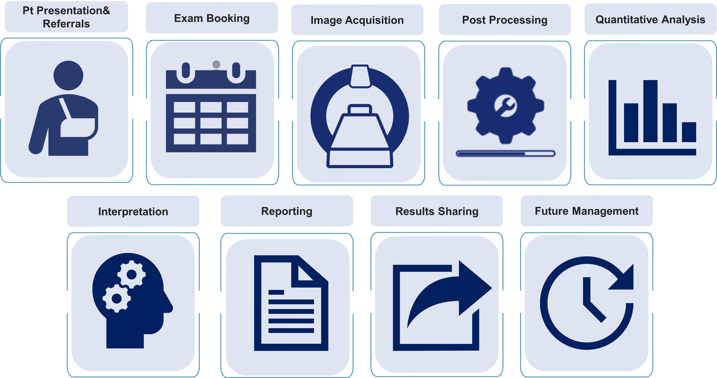
Patient pathway from request report
Notes:
patient pathway from hospital admission to radiology report and follow-up, with summary of how artificial intelligence tools may enhance clinical practice and patient experience.

Slide 12
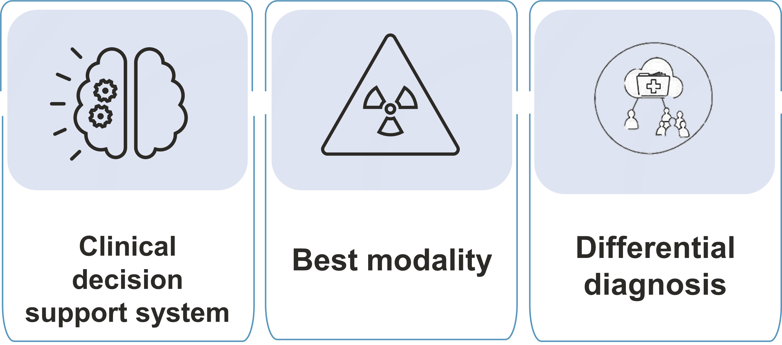
Patient Presentation & Referrals
Notes:
AI-enhanced CDS tool could allow for the rapid synthesis of all patient information held within electronic health records (EHR), matched against national referral guidelines, to provide clinicians the most appropriate next course of action.

Slide 13
Exam Booking
Notes:
AI-supported predictive modelling could help with resource allocation, particularly within NHS trusts which encompass a mixture of tertiary referral and district general hospitals.
Expected numbers of outpatient clinics per day (and subsequent walk-in’ imaging referrals),
SW can use request information along with the DICOM metadata from baseline imaging to suggest which scanners the patient should be booked for.
AI-supported predictive modelling within the EHR can identify habitual missed appointments
An AI-supported notification system via a smartphone application that communicates with parents in real time, could provide them the option of bringing an appointment forward due to last minute cancellations or arriving slightly later if their appointment is delayed
Chatbot's also known as an Artificial Conversational Entity) uses NLP+DL

Slide 14
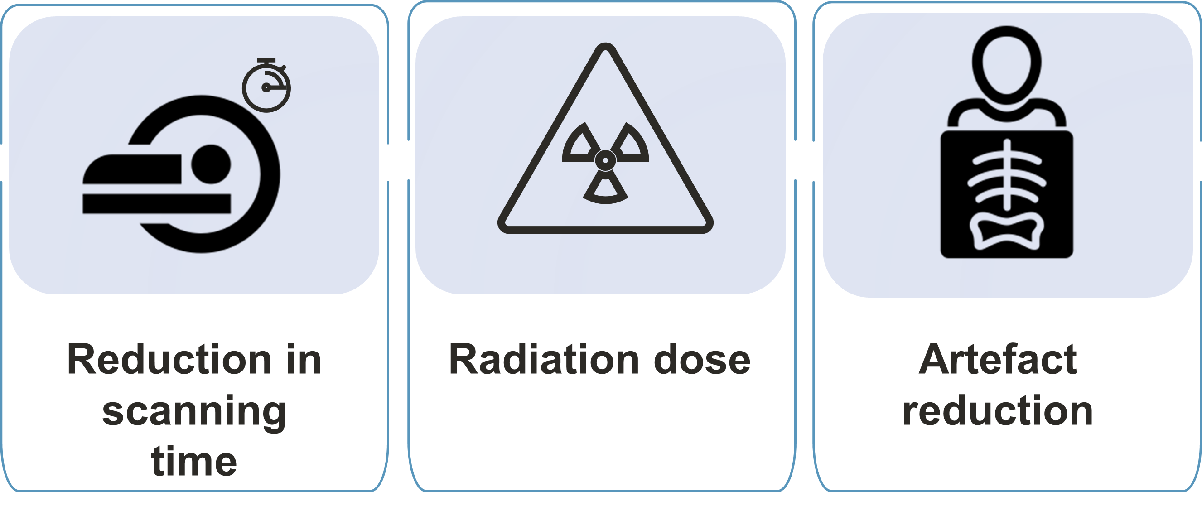
Image Acquisition
Notes:
AI-supported deep-learning tools are now being used to reduce scanning times, and in some cases the need for intravenous contrast.
to learn relationships between zero-filled k-space data and those of fully sampled k-space data for a particular study type; thereby allowing for interpolation of missing data in future unseen studies +using neural networks to remove aliasing from under-sampled real-time MR data to enhance image reconstruction times…. these reconstructions can sometimes introduce blurring or remove findings that would not have been present on the original ‘ground truth’ images, highlighting the importance that such tools to be rigorously tested prior to routine clinical implementation.
AI-based tools for reducing CT radiation dose while maintaining image quality can also be achieved by reconstructing high-quality images from reduced amounts of raw data, AI model different examples of normal and abnormal pathology at low and standard radiation dosages, then assessing the model’s ability to produce extrapolated ‘standard dose’ images when provided with only noisy, low-dose images from ‘unseen’ cases. In paediatric imaging, MacDougall et al 31% reduction in image noise after training a neural network to create iterative reconstructed CT images from the filtered back projection data of low-dose abdominal CTs. Less doses of gadolinium are administered with the help of DL techniques which will generate virtual contract MR images from unenhanced MR sequences with structural index of 0.872 IQ OK, however it was note that the virtual contract map was blurry and less nodular around brain tumors.
Post-processing techniques paediatric spinal cord MRIs was achieved through a multi-stage process of computer-aided detection, segmentation, feature extraction with an accuracy of 84% in separating true cord from artefact

Slide 15
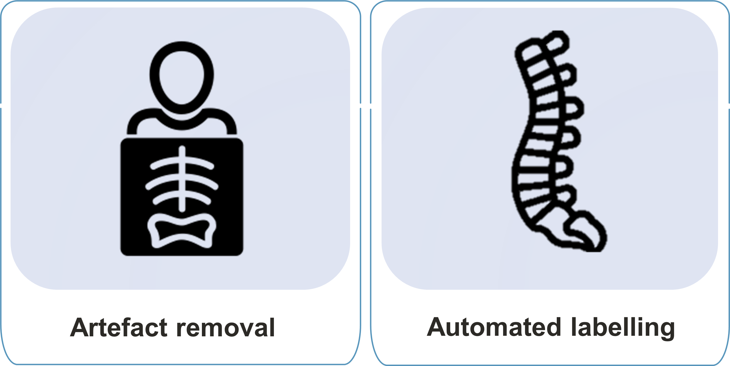
Post Processing
Notes:
Yi P et al have shown that it is possible to successfully use AI to automatically label paediatric musculoskeletal radiographs into their respective body parts

Slide 16
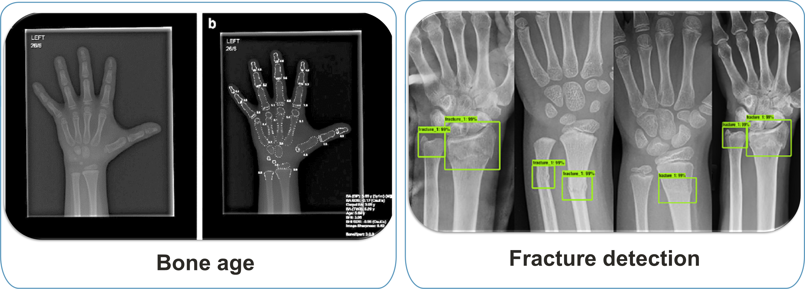
Quantitative Analysis
Notes:
Automated segmentation and subsequent calculation of bone age from hand radiographs, rather than the traditional and time-consuming manual Greulich-Pyle or Tanner-Whitehouse assessments.

Slide 17
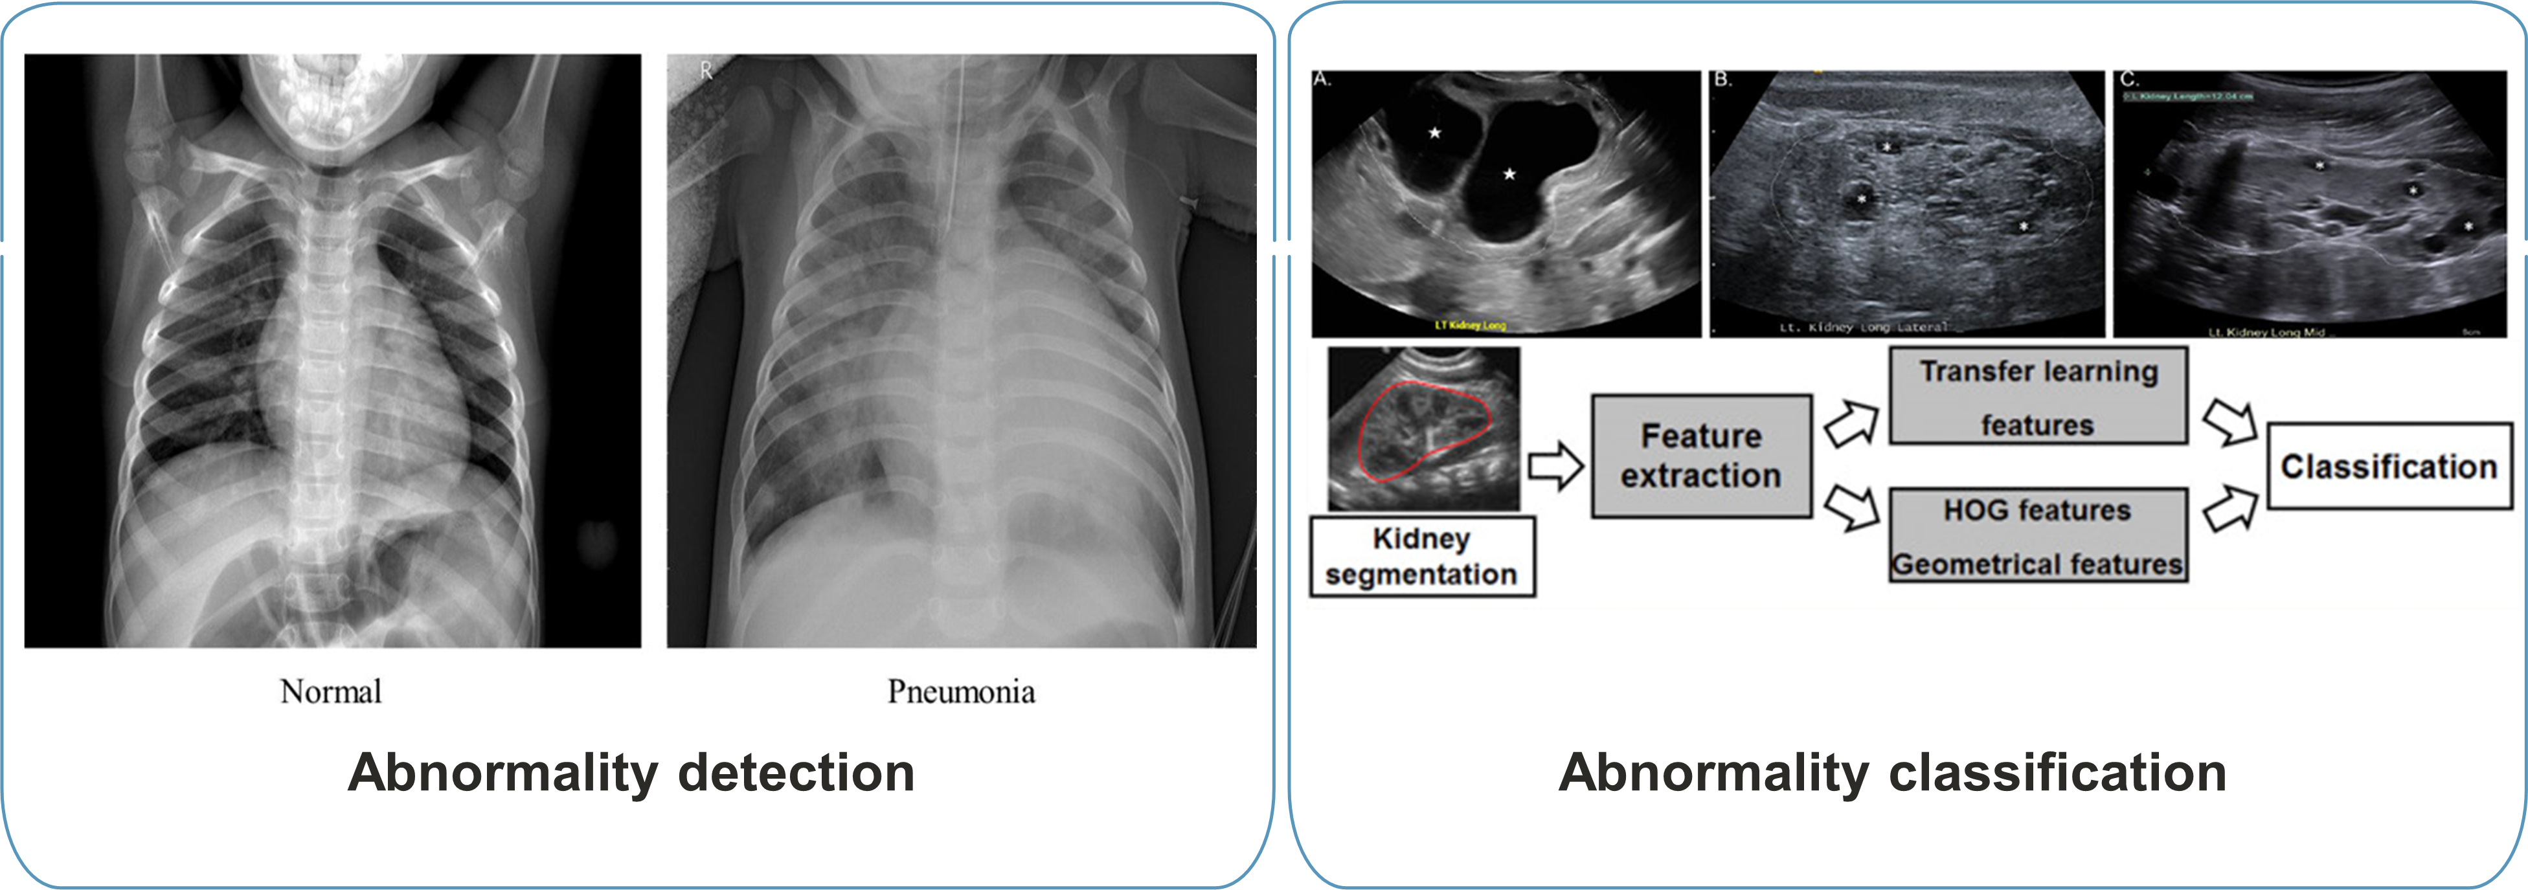
Image Interpretation
Notes:
Detection of a wide spectrum of diseases, including paediatric pneumonia, elbow effusions, developmental dysplasia of the hip, wrist fractures on radiography.
Zheng et al developed a feature extraction algorithm which performed automated classification of congenital abnormalities of the kidney and urinary tract on paediatric ultrasound, with
a sensitivity of over 80%.

Slide 18
Reporting
Notes:
Workflow prioritisation with AI tools to facilitate urgent radiology reporting have been explored in the adult literature, predominantly for urgent findings on chest radiography and CT heads. significant abnormalities are flagged up on the reporting worklist and reported by radiologists first (have not been widely described in children)
Automated identification and labelling of images imported into PACS by modality and body part coverage, ensures appropriate hanging protocol and selection of appropriate working list and exam code.

Slide 19
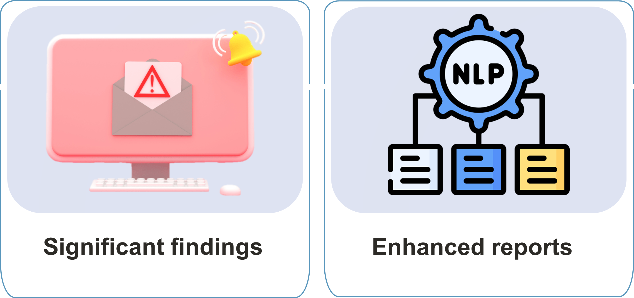
Results Sharing
Notes:
Pediatricians could priorities clinical management and findings above a certain level of urgency could be automatically assigned to the next multidisciplinary team meeting simply by adding the term
(NLP) tool was able to identify the presence of a deep vein thrombosis (DVT) in children from free text ultrasound reports and generate a clinical alert …TO DETECT HA- VTE Venous thromboembolism

Slide 20
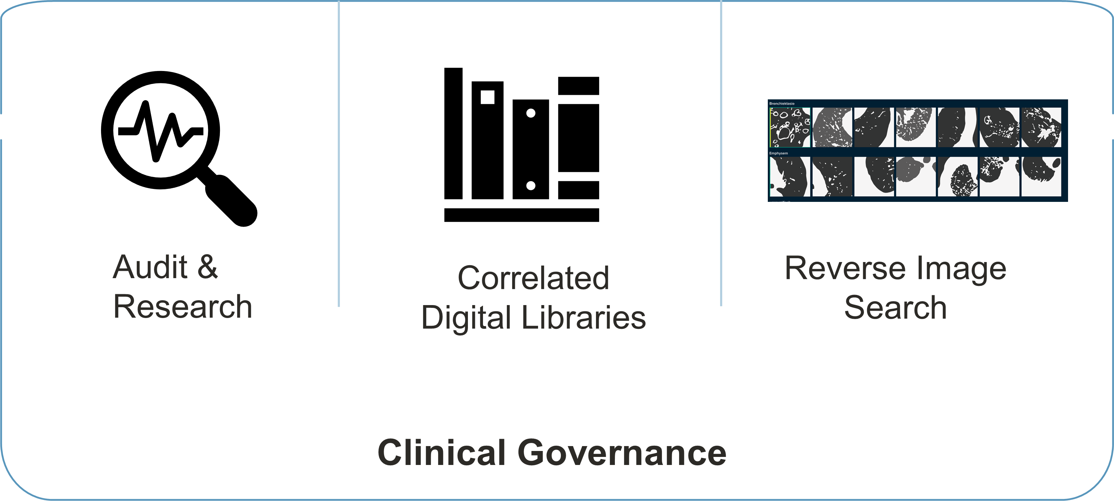
Future Management
Notes:
Using NLP to mine information from the EHR, radiology reports and DICOM metadata could result in faster search and potentially larger datasets for audit and research projects.
Finding interesting cases for a teaching library (potentially with digital pathology correlation, and information of patient outcomes), as well as providing direct feedback for trainees on their reporting skills, The AI algorithm could further help education by displaying the commonest errors made by trainees next to the correct diagnosis, without senior input.
Where a differential diagnosis is uncertain for anunusual imaging pattern be possible to mark the region of interest on the image and run a ‘reverse image search’ through the entire PACS system looking for other studies with confirmed diagnoses in patients with similar imaging patterns (contextflow SEARCH) contextflow SEARCH: 3D image search engine. 2020. Available from: https:// contextflow. com/ solution/ search/ [accessed 08 Oct 2023].

Slide 21
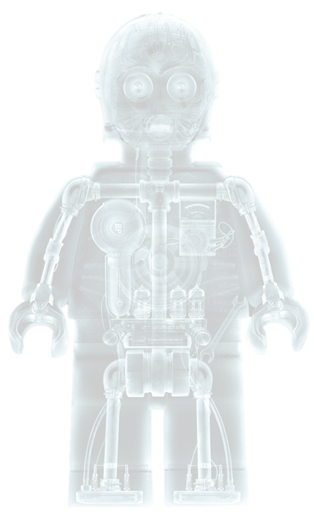
Predictive modelling
Notes:
The AUC ROC curve is basically a way of measuring the performance of an ML model. AUC measures the ability of a binary classifier to distinguish between classes and is used as a summary of the ROC curve

Slide 22
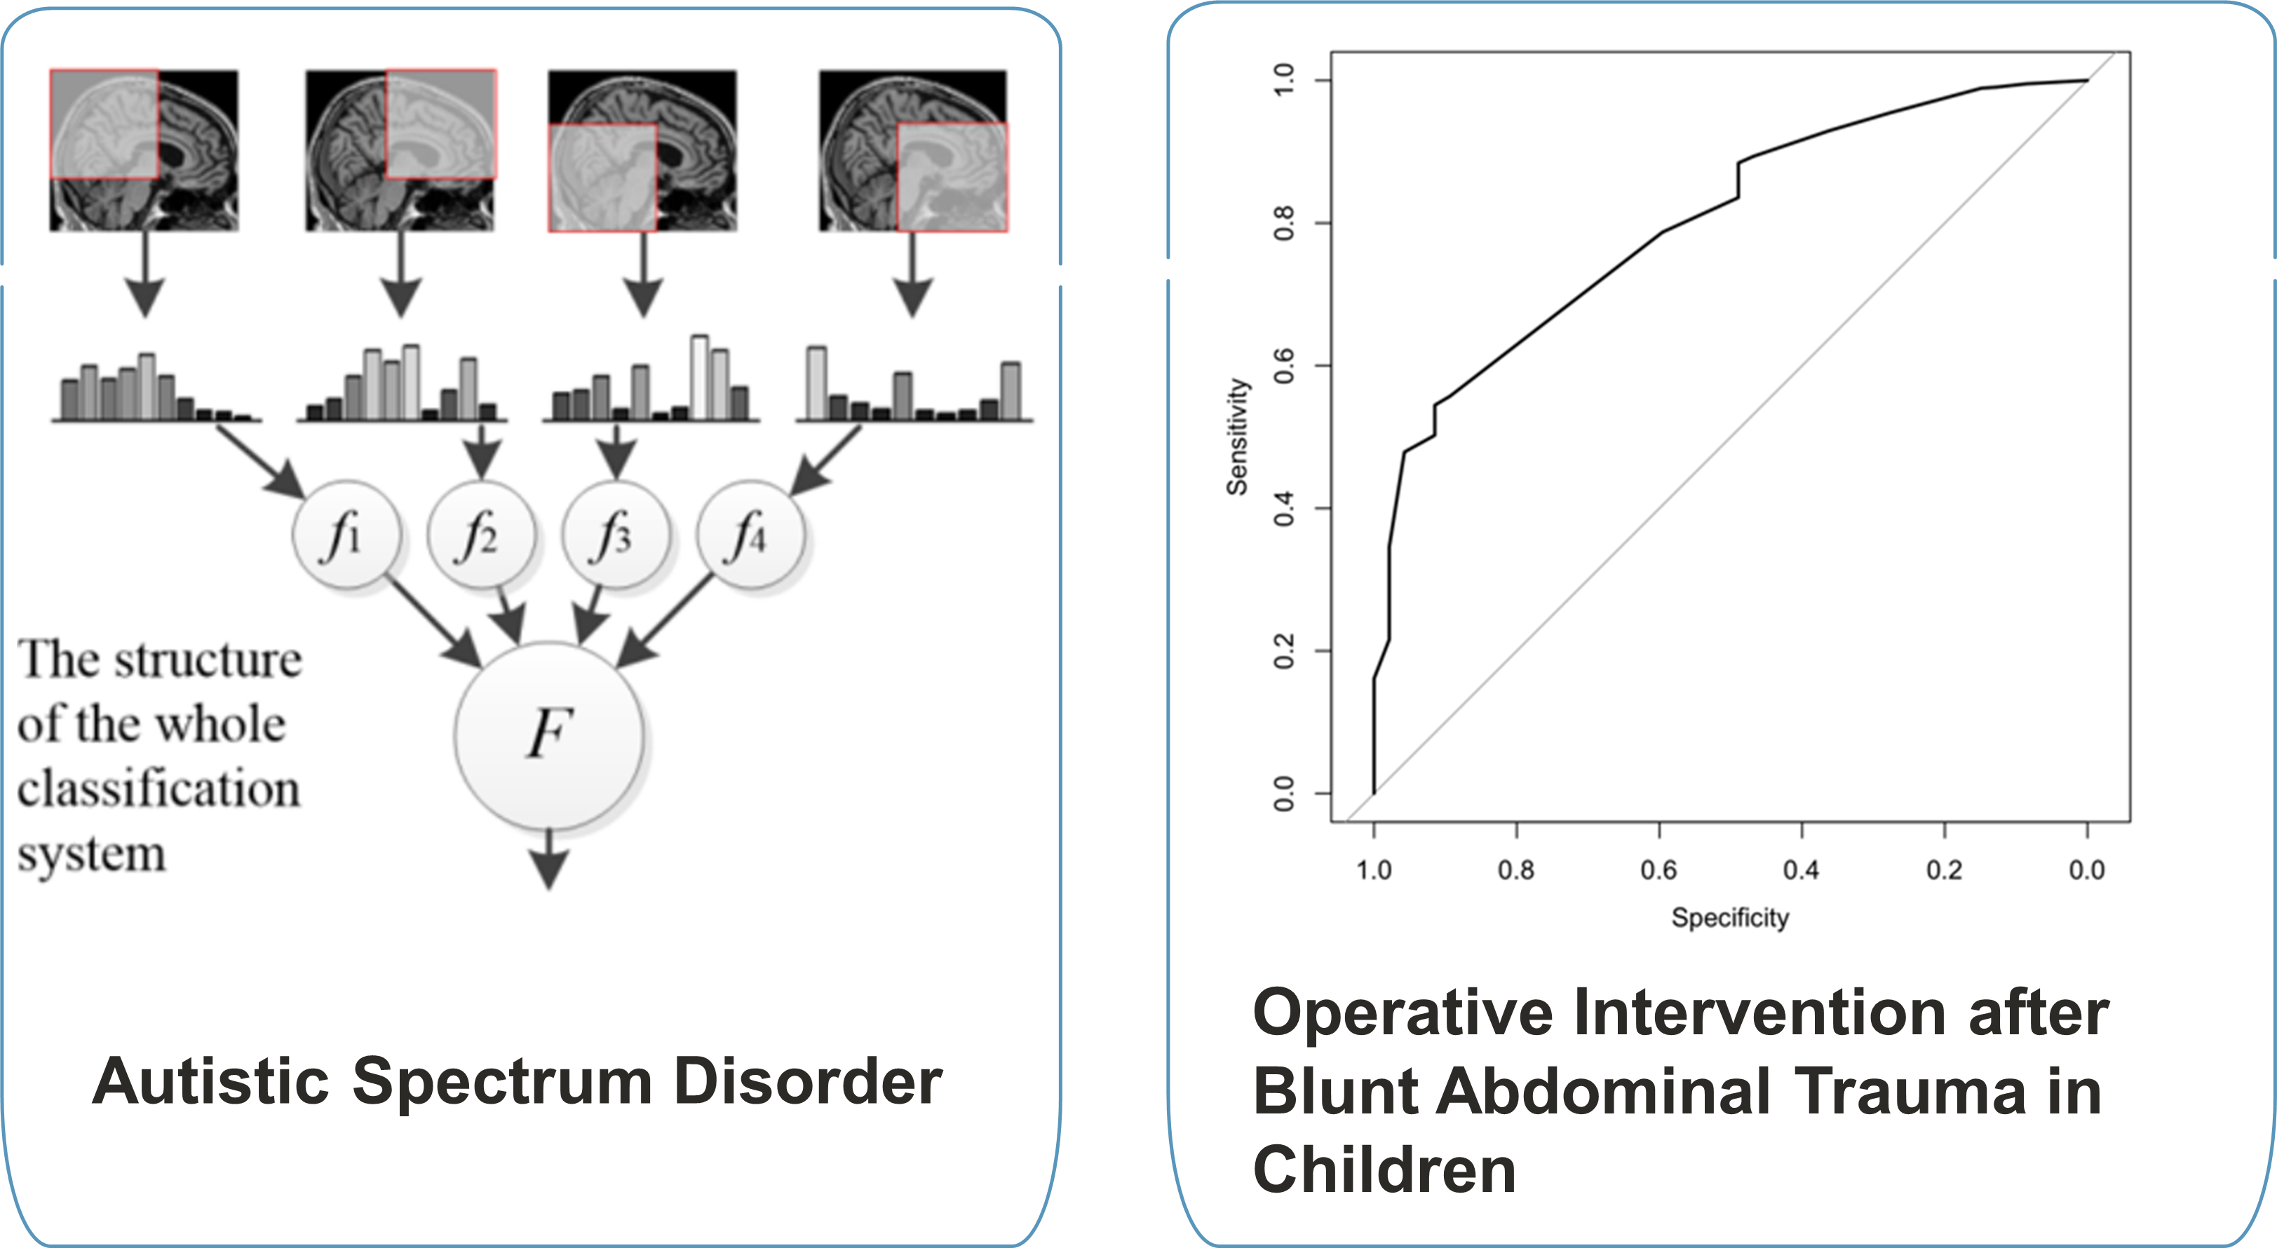
Predictive modelling
Notes:
Weiss et al have created a multicentre clinical and imaging dataset to develop machine-learning frameworks for the detection and outcome prediction in neonatal hypoxic ischaemic encephalopathy.
Chen et al were able to identify neuroimaging biomarkers from brain MRIs in children who could distinguish biomarkers from brain MRIs in children who could distinguish
those with autistic spectrum disorder from healthy controls with (AUC) of >0.75 AI assisted tools such as these could aid early identification of certain diseases, or in patients who may be difficult
to examine or acquire a history from. Histogram based morphometry HBM Classification framework
A clinical and radiologic prediction rule was validated using a large multi-institutional dataset of pediatric BAT patients, demonstrating a high degree of accuracy in identifying children who
underwent surgery. FF presence of free fluid ,SOI presence of solid organ injury ,and TLF thoracolumbar fracture are the most important factors associated with the need for surgical intervention.
Area Under the Curve (AUC) of 0.80

Slide 23
AI Challenges

Slide 24
AI Pediatric Imaging Challenges
Notes:
Many of these are generic and affect all aspects of healthcare (i.e., data security, legal, ethical and implementation considerations, standardisation of clinical terminologies)
Should remain cautious of the dangers that expedited implementation of AI tools.
There is a greater heterogeneity in data due to wide variations of normal findings at different stages of childhood development
1st issue: improper external validation of algorithms in children, and ignorance amongst healthcare professionals regarding the intended usage of the AI tool two different automated software
for vertebral fracture detection designed for adults were applied to paediatric spine radiographs. The overall sensitivity and specificity dropped significantly to between 26–36% and 95–98%, low sensitivity means a high false-negative rate, useless as a screening tool. Individual hospitals may need mechanisms in place to audit errors and potential improvements for AI solutions according to their local range of cases and local demographics.
2^{nd issue :} found that the public were overwhelmingly positive on the transformative impact of AI in radiology, there was still an underlying mistrust for autonomous computer systems. Interestingly, parental and children’s views have yet to be specifically addressed and may be at odds with what the general adult public perceive as acceptable for themselves. Acceptability likely to be linked with more ‘explainable’ AI tools

Slide 25
AI Challenges
Notes:
opportunity for early adopters to better determine how AI solutions could enhance the workflow of paediatric radiology–potentially providing a more individualised patient and referrer-centred approach.

Slide 26
Conclusion
AI as any new tool has its opportunities and pitfalls, without eager healthcare professionals it will never thrive, we have the power to enable it by labelling and structuring data, we standardize our practice and we implement, test and validate models, therefore :
NO Imaging AI can operate without radiologist supervision and approval
Notes:
Paediatric radiologists are well placed and should maintain a central role in determining how these AI tools are evaluated, implemented and embedded to provide better and safer clinical healthcare.
If there is an AI in imaging it will be AI RUN BY RADIOLOGITS

Slide 27
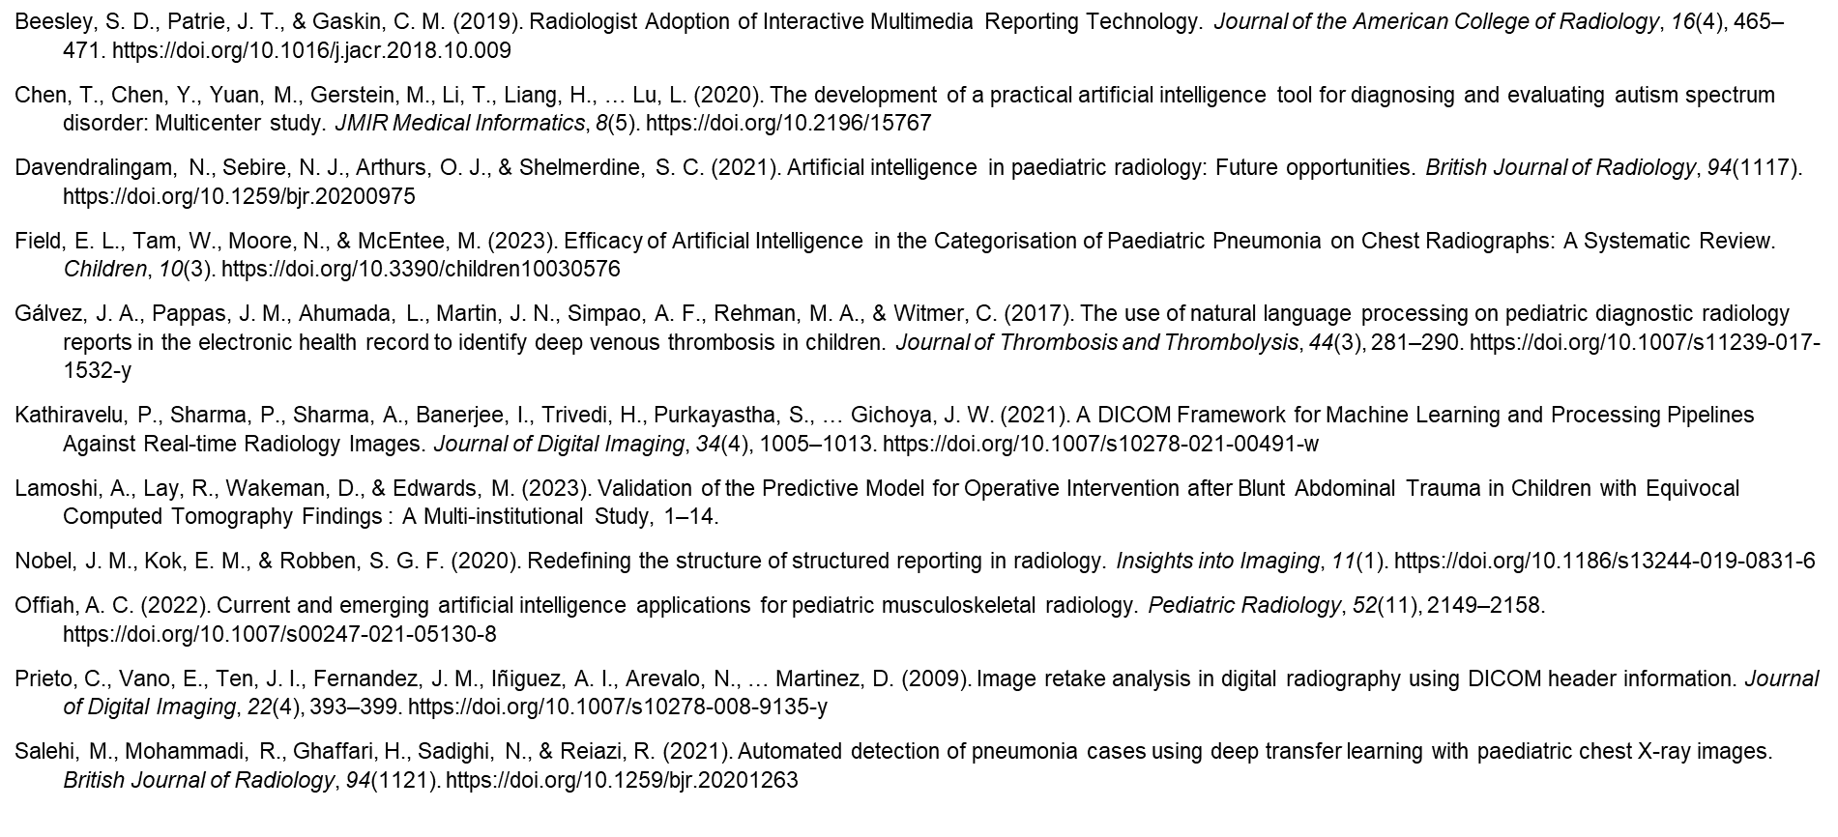
References

Slide 28
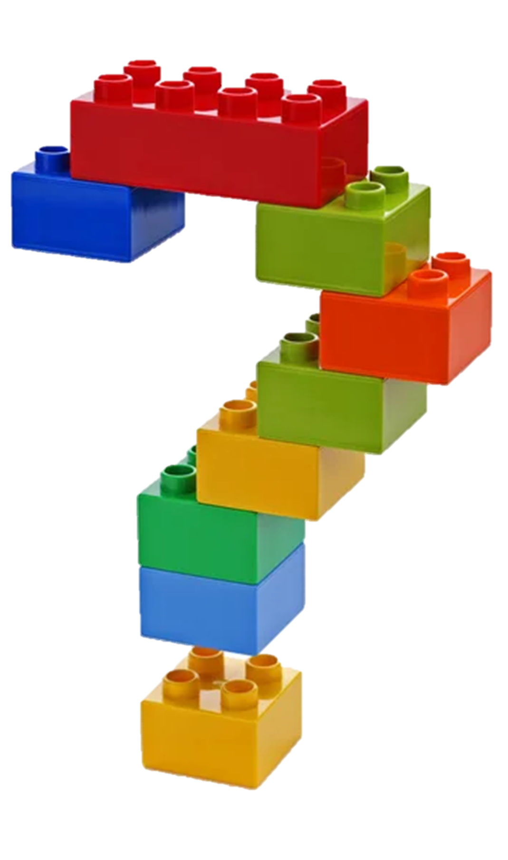
Discussion
Eman Nabrawi
Health Informatics | Strategy | Leadership | Digital Transformation | System Adoption | Analytics | Research

